Slide 1
The 2023 Curriculum Frameworks for Comprehensive Health and Physical Education Frameworks
Sarah Benes
Holly Alperin
Anne DeMallie
Kristen McKinnon

Slide 2
Today’s Session
Purposes
Agenda
Give you a sense of the revisions’ scope and public sentiment toward them
Hear your recommendations for supporting implementation
Provide guidance on Opt Out state law
Future opportunities
Presentation (30m)
Small-group discussions (20m)
Whole-group debrief (10m)
Opt out guidance (10 min)
Questions/closing (5 min)

Slide 3
The 2018–2023 Review and Revision Process
Scope of the Work and Public Response

Slide 4
Approach to Revisions
Goals
Touchstones
Build upon the foundation of the first Comprehensive Health Framework
Add detail and attention to critical skills of physical and health education
Link student well-being, school performance, and community & family involvement
Shifts to practices
Currency and relevancy
Enhance physical education
Add social and emotional learning
Focus on equity

Slide 5
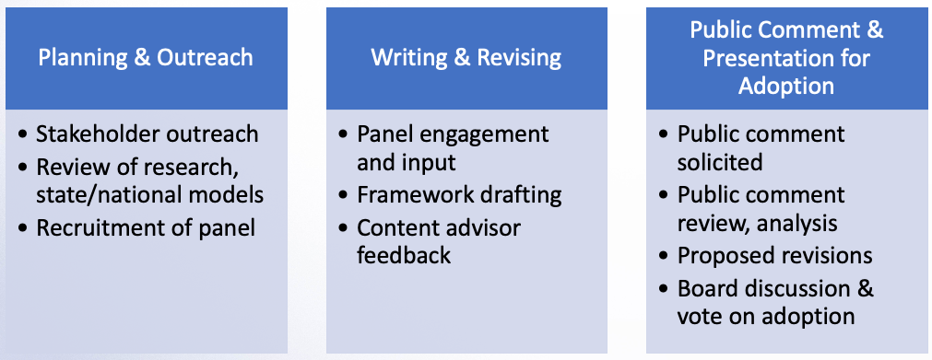
Review & Revision Process

Slide 6
Shifts in Revised Frameworks
Stronger emphasis on practices
Explicit representation and integration of physical education (PE)
Articulation of social and emotional competencies that can apply across school curriculum & content areas
Updates to reflect current & ever-changing influences on health (including technology, media & social media)
Increased focus & emphasis on equity
Updated guiding principles to encourage a Whole School, Whole Community, Whole Child approach

Slide 7
Practices
Practice 1: Decision-making and Problem-solving. Make health-promoting, informed, responsible decisions and solve problems in a variety of health-related situations.
Practice 2: Self-management and Goal Setting. Set goals, engage in health-promoting behaviors, and avoid risky behaviors.
Practice 3: Social Awareness, Relationship, and Communication Skills. Enhance relationships, personal health, and the health of others through social awareness and effective communication.
Practice 4: Movement Skills. Demonstrate competence in, and knowledge of, a variety of movement concepts, principles, motor skills, and physical fitness components in order to engage in purposeful and health-promoting physical activity, including sports and games.

Slide 8
Practices
Practice 5: Self-awareness and Analyzing Influences. Examine how emotions, thoughts, needs, values, beliefs, and other factors (both internal and external) influence behaviors and articulate how these influences impact health behavior and outcomes.
Practice 6: Information and Resource Seeking. Access, evaluate, and use valid and reliable health information, products, services, and related resources.
Practice 7: Self-Advocacy and Health Promotion. Promote personal, family, and community health and well-being.

Slide 9
Topics
Healthy Relationships [HR]
Mental and Emotional Health [MH]
Nutrition and Balanced Eating [NE]
Personal Safety [PS]
Physical Activity and Fitness [PF]
Physical Health and Hygiene [PH]
Public, Community, and Environmental Health [CE]
Sexual Health [SH]
Substance Use and Misuse [SU]

Slide 10
Sample Public Comment Responses
 | Agree | Disagree
Overall, the Vision section of the draft framework provides a clear and compelling description of comprehensive health and physical education as central to a well-rounded education. | 57% | 43%
Overall, the Guiding Principles identify important characteristics of a high-quality comprehensive health and physical education program. | 55% | 45%
Overall, the Practices for Comprehensive Health and Physical Education identify the most important processes and skills that students need to promote and maintain lifelong physical and mental health. | 54% | 46%

Slide 11
Sample ESE Responses to Public Comment
Comment Summary/Examples | Action/Response
Feedback included concerns about the lack of clearly designated PE standards and suggestions to adopt the SHAPE America National Physical Education standards (which are under revision). | Created a crosswalk showing alignment with 2013 & proposed 2024 SHAPE America National PE Standards Elicited additional feedback from national experts Added coding to standards to identify PE standards Plan to include PE specific implementation resources

Slide 12
Sample ESE Responses to Public Comment
Comment Summary/Examples | Action/Response
Opposition to the sexual health and sexual orientation standards included concerns about age-appropriateness and implementation, religious objections, and concerns from parents about schools teaching values and beliefs, in general and with respect to this specific topic. | Standards related to sexual health are research based and reflect best practice Adjusted coding to show that the goal is attainment by the end of the grade span Gender identity standards were moved from the “Sexual Health” topic Implementation will include information on the Opt Out law and laws related to school responsibility for education free from discrimination

Slide 13
Sample ESE Responses to Public Comment
Comment Summary/Examples | Action/Response
Opposition to the inclusion of gender identity included concerns about age-appropriateness and implementation, questions about terminology, religious objections and concerns from parents about schools teaching values and beliefs, in general and with respect to this specific topic. | Standards related to gender identity are research based and aligned with the National Sex Ed Standards Gender identity is a protected class, DESE is committed to ensuring all students have access to an education free from discrimination Implementation support will include best practices in teaching gender identity and supports for community engagement

Slide 14
Sample ESE Responses to Public Comment
Comment Summary/Examples | Action/Response
Comments highlight the importance of specifically teaching about menstruation, reducing the stigma associated with menstruation, and the need for students to be able to identify when to seek medical support related to menstruation. | Additional standards added Implementation support will include guidance on how to teach about menstruation, including when a menstruating person needs additional medical support or intervention.

Slide 15
Sample ESE Responses to Public Comment
Comment Summary/Examples | Action/Response
Concerns were raised about: Ensuring equitable access to opportunities for CHPE for all students (e.g., students with disabilities, multi-lingual learners, etc.). Need for training and other supports for educators to implement the standards Lack of time or dedicated courses/classes to implement comprehensive health and physical education | State law requires all public schools to teach health education and physical education, but school districts have discretion to determine how standards are implemented at the local level, including what curriculum and materials they will use Plans for implementation support to include these topics Licensure will be updated

Slide 16
Discussion

Slide 17
In the next 20 minutes…
Identify opportunities for action and areas of need related to implementing the revised framework in your districts.
Discuss ways in which ESE might support your implementation of the frameworks?
Record the group’s thoughts on the padlet and be prepared to share with the larger group (if time).

Slide 18
Opt out law guidance
G.L. c. 71, § 32A Parental Notification Law
DESE Advisory Opinion on the Parental Notification Law
603 CMR 5.00: Dispute Resolution under Parental Notification Law
No Change

Slide 19
Safe & Supportive Schools
State laws and regulations require that public schools:
"...shall, through their curricula, encourage respect for the human and civil rights of all individuals regardless of race, color, sex, gender identity, religion, national origin or sexual orientation.” (MGL Ch. 76, Sec. 5)
“…do not discriminate against students on the basis of race, color, sex, gender identity, religion, national origin, or sexual orientation, and that all students have equal rights of access and equal enjoyment of the opportunities, advantages, privileges and courses of study at such schools.” (603 CMR 26.00)
https://www.doe.mass.edu/lawsregs/603cmr26.html?section=all

Slide 20
Safe & Supportive Schools
All students in Massachusetts, particularly students from historically underserved groups and communities, will have equitable opportunities to excel in all content areas across all grades. Culturally and linguistically sustaining classroom and school practices will support students to thrive by creating affirming environments where students have a sense of belonging, engage in deeper learning, and are held to high expectations with targeted support.

Slide 21
Safe & Supportive Schools
Resources and Training/TA Opportunities:
Safe and Supportive Schools webpage (https://www.doe.mass.edu/sfs/safety/)
Safe Schools Program for LGBTQ Students (https://www.doe.mass.edu/sfs/lgbtq/)

Slide 22
Future Opportunities
Spring 2024:
Half or full day trainings for implementation support around key elements of the framework:
Unpacking standards
Curriculum selection, revision, or adaptation
Best practices in topic areas & in practices
Equity & meeting the needs of diverse learners
Community engagement

Slide 23
Future Opportunities
Summer 2024:
Week-long summer institutes
In-depth guidance on best practices in health education, physical education and social emotional learning
Comprehensive guidance and training in key framework topics and high quality instructional materials

Slide 24
We’re Hiring!
Join the DESE STEM Team!
Are you passionate about improving Comprehensive Health and Physical Education (CHPE) teaching and learning for all students? Do you want to be part of a high impact, equity-driven team? Apply to join DESE’s STEM Team!
DESE seeks an individual who has deep knowledge and understanding of the PK-12 education of health and physical education disciplines; has experience successfully managing various projects and initiatives to meet ambitious outcome goals; and can lead with equity first. The CHPE Content Support Lead is a critical position responsible for the development of and support for the implementation of the CHPE Curriculum Frameworks and resources.
If this sounds like the type of work, you would like to be a part of – we’d love to have you apply to join our team! Apply on MassCareers Today. First consideration will be given to those who apply in the first 2 weeks of posting. Please reach out to Anne DeMallie [Anne.F.DeMallie@mass.gov] with any questions.

Slide 25
Thank you!
instructionalsupport@mass.gov

