Slide 1
Information Session
CS Engage Grant
Paula Moore
Digital Literacy and Computer Science Content Lead
June 27, 2023

Slide 2
Meeting will be recorded
This meeting is being recorded and will be considered a public record.
It will be posted to the STEM Grants website for those who were not able to attend.
Feel free to turn off your video.

Slide 3
Be in the know!
STEM Newsletter: News, teacher opportunities, student opportunities, grants, etc.
SIGN UP
DLCS Leader Network (and other Content-Area Networks): Meets 5 times per year. In-person and virtual meetings.
SIGN UP

Slide 4
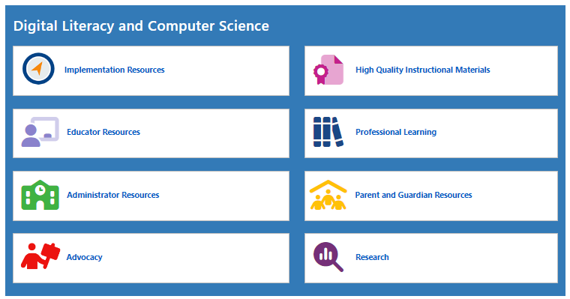
New STEM Webpage!
Each content area
DLCS
Science & Technology Engineering
Math
has resources organized by your needs.

Slide 5
CS Engage Intro
CS Engage
Engage your creativity!

Slide 6
A Common Understanding of Terminology is Important
Technology Engineering
Educational Technology
Digital Literacy
Computer Science
≠
<>
!=
Image by rawpixel.com on Freepik
Image by vectorjuice on Freepik

Slide 7
Digital Literacy and Computer Science
Digital Literacy
Computer Science
Computing and Society
Safety, Security, Ethics
Societal Impact
Digital Tools and Collaboration
Student selection of appropriate tools
Effective research & bias analysis skills
Computing Systems
Computing Devices
Networks
Computational Thinking
Algorithms
Data
Programming
Modeling and simulation

Slide 8
Note: All official details are in the Grant posting. If there is a discrepancy between this presentation and the posting, use the grant posting information.
CS Engage Grant

Slide 9
CS Engage Grant Goals
FUND CODE 126: FY24 126 Computer Science (CS) Engage Grant
CS Engage Grant
Engage your students!
Our Goals:
To support districts in creating an Implementation plan for an equity-driven, high-quality Computer Science Education Pathway K-12.
To identify issues of capacity, access, participation, and engagement (CAPE) and seek solutions in order to increase participation in CS courses.
To support teachers in learning CS skills and using high-quality curriculum that aligns with our standards and challenges students at their grade level
To engage students in grade-level, challenging, but fun, CS coursework.

Slide 10
Building a District Team
Areas of Responsibility
Who
Vision setting for the district
Schedule modifications
Funding for staff, curricula, PD, and devices
Teacher capacity planning
Coaching / PD at elementary
Local HS graduation requirement?
Include other subject area leaders:
Integrating Digital Literacy
Integrating Computer Science
At least:
District Administrator (Curriculum Leader),
Building Administrator(s), and
DLCS Teachers/Coaches

Slide 11
Developing a Strong DLCS K-12 Pathway
Covered under continuation grant next year.
More information on these steps can be found in the DLCS Implementation Process document.

Slide 12
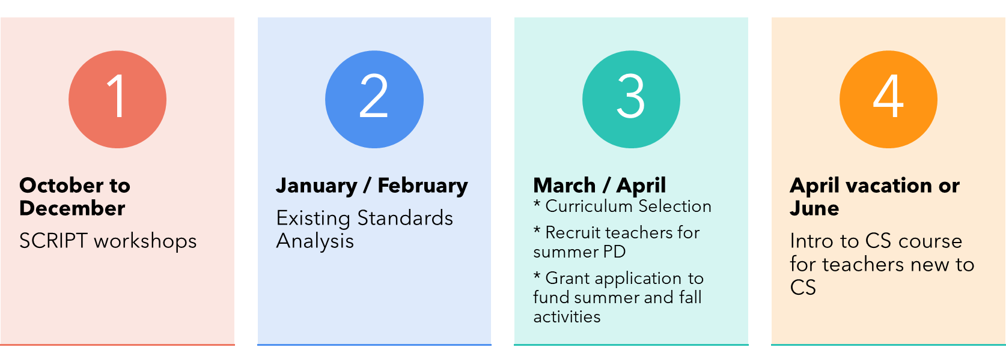
Timeline Year 1
Planned Timeline October 2023 to June 30, 2024
2 in-person full day meetings (October and November)
3 virtual 2-hour meetings (December to March)
1 in-person full day meeting (March/April)
1 one-on-one check-in call with District Team Leader (April)

Slide 13
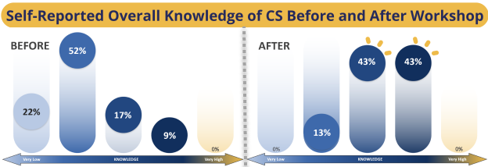
Intro to CS course info
CS Engage Grant!
Engage new teachers!
Engage teachers new to Computer Science with an Intro to CS course.
Allows educators to learn as students without focusing on a curriculum
Empowers educators to feel more confident when taking curriculum PD
Graphics by SageFox

Slide 14
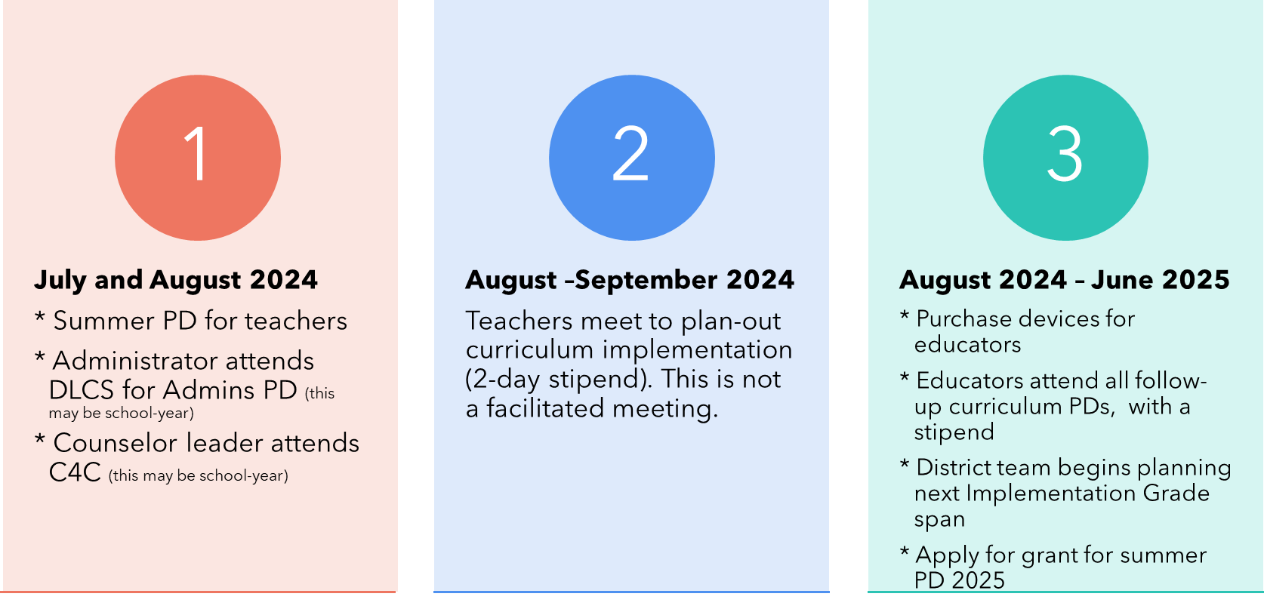
Timeline Year 2
Tentative Timeline July 1, 2024 - June 30, 2025
Covered under continuation grant next year.

Slide 15
Funding Year 1
Funding October 2023 - June 30, 2024
Facilitated district team meetings
3 in-person
3 two-hour virtual
Includes substitute reimbursement & travel
Intro to CS course:
Course cost
Stipend for teacher
Travel costs

Slide 16
Funding Year 2
Tentative Funding
July 1, 2024 - June 30, 2025
Covered under continuation grant next year.
Implementation of Year 1 plan:
Summer Curriculum PD (HQIM, comprehensive only):
Course cost
Teacher stipends ($1000 for the week)
Travel (in MA)
4 school-year PD sessions (for select curricula)
Stipends for 2 school-year curriculum planning days (in-district)
Up to $1000 per teacher for classroom CS materials
Development of Year 2 plan:
Facilitated District meetings
Intro to CS workshop for new teachers

Slide 17
Other Important Grant Information
Contracted PD Coordinator
Run the workshops
Create a website for meeting information
Schedule the Intro to CS and Summer Curriculum PD
Manages the stipend payments for teachers
Collects W-2s from teachers and will pay teachers directly
Invoices the district for teachers who attended PD
The district will pay the PD Coordinator with the Grant funds
Grant Evaluation
DESE will contract a grant evaluator
District teams and teachers attending PD will be asked to participate in surveys for the evaluation

Slide 18
Three Parts to Application
Part i - General — Program Unit Signature Page It must be a “wet signature” from an authorized signatory
Part ii - Budget Workbook
Part iii - Program Information

Slide 19
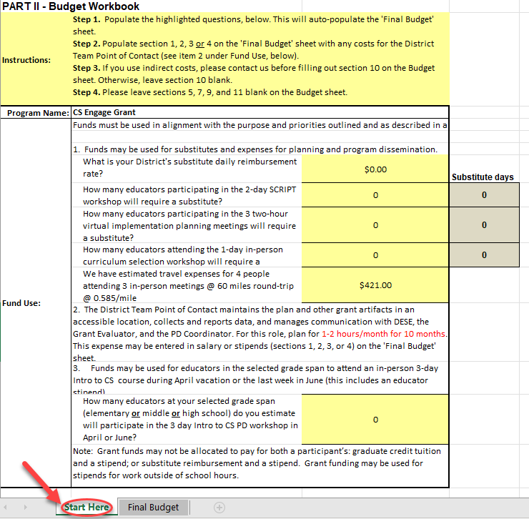
Budget Workbook Explanation
The Budget Workbook has two sheets: “Start Here” and “Final Budget”
Select the “Start Here” sheet
Only fill in the yellow cells - the Final Budget will be calculated
[Optional] Calculate cost of the District Team Point of Contact. Read item #2
[Optional] Indirect costs can be entered on the “Final Budget” sheet
Use the final amount on the “Final Budget” sheet on your Part 1 signature sheet

Slide 20
Part iii - Program Information
You MUST have a district team that consists of:
one district administrator,
one school administrator for the grade span on which you will be focusing (DESE recommends focusing on middle school implementation in the first year), and
one digital literacy and computer science teacher
They are expected to attend all in-person and virtual meetings
PART E – Commitments
Please read thoroughly and ensure that your district can honor the commitments.

Slide 21
Important Dates
FUND CODE 126: FY24 126 Computer Science (CS) Engage Grant
CS Engage Grant
Dates:
Friday, June 30, 2023: Please submit all questions to paula.b.moore@mass.gov with a subject line of “FC 126 Question”. A link to Questions and Answers will be posted on the STEM Grants and Opportunities page.
Friday, July 28, 2023 by 5:00 pm Eastern Time: Grant Applications Due

