Slide 1
What’s In This Slide Deck?
Section 1: Overview of the 2017 revisions to the Massachusetts curriculum frameworks for math and ELA/literacy
Section 2: ESE’s supports for implementing the 2017 curriculum frameworks for math and ELA/literacy
Section 3: Connections among the 2017 frameworks for math and ELA/literacy and the 2016 frameworks for STE and DLCS
Notes:
These slides are designed to be adaptable for a variety of venues, audiences, and purposes. Clarifications appear in the “notes” section of each slide. Feel free to distribute or present some or all of this information as appropriate. If you have questions or feedback, please contact instructionalsupport@doe.mass.edu.

Slide 2
Overview of the 2017 Revisions to the Massachusetts Curriculum Frameworks for Math and ELA/Literacy
Goals and major outcomes of the framework review process
Notes:
The slides in this section do not attempt to detail every change—or even every type of change—made to the frameworks, but they provide an overview and a framework for thinking about the changes. For a list of changes to the standards that may affect planning in schools, please see the “Highlights of the 2017 Revisions” documents available at http://www.doe.mass.edu/frameworks/. For a complete list of changes to the standards and the rationale for each change, please see the “Grade-by-Grade Explanation of Changes” documents presented to the Board of Elementary and Secondary Education in March 2017.

Slide 3
Goals of the Review Process
Make use of lessons learned in six years of implementing the 2011 standards
Increase clarity, coherence, and rigor where necessary
Maintain clarity, coherence, and rigor where appropriate
Avoid unnecessary disruption to curriculum, instruction, and assessment
Notes:
The next few slides focus on the three guideposts named here—clarity, coherence, and rigor—in turn.

Slide 4
Math: Clarity
Descriptions of Standards for Mathematical Practice revised to provide examples specific to each grade span: PK–5, 6–8, and 9–12.
Key terms, such as “fluency” and “know from memory,” clarified.
Model course standards edited to clarify content expectations and boundaries.
Standard codes revised to include letter denoting cluster level; standards previously coded “MA” fully integrated.
Notes:
The 2017 Frameworks provide additional interpretation of the standards appropriate for PK-12 classrooms. This revision is intended for understanding how the original language of the standards for mathematical practice applies in different grade levels. These narrative descriptions integrate the elementary, middle, and high school grade/course content with the practices to provide a coherent description of how the practice standards play out in the PK-5, 6-8, and 9-12 classrooms.
Definitions for key terms are included in the 2017 Math Framework, particularly for the terms: fluently, know from memory, algorithms, and standard algorithms. There was much discussion about the meaning of fluency and ‘know from memory’. There is a very strong and coherent progression that develops students’ fluency in number sense and operations. The development of fluency begins in earlier grades where they develop an understanding of a concept by explorations, using concrete models, and solving problems. Eventually students learn to use variety of strategies as they develop fluency with numbers and operations. After this development of fluency, in two standards students are expected to know from memory math facts: grades 2 (addition/subtraction) and grades 3 (multiplication/division) of two single-digit numbers.
Content boundaries (for example: types of functions) were previously delineated in the footnotes of the HS model courses. In the 2017 Math Framework these footnotes were incorporated into a standard to make the expectation of the standard in a particular grade or course clearer and easier to use.

Slide 5
Math: Coherence
Solidified learning progression related to recognizing patterns in numbers and ratio/proportions/rates in order to lay a foundation for algebraic thinking. For example:
Added language to recognize and/or identify patterns in grades K–2.
Added “rate” to grade 6 cluster heading in Ratio and Proportional Relationships domain.
Made edits to ensure consistent development of content PK–12.
Notes:
A coherent progression of learning of the content standards in these PK-8 Domains prepares students for the high school conceptual category’s standards that are dispersed throughout the high school model courses. For example, the coherent progression of PK-5 standards in Number and Operations in base ten and Fractions prepares for learning about ratios and proportional relationships and the number system in grade 6.
Recognizing patterns in numbers is key to mathematic understanding of numbers and develops algebraic thinking, Recognizing patterns includes the practices of looking for regularity and looking for patterns or structure in our number system. Looking for and finding patterns is foundational for algebraic thinking. This edit explicitly bring this learning progression to younger children while maintaining the critical focus on arithmetic in these early grades.
Grade 6 focuses on ratio, rate, and proportional reasoning. Connecting ratio and rate is an identified critical area for grade 6. The term “rate” was added to explicitly insure that the focus is on both ratio and rate concepts for the standards under this heading. Focusing on rates allow for the development of proportional reasoning to solve real world problems and is key in the progression to Algebra.
The focus on rate insures a stronger foundation for Algebra concepts of linearity and slope.

Slide 6
Math: Rigor
Definition of “mathematical rigor” as balanced approach.
Course-taking pathway compressing grades 6–8 standards to allow completion of Model Algebra I course in grade 8.
Decision-making guidance for completing 4 years of high school mathematics culminating in an advanced math class in grade 12.
Retention of the high school (+) “plus” standards in the model high school courses.
Notes:
Rigor in mathematics is about challenging students to develop understanding of mathematical concepts as they develop procedural skills and then apply those understanding and skills to solve real world and mathematical problem solving situations. Mathematical rigor insures students have the opportunity to learn concepts and practices needed to be prepared for College and Career Readiness. The 2017 Mathematics Framework maintains the expectation that all students will develop mathematical understanding of concepts, procedural skills and fluencies, and context based problem solving abilities.
Four model course pathways are included referencing both Traditional and Integrated courses. The approach typically seen in MA high schools, (Traditional) consists of two algebra courses and a geometry course, with some data, probability and statistics included in each course followed by an advanced math course. The approach typically seen internationally (Integrated) consists of a sequence of three courses Math I, II, III, each of which also includes number, algebra, geometry, probability and statistics. Both can be designed to include Precalculus and culminate in Calculus.

Slide 7
ELA/Literacy: Clarity
Sample instructional scenarios and student work provide illustrations of specific standards.
Updated and expanded glossary entries define terms as they are used in the standards.
Edits ensure consistent usage of terms: for example: text, audience, text features.
New and updated guidance on text complexity helps educators choose high-quality texts.
Notes:
Additional notes on each of the points on this slide, in order:
The illustrative examples appear in blue boxes throughout the framework. They are examples, not requirements.
Confusingly, some glossary definitions in the 2011 framework did not match the standards’ usage of the terms.
Note that “text,” “audience,” and “text features” are all defined in the 2017 framework’s glossary as well.
Guidance on text complexity includes sample text sets, criteria for evaluating qualitative complexity, and more.

Slide 8
ELA/Literacy: Coherence
Cross-references and parallel expectations reinforce connections across strands.
Massachusetts-specific standards added in 2011 now integrated more fully.
Some vertical progressions smoothed: for example, sentence production in grades 1–3.
Language standards emphasize application in authentic oral and written communication.
Notes:
Additional notes on each of the points on this slide, in order:
Parallel expectations: e.g., standards for writing poetry (W.3) in K-5 reinforce grade-level reading expectations.
We heard from educators that the 2011 MA standards were important but difficult to implement as add-ons.
Sentence production: i.e., producing simple, compound, complex, and compound-complex sentences.
We heard from the field that the language strand, and especially L.1, was too isolated from other strands.

Slide 9
ELA/Literacy: Rigor
Writing standards emphasize importance of flexibility and nuance in student writing.
Academic and discipline-specific language mentioned more frequently and explicitly.
More sustained research projects expected in middle grades as well as high school.
High school standards align more tightly with postsecondary approaches to textual analysis.
Notes:
Additional notes on each of the points on this slide, in order:
Flexibility and nuance: e.g., using narrative techniques to present anecdotal evidence for an argument
Language: e.g., standards for giving presentations (SL.4) and revising writing (W.5) mention vocabulary
Research: this is an example of a change that applies both to ELA and to literacy in the content areas
Postsecondary approaches: e.g., noticing inconsistencies within as well as between texts

Slide 10
Supports for Implementing the 2017 Massachusetts Curriculum Frameworks for ELA/Literacy and Mathematics
- New, updated, and forthcoming resources
- Opportunities for direct engagement with ESE
- Three core messages about the standards
Notes:
This section highlights some of the ways in which ESE is or will be supporting implementation of the 2017 curriculum frameworks. Note that these slides are current as of August 2017; please check ESE’s website and news sources for more recent updates.

Slide 11
Where to Find (Most) Resources
http://www.doe.mass.edu/frameworks/
Notes:
The frameworks pages have been reorganized slightly: there is no longer a separate “current frameworks” page, and all current frameworks are now available on the home “frameworks” page. Most frameworks-related resources will be posted here, although some, like the What to Look For guides and the Writing Standards in Action materials, are elsewhere—as noted in the relevant slides below.

Slide 12
New: “Highlights” Documents
“Highlights” available at http://www.doe.mass.edu/frameworks/
Notes:
These are new resources available for both math and ELA/literacy as of summer 2017.
Each is several pages long and focuses on changes that may affect planning or assessment.
These primarily target professional educators: teachers and school and district administrators.
The screenshot here is from the first page of the math document.

Slide 13
New: Quick Reference Guides
QRGs available at http://www.doe.mass.edu/frameworks/
Notes:
These are new resources that will be released on a rolling basis throughout 2017-2018.
Each QRG is two pages (or one double-sided page) and designed to be very user-friendly.
Audiences for these may include teachers, coaches, and administrators as well as families.
Shown here is the beginning of a QRG on close reading in secondary ELA classrooms.
As of August 2017, four QRGs exist for ELA/literacy. More are forthcoming in both content areas.

Slide 14
Updated: “What to Look For” Guides
WTLFs available at http://www.doe.mass.edu/candi/observation/
Notes:
The WTLFs are designed to be printed (as one double-sided sheet) and brought to classroom observations.
The front side of each summarizes standards for the relevant grade level and content area.
The back side lists teacher and student behaviors aligned with the model evaluation rubric and the frameworks.
As of August 2017 all ELA/literacy and math WTLFs have been updated to align with the 2017 frameworks.
In addition, WTLFs now exist for high school grades or courses in ELA and math (as well as STE).
The back page of every WTLF, in all three subjects, also underwent substantial updates in summer 2017.

Slide 15
Updated: Writing Standards in Action
WSA materials available at http://www.doe.mass.edu/candi/wsa/
Notes:
The WSA Project annotates student work to show how it demonstrates mastery of the MA standards.
Annotated and unmarked samples can be used with teachers, families, and students themselves.
Shown here is an excerpt from a fifth-grader’s interdisciplinary research project on hot air balloons.
As of August 2017 all WSA materials have been updated to align to the 2017 ELA/literacy framework.
The 2017 ELA/literacy framework also links directly from specific standards to relevant writing samples.

Slide 16
Forthcoming: Other Resources
Family-friendly, multilingual guides to the standards by grade, with prompts for conversations at home (with children) and at school (with teachers)
Guidance on “scaffolding the standards” for students working below grade level
More user-friendly way of navigating standards electronically
Notes:
These are resources we will work to develop during the 2017-2018 academic year.
The latter two projects are still quite nebulous as of August 2017.

Slide 17
Direct Engagement: Networks
Regional and statewide networks in 2017–2018:
Early numeracy (math, pre-K–3)
Proportional reasoning (math, grades 4–7)
Coursework pathways (math, grades 6–12)
Integrating standards (part of Early Grades Literacy Grant)
Integrating standards (literacy, grades 4–12)
Flexibility in student writing (literacy, grades 9–12)
Time on science (STE, pre-K–5)
Standards-aligned assessments (STE, grades 5–8)
Urban district leaders (math, literacy, STE; pre-K–12)
English learner education leaders (pre-K–12)
For more information, see: http://www.doe.mass.edu/candi/networks.pdf
Notes:
ESE’s Center for Instructional Support will be running 12 educator networks during the 2017-2018 academic year. The networks will convene classroom, school, and district leaders from across the state to learn about the standards and to develop, test, and refine tools and strategies for implementing them effectively. Each network will meet several times over the course of the school year and focus on a specific aspect of the ELA/literacy, math, or STE framework. Please note that several of the networks are meant to be attended by district teams rather than individuals.

Slide 18
We Believe:
Every student should engage…
with grade-appropriate text every day.
with meaningful real-world problems every day.
in scientific conversations using data every week.
Notes:
In all our efforts to support implementation of the 2017 frameworks as well as previously revised frameworks such as the 2016 STE one, ESE will be emphasizing these core messages, each of which has interdisciplinary implications.

Slide 19
Connections Among the Massachusetts Curriculum Frameworks for ELA/Literacy, Mathematics, STE, and DLCS
Parallels and cross-references designed to maximize coherence in expectations for both students and teachers
Notes:
This section is “weedier” than the previous two; it delves quite deeply into specific standards and content. While these slides focus on the four most recently updated frameworks, all Massachusetts curriculum frameworks—and all subject areas—are interconnected. Moving forward, making interdisciplinary connections more explicit and well-supported will be a goal of all framework review and revision processes ESE undertakes.

Slide 20
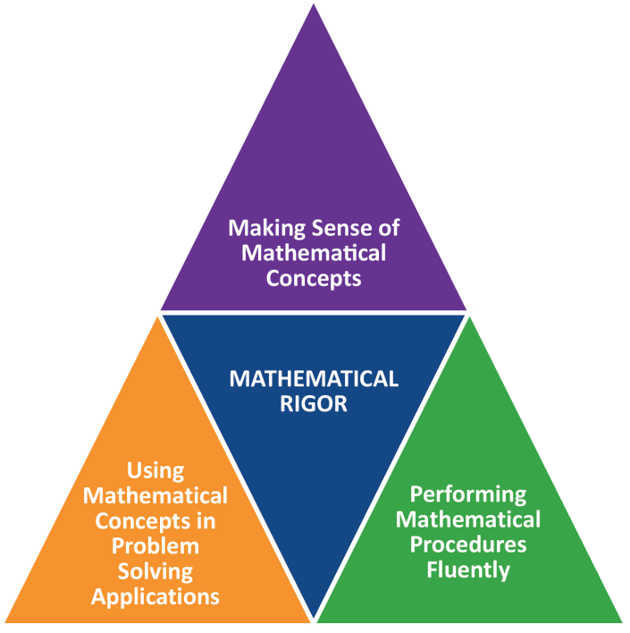
Mathematics - A Balanced Approach
Notes:
Balance within the Mathematics Framework refers to Mathematical Rigor.
The content and practice standards focus on developing students in the following areas:
Conceptual understanding – make sense of the math, reason about and understand math concepts and ideas
Procedural skills – know mathematical facts, compute and do the math
Capacity – solve a wide range of problems in various contexts by reasoning, thinking, and applying the mathematics they have learned.
Instruction and assessment should reflect a balance of all three aspects of Mathematical Rigor.

Slide 21
Mathematics - A Balanced Approach
2.OA.C.3 - Determine whether a group of objects (up to 20) has an odd or even number of members, e.g., by pairing objects or counting them by 2s; write an equation to express an even number as a sum of two equal addends.
Notes:
For example, a 2nd grade standard can be analyzed in regard to each aspect of Mathematical Rigor.
Conceptual understanding –Explain what it means for a number to be even or odd (can be paired, broken in half, organized to match rows)
Procedural skills – Memorize and apply a rule for recognizing even numbers (0,2,4,6,8)
Capacity - Odd/Even and arrays as a foundation for multiplication, organize an array or group, 2 is a factor

Slide 22
Mathematics - A Balanced Approach
6.NS.B.4 - Find the greatest common factor of two whole numbers less than or equal to 100 and the least common multiple of two whole numbers less than or equal to 12. Use the distributive property to express a sum of two whole numbers 1–100 with a common factor as a multiple of a sum of two whole numbers with no common factor. For example, express 36 + 8 as 4 (9 + 2).
Notes:
For example, a 6th grade standard can be analyzed in regard to each aspect of Mathematical Rigor.
Conceptual understanding –Explain the role of common factors within the use of the distributive property
Procedural skills – Memorize and apply a procedure to determine the greatest common factor of two whole numbers
Capacity - Apply understanding and procedures associated with multiples and factors to interpret relative size of quantities.

Slide 23
Standards for Mathematical Practice
Standards, to be taught and assessed
What successful math learners do to learn and solve problems
Applicable across content areas
Connected to growth mindset
Apply to the spectrum of learners
Notes:
The Standards of Mathematical Practice has been delineated in the 2017 Mathematics Frameworks by grade spans PK-5, 6-8, and 9-12. It is important to contextualize the Standards for Mathematical Practice as standards that must be taught and assessed through integration with the content standards. This expectation dictates that the Standards for Mathematical Practice are to be learned and applied by all students across performance levels. Students can learn how to apply the practices with more frequency and success, just as they improve their content knowledge.

Slide 24
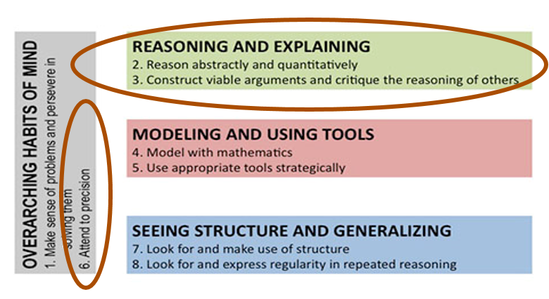
Standards for Mathematical Practice
Notes:
The Standards for Mathematical Practice can be thought of as being grouped into 4 categories shown above. For this presentation we focus on #3 and #6. The practice of constructing arguments and critiquing the reasoning of others is common across all the content frameworks. In Math this is specifically identified as a practice (SMP 3) students must apply on a daily basis both to learn new material and apply previous learning. The expectation to use precise language and vocabulary is vital to constructing arguments in math and other disciplines as well.

Slide 25
Standards for Mathematical Practice
3. Construct viable arguments and critique the reasoning of others.
Mathematically proficient students understand and use stated assumptions, definitions, and previously established results in constructing arguments. They make conjectures and build a logical progression of statements to explore the truth of their conjectures. They are able to analyze situations by breaking them into cases, and can recognize and use counterexamples. They justify their conclusions, communicate them to others, and respond to the arguments of others. They reason inductively about data, making plausible arguments that take into account the context from which the data arose. Mathematically proficient students are also able to compare the effectiveness of two plausible arguments, distinguish correct logic or reasoning from that which is flawed, and—if there is a flaw in an argument—explain what it is. Elementary students can construct arguments using concrete referents such as objects, drawings, diagrams, and actions. Such arguments can make sense and be correct, even though they are not generalized or made formal until later grades. Later, students learn to determine domains to which an argument applies. Students at all grades can listen or read the arguments of others, decide whether they make sense, and ask useful questions to clarify or improve the arguments.
3. Construct viable arguments and critique the reasoning of others.
Mathematically proficient students understand and use stated assumptions, definitions, and previously established results in constructing arguments. They make conjectures and build a logical progression of statements to explore the truth of their conjectures. They are able to analyze situations by breaking them into cases, and can recognize and use counterexamples. They justify their conclusions, communicate them to others, and respond to the arguments of others. They reason inductively about data, making plausible arguments that take into account the context from which the data arose. Mathematically proficient students are also able to compare the effectiveness of two plausible arguments, distinguish correct logic or reasoning from that which is flawed, and—if there is a flaw in an argument—explain what it is. Elementary students can construct arguments using concrete referents such as objects, drawings, diagrams, and actions. Such arguments can make sense and be correct, even though they are not generalized or made formal until later grades. Later, students learn to determine domains to which an argument applies. Students at all grades can listen or read the arguments of others, decide whether they make sense, and ask useful questions to clarify or improve the arguments.
Notes:
This slide and the next highlight some of the text from SMP #3 and #6 that specifically call out the need for students to communicate their thinking while providing evidence.

Slide 26
Standards for Mathematical Practice
6. Attend to precision.
Mathematically proficient students try to communicate precisely to others. They try to use clear definitions in discussion with others and in communicating their own reasoning verbally and/or in writing. In problem solving they state the meaning of the symbols they choose, including using the equal sign consistently and appropriately. They are careful about specifying units of measure and labeling axes to clarify the correspondence with quantities in a problem. They calculate accurately and efficiently, expressing numerical answers with a degree of precision appropriate for the problem context. In the elementary grades, students give carefully formulated explanations to each other. By the time they reach high school, they have learned to examine claims and make explicit use of definitions.
6. Attend to precision.
Mathematically proficient students try to communicate precisely to others. They try to use clear definitions in discussion with others and in communicating their own reasoning verbally and/or in writing. In problem solving they state the meaning of the symbols they choose, including using the equal sign consistently and appropriately. They are careful about specifying units of measure and labeling axes to clarify the correspondence with quantities in a problem. They calculate accurately and efficiently, expressing numerical answers with a degree of precision appropriate for the problem context. In the elementary grades, students give carefully formulated explanations to each other. By the time they reach high school, they have learned to examine claims and make explicit use of definitions.

Slide 27
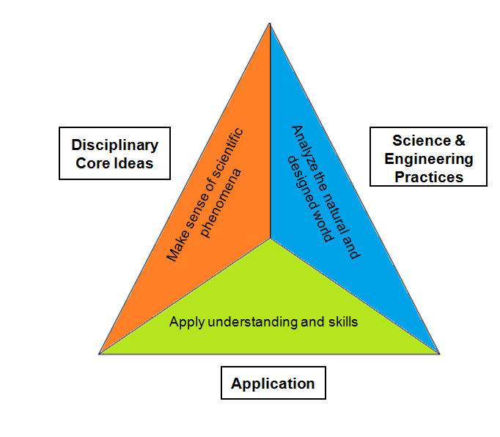
Science Technology/Engineering Rigor and Balance
Notes:
The STE standards are designed to include three interrelated components necessary to prepare students for college and careers in the STE fields:
Conceptual understanding of disciplinary core ideas
Science and engineering practices
Application to the natural and designed world
Similar to the balance sought through Mathematical Rigor, STE courses should seek a balance of these three elements through tasks and assessments.

Slide 28
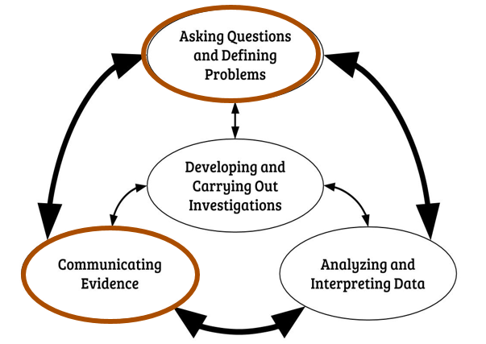
STE – Scientific Inquiry
Notes:
The 2016 STE Framework describes the process of Scientific Inquiry and Engineering Design.
Communication and argumentation are vital aspects of the Scientific Inquiry process.
Asking questions and defining problems. Scientific questions arise in a variety of ways. They can be driven by curiosity about the world; inspired by the predictions of a model, theory, or findings from previous investigations; or stimulated by the need to solve a problem. Asking questions also leads to involvement in other practices.
Communicating evidence. Communicating explanations for the causes of phenomena is central to science. An explanation includes a claim that relates how a variable or variables relate to another variable or set of variables. A claim is often made in response to a question and in the process of answering the question. Argumentation is a process for reaching agreements about explanations and design solutions. Reasoning based on evidence is essential in identifying the best explanation for a natural phenomenon. Being able to communicate clearly and persuasively is critical to engaging with multiple sources of technical information and evaluating the merit and validity of claims, methods, and designs.

Slide 29
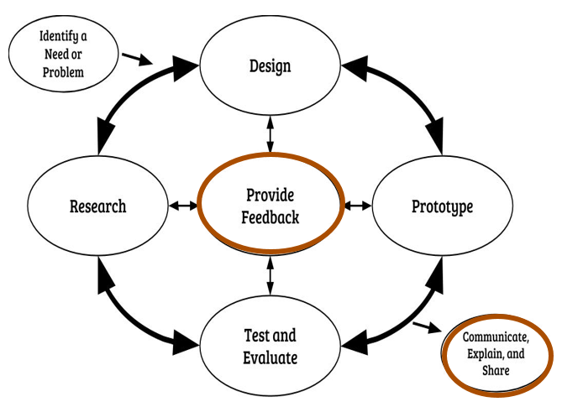
STE – Engineering Design
Notes:
Communication is also a vital aspects of the Engineering Design process.
Provide feedback. Feedback through oral or written comments provides constructive criticism to improve a solution and design. Feedback can be asked for and/or given at any point during engineering design. Determining how to communicate and act on feedback is critical.
Communicate, explain, and share. Communicating, explaining, and sharing the solution and design is essential to conveying how it works and does (or does not), solving the identified need or problem, and meeting the criteria and constraints. Communication of explanations must be clear and analytical.
Also, both the process of Scientific Inquiry and Engineering Design are predicated on a meaningful task, problem to solve, or investigate. In Mathematics and STE students should be solving problems that are relevant and present the right amount of challenge to apply and enhance their learning.

Slide 30
Science and Engineering Practices - #7 Engaging in argument from evidence
PK–2 | Construct an argument with evidence for how plants and animals can change the environment; distinguish between opinions and evidence in one’s own explanations; listen actively to others to indicate agreement or disagreement based on evidence.
3–5 | Construct an argument that animals and plants have internal and external structures that support their survival, growth, behavior, and reproduction; distinguish among facts, reasoned judgment based on data, and speculation in an argument.
6–8 | Construct an argument based on evidence for how environmental and genetic factors influence organism growth; respectfully provide and receive critiques about one’s arguments, procedures, and models by citing relevant evidence with pertinent detail.
HS | Respectfully provide and/or receive critiques on scientific arguments by probing reasoning and evidence and challenging ideas and conclusions, and determining what additional information is required to solve contradictions.
Notes:
The Science and Engineering Practices within the STE Framework specifically site the need for students to engage in argument by citing evidence. This slide presents the development of this practice (#7) from PK-2 through High School. While keeping the central focus on argumentation the expectations for students increase over time from recognizing the differences between opinions and evidence to determining when and what additional information may be required to solve a contradiction.

Slide 31
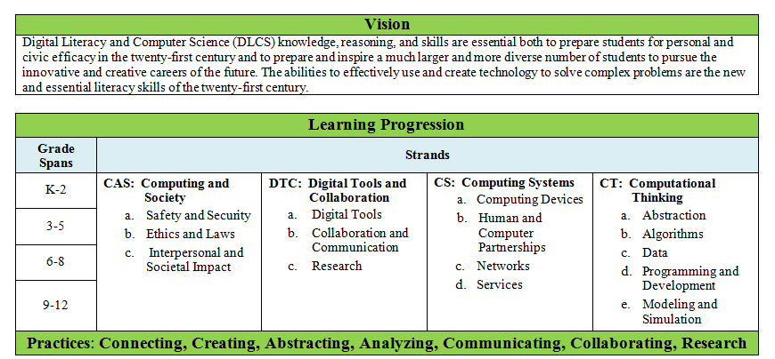
Digital Literacy and Computer Science
Notes:
The Digital Literacy and Computer Science Framework is explicitly designed to encourage a balanced and integrated approach to implementation. The standards are organized into 4 strands and 7 practices that extend Kindergarten to 12th Grade. Effective DLCS instruction requires strategic integration of the strands through authentic problems and contexts.

Slide 32
DLCS - Guiding Principle 1: Learning
Digital Literacy and Computer Science ideas should be explored in ways that stimulate curiosity, create enjoyment, and develop depth of understanding.
Students should be actively engaged in designing, creating and inventing, discussing ideas, and applying their skills in interesting, thought-provoking situations. As students develop technology skills, it is important they apply these skills in their classroom, school, and life so that they will understand why these skills are important. For example, a student who needs to gather data in a science experiment and organize and manipulate the data in order to analyze the results will see a reason for learning about the features and function of a data collection tool and database. This is context-sensitive learning in which technology skills instruction is centered on the students needs. Student understanding is further developed through ongoing reflection about cognitively demanding and worthwhile tasks.
Tasks should be designed to challenge students in multiple ways. Activities should build upon curiosity and prior knowledge and enable students to solve progressively deeper, broader, and more sophisticated problems. Digital literacy and computer science tasks reflecting sound and significant concepts should generate active classroom talk, promote the development of conjectures, and lead to an understanding of the necessity for digital literacy and computer science reasoning.
Digital Literacy and Computer Science ideas should be explored in ways that stimulate curiosity, create enjoyment, and develop depth of understanding.
Students should be actively engaged in designing, creating and inventing, discussing ideas, and applying their skills in interesting, thought-provoking situations. As students develop technology skills, it is important they apply these skills in their classroom, school, and life so that they will understand why these skills are important. For example, a student who needs to gather data in a science experiment and organize and manipulate the data in order to analyze the results will see a reason for learning about the features and function of a data collection tool and database. This is context-sensitive learning in which technology skills instruction is centered on the students needs. Student understanding is further developed through ongoing reflection about cognitively demanding and worthwhile tasks.
Tasks should be designed to challenge students in multiple ways. Activities should build upon curiosity and prior knowledge and enable students to solve progressively deeper, broader, and more sophisticated problems. Digital literacy and computer science tasks reflecting sound and significant concepts should generate active classroom talk, promote the development of conjectures, and lead to an understanding of the necessity for digital literacy and computer science reasoning.
Notes:
The Digital Literacy and Computer Science Framework is written to reflect 6 guiding principles. Included in Guiding Principle #1 is specific reference to the need for authentic and meaningful tasks. Like the Engineering Design process, student should engage with the DLCS standards through authentic and meaningful situations, highlights are in red.

Slide 33
DLCS – Practice #5 Communicating
Communication is the expression and exchange of information between two or more people. Communication includes written and oral mediums, as well as tangible representations supported by graphs, visualizations, demonstrations, stories, and analysis. Effective communication is accurate, clear, concise, persuasive, and responsible. Skills include:
Evaluating various digital tools for best expression of a particular idea or set of information;
Selecting and using digital media and tools to communicate effectively;
Communicating to or with different audiences;
Describing computation with accurate and precise language, notations, or visualizations where relevant;
Summarizing the purpose of a proposed solution, model, prototype, or computational artifact;
Justifying the design, appropriateness of choices, and selection of a solution; and
Communicating responsibly, such as respecting intellectual property.
Communication is the expression and exchange of information between two or more people. Communication includes written and oral mediums, as well as tangible representations supported by graphs, visualizations, demonstrations, stories, and analysis. Effective communication is accurate, clear, concise, persuasive, and responsible. Skills include:
Evaluating various digital tools for best expression of a particular idea or set of information;
Selecting and using digital media and tools to communicate effectively;
Communicating to or with different audiences;
Describing computation with accurate and precise language, notations, or visualizations where relevant;
Summarizing the purpose of a proposed solution, model, prototype, or computational artifact;
Justifying the design, appropriateness of choices, and selection of a solution; and
Communicating responsibly, such as respecting intellectual property.
Notes:
The Digital Literacy and Computer Science Framework include 7 practices. Practice #5 specifically addresses the importance of communication, highlights are in red. Like the STE and Mathematics, teaching and learning the DLCS standards includes justification of design and the precise use of language.

Slide 34
ELA/Literacy
Balance knowledge, understanding, application
Explain and argue coherently and convincingly
Analyze and evaluate claims and evidence
Notice patterns and underlying structures
Interpret qualitative and quantitative data
Define questions and structure inquiry
Communicate clearly and precisely
Choose appropriate tools and strategies
Notes:
These are all skills referenced in the slides above on math, STE, and DLCS.
Some notes on their application in ELA/literacy, in order of the points on this slide: “Balance…” for example, in knowing, understanding, and manipulating the “rules” of grammar
“Explain and argue…” both orally and in writing, for a variety of tasks, purposes, and audiences
“Analyze and evaluate…” when reading, when listening or viewing, and when revising writing
“Notice patterns…” such as beats in a line of poetry, or a common plotline or character type
“Interpret…” words are qualitative data; counting syllables and beats can generate quantitative data
“Define questions…” the research standards (W.7-9) include expectations for self-directed inquiry
“Communicate…” most explicit in the language strand, which applies to both written and oral language
“Choose…” tools may be physical (like dictionaries) or mental (like knowledge of Greek/Latin roots)

Slide 35
ELA/Literacy
Specific standards link to relevant examples and standards from various content areas
Resource sections discuss broader connections among content areas, citing guidance on literacy in other frameworks
Notes:
Because the ELA/literacy framework applies directly to instruction in multiple content areas, it needs to be especially clear about its cross-curricular applications. It does this through both specific and general references to various subject areas. Specific references include sample student work and instructional scenarios that link certain ELA/literacy standards to learning across the curriculum. For example, the first screenshot here shows an instructional scenario linking the ELA/literacy standards for vocabulary to the study of fractions. More general discussions of interdisciplinary connections appear in the resource sections that follow the standards in the ELA/literacy framework. For example, the second screenshot here shows part of a guiding principle from the STE framework, as quoted in the ELA/literacy framework.

Slide 36
ELA/Literacy: PK–5
Standards address literacy across the curriculum more explicitly
Notes:
The 2017 revisions also involved adding some new content to the ELA/literacy standards. This content was carefully selected to avoid increasing the amount of material for which teachers are responsible. To see how, consider the examples shown here from the kindergarten (top) and grade 3 (bottom) language standards. The math standards, in the math framework, expect students to write numbers from 0 to 20 in kindergarten and use the symbols < and > in grade 3. The boxed content in the ELA/literacy standards above simply reinforces those expectations from a literacy perspective.

Slide 37
ELA/Literacy: 6–12
Standards for Literacy in the Content Areas include Speaking and Listening strand
Comprehension and Collaboration
Prepare for and participate effectively in a range of conversations and collaborations…
Integrate and evaluate information presented in diverse media and formats…
Evaluate a speaker’s point of view, reasoning, and use of evidence…
Presentation of Knowledge and Ideas
Present information, findings, and supporting evidence…
Make strategic use of digital media and visual displays of data…
Adapt speech to a variety of contexts and communicative tasks…
Notes:
In the secondary grades, new material emphasizing literacy across the curriculum takes the form of expanded speaking and listening standards. The 2011 framework included reading and writing standards but not speaking and listening standards for literacy in the content areas. Speaking and listening are important across disciplines, however, and the speaking and listening anchor standards (excerpted in orange on this slide) are relevant to classes in a variety of subject areas—as demonstrated by the slides on math, STE, and DLCS above. The 2017 framework thus includes speaking and listening standards for literacy in the content areas at grades 6 to 12. Again, the goal of the change was to reinforce what teachers are already doing, not to add more to teachers’ plates.

