Slide 1
Exploration Activity: Fractions From
First to Sixth Grade
Exploring Fractions in the 2011 MA Curriculum Framework for Mathematics

Slide 2
Session Goal
We will explore:
how the shifts in the 2011 Mathematics Curriculum Frameworks help to build conceptual knowledge of fractions
how these fraction concepts progress through the grades.
Notes:
In this presentation we will look at how explicit use of visual models in the new frameworks help students to build a conceptual understanding of fractions and how this conceptual understanding and the use of visual models is built upon.
NOTE TO FACILITATOR: This exploration is expected to take at least three hours. We suggest that you review all of the slides and make strategic decisions about what is best for your audience.
For example, you may want to:
Break it up into a series of shorter presentations to allow time to dig into the math problems
Use it as the focus of several Professional Learning Community meetings
Use it as the foundation for professional development for your teachers on fractions
Modify the presentation for different audiences. Some possible adaptations are:
1st-2nd Grade Teachers: Slides 1-26 and 56-58
3rd-4th Grade Teachers: Slides 1-38 and 56-58
5th-6th Grade Teachers: Slides 1-12 and 27-58

Slide 3
Session Overview
Setting the Context: Fraction Math Problem
Key Shifts and the Fractions Progression
Fractions Progression:
  Grades 1and 2: Partition Shapes
  Grade 3-5: Fraction are Critical Areas
  Grade 6:
      Dividing Fractions by Fractions
      Connecting Fractions to Ratios and Proportional Relationships
Notes:
In this presentation, we will trace fraction concepts starting in first and second grade where a foundation is laid in the Geometry Domain, to third through fifth grade where fractions are a critical area of focus of each year to sixth grade where there is one fraction standard and where Ratios and Proportional Reasoning become a critical area of focus.

Slide 4
Setting the Context
How many 1/3 cup servings are in 2 cups of raisins?
4
5.NF.7.c., page 51, Massachusetts Curriculum Framework for Mathematics, March 2011
Notes:
To initiate thinking about fractions, have participants turn and talk to a neighbor about what equation they would use to represent this problem.

Slide 5
Setting the Context
How many 1/3 cup servings are in 2 cups of raisins?
2 cups
1/3
1/3
1/3
1 cup
1/3
1/3
1/3
5
5.NF.7.c., page 51, MP.2, p. 15 Massachusetts Curriculum Framework for Mathematics, March 2011
Notes:
Here is a visual representation. Do you still agree that your equation represents this problem. Make any changes to it.

Slide 6
Setting the Context
How many 1/3 cup servings are in 2 cups of raisins?
2 ÷ 1/3 =
6 servings
2 cups
1/3
1/3
1/3
1 cup
1/3
1/3
1/3
6
5.NF.7.c., page 51, Massachusetts Curriculum Framework for Mathematics, March 2011
Notes:
This problem could be represented as 2 divided by 1/3. (It could also be represented as 1/3 X ____ = 2.) Participants might struggle with why this is a division problem. If so, it is helpful to remind them of their work with division of whole numbers. For example, if they think about how division is repeated subtraction, they could see that one way to solve this problem is to keep subtracting 1/3 from 2 until there is none left. For fifth graders to be able to build on their understanding of division of whole numbers, they need to have built a strong foundation for division of whole numbers using repeat subtraction when they were in 3rd grade.
The answer, 6 is larger than the number that you started with. Turn and Talk: Would the visual representation help students see why the answer is larger than the initial numbers in the problem?

Slide 7
II. Key Shifts and the Fractions Progression

Slide 8
The Progression: Fractions to Ratios and Proportional Reasoning
Exploring the key shifts in this progression:
Focus: fractions are identified as Critical Areas in grades 3-5
Coherence: fraction concepts build from grades 1-6
Clarity: precise language, specifying use of a variety of types visual models
Rigor:
  visual representations to support conceptual understanding
  ongoing development of the Standards for Mathematical Practice
8
Massachusetts Department of Elementary and Secondary Education
Notes:
As we trace the progression of fractions in the 2011 standards, we would like to draw your attention to the key shifts in the standards which are vital components of the progression.
FOCUS: In the third through fifth grades, fractions are identified as critical areas.
COHERENCE: We will trace the coherence of the progression of fraction concepts from first through sixth grades.
CLARITY: We will look at the precise language in the standards. In particular, we will look at how the standards explicitly require use of visual models.
RIGOR: By using visual models to support conceptual understanding and by focusing on the Standards for Mathematical Practice, the standards are more rigorous.
8
Massachusetts Department of Elementary and Secondary Education

Slide 9
Domain Progression in the 2011 MA Math Frameworks
PK-8 Domains Progression
Domains
PK
K
1
2
3
4
5
6
7
8
Counting and Cardinality
MA
Operations and Algebraic Thinking
MA
Number and Operations in Base Ten
Number and Operations - Fractions
Ratios and Proportional Relationships
The Number System
MA
Expressions and Equations
Functions
Measurement and Data
MA
Geometry
MA
Statistics and Probability
Coherence Exploration http://www.doe.mass.edu/candi/commoncore/mathexplore/
Notes:
A major shift which provides coherence in the 2011 Math Frameworks, is that standards are grouped into domains. You will see that the “Number and Operations—Fractions” is a domain in 3rd through 5th grade and Ratios and Proportional Relationships is a domain in 6th and 7th grade. You might also notice that the Fractions domain is one of many that is expected to be learned by the end of 5th grade. From the fractions concepts, students progress to ratio and proportional reasoning concepts. In the last section of this presentation, we will focus on the transition from fractions to ratios and proportions so that educators can both help students avoid misconceptions and can build on their prior knowledge.

Slide 10
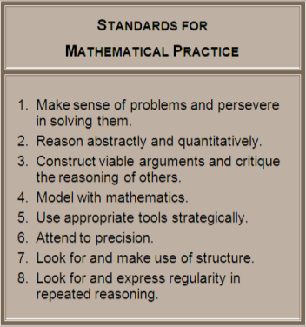
Fractions Progression and the Standards for Mathematical Practice
Visual representations and modeling help students:
Understand
Communicate
Problem Solve
10
Massachusetts Department of Elementary and Secondary Education
Notes:
Another major shift in the 2011 Standards is rigor which can be found in both the content standards and the Standards for Mathematical Practice (MP). At the beginning of each grade level a short hand version of MPs are listed to remind us that they should be an integral part of students mathematical education from prek to 12. A longer description of the MPs can be found in the Massachusetts Curriculum Framework for Mathematics beginning on page 15. The Standards for Mathematical Practice increase the rigor of the content standards in several ways. By creating visual models to “make sense of problems” students develop a deep understanding of the math. By asking students to support their “viable arguments or the reasoning of others” with models, the level of rigor is raised. As you can see, the math practices lend themselves to deeper problem solving. Throughout this presentation you will see both the content and practice standards listed with math problems. Please note that many rich problems lend themselves to multiple math practices and we have only selected one to focus on in each problem.
10
Massachusetts Department of Elementary and Secondary Education

Slide 11
Visual Models in the New Standards, an Example
4.NF.1 Explain why a fraction a/b is equivalent to a fraction (n × a)/(n × b) by using visual fraction models, with attention to how the number and size of the parts differ even though the two fractions themselves are the same size. Use this principle to recognize and generate equivalent fractions.
11
Notes:
Another major shift in the standards is Clarity. For the purpose of this slide, we have bolded the phrase “visual fraction model” to demonstrate how it is explicitly stated in the standard.

Slide 12
Visual Models in the New Standards
3.NF1. | 4.NF 5.
3.NF2 a. number line diagram | 4.NF 6. For example… a number line diagram.
3.NF2 b. number line diagram | 4.NF 7. e.g., by using a visual model.
3.NF3. a. number line | Number and Operations—Fractions 5.NF
3.NF3. b. by using a visual fraction model
3.NF3. c. Examples: number line diagram. | 5.NF 1.
3.NF3. d. e.g., by using a visual fraction model. | 5.NF 2. e.g., by using visual fraction models
 | 5.NF 3. e.g., by using visual fraction models
4.NF 1. by using visual fraction models | 5.NF 4. a. For example, use a visual fraction model
4.NF 2. e.g., by using a visual fraction model. | 5.NF 4. b. Find the area of a rectangle with fractional side lengths by tiling it with unit squares 5.NF 5. a.
4.NF 3. a. | 5.NF 5. b.
4.NF 3. b. e.g., by using a visual fraction model. | 5.NF 6. e.g., by using visual fraction models
4.NF 3. c. | 5.NF 7. a. For example…use a visual fraction model
4.NF 3. d. e.g., by using visual fraction models | 5.NF 7. b.For example… use a visual fraction
4.NF 4. a. For example, use a visual fraction model | 5.NF 7. c.e.g., by using visual fraction models
4.NF 4. b. For example, use a visual fraction model
4.NF 4. c. e.g., by using visual fraction models
12
Notes:
All of the fraction standards in grades 3-5 are listed here. In all cases where the use of a visual model was explicitly stated in the standards, that language is included on this chart. As you can see, almost all of the fraction standards for grades 3-5 explicitly mention the use of “a number line diagram” or “a visual fraction model.” In this presentation, we will look at some of these visual models.

Slide 13
III. Grades One and Two: Partition Shapes
Notes:
In first and second grade, fraction concepts and the vocabulary that supports them are introduced through the Geometry domain.

Slide 14
Building Fraction Language in 1st Grade
1.G.3 Partition circles and rectangles into two and four equal shares, describe the shares using the words halves, fourths, and quarters, and use the phrases half of, fourth of, and quarter of. Describe the whole as two of, or four of the shares. Understand for these examples that decomposing into more equal shares creates smaller shares.
“The circle is composed of 4 fourths or 4 quarters or 4 equal shares.”
“Half of the rectangle is blue.”
Notes:
Starting in first grade, before fractions become a major focus, students are beginning to accurately use the language of fractions such as “halves, fourths, quarters and equal shares.” Students have been composing and decomposing numbers since kindergarten and so it is appropriate for them to discuss composing and decomposing shapes. This introduction to early fraction concepts in the Geometry strand is an example of the way in which coherence has been built into the standards. Please also note the clarity in the standard: the precise vocabulary that students should learn to use with ease is written into the standard. Use precise, language is part of Math Practice 6, Attend to Precision. It states, “Mathematically proficient students try to communicate precisely to others. They try to use clear definitions in discussion with others and in their own reasoning.” Explicit use of precise language is also excellent for language development and provide access for English Language Learners.

Slide 15
Building Fraction Language in 2nd Grade
2.G.3 Partition circles and rectangles into two, three, or four equal shares, describe the shares using the words halves, thirds, half of, a third of, etc., and describe the whole as two halves, three thirds, four fourths. Recognize that equal shares of identical wholes need not have the same shape.
one third
one third
one third
“These squares are all composed of 4 fourths, but the fourths look different.”

Slide 16
IV. Grades Three through Five: Fractions are Critical Areas in these Grades

Slide 17
Third Grade Fraction Critical Area #2
(2) Students develop an understanding of fractions, beginning with unit fractions. Students view fractions in general as being built out of unit fractions, and they use fractions along with visual fraction models to represent parts of a whole. Students understand that the size of a fractional part is relative to the size of the whole. They solve problems that involve comparing fractions by using visual fraction models and strategies based on noticing equal numerators or denominators.
Page 38, Massachusetts Curriculum Framework for Mathematics, March 2011
(bolded for emphasis)
17
Notes:
Two to four critical areas are identified for each grade level in the math curriculum framework. The critical areas bring focus to the instruction for the year. Here you can see that the second critical area in third grade is fractions. Please note that phrases have been bolded for this presentation for emphasis. We will look at visual models of these bolded phrases in the following slides.

Slide 18





3rd Grade: Fractions are Composed of Unit Fractions
3.NF.1, page 41, MP 3, p. 15 Massachusetts Curriculum Framework for Mathematics, March 2011
18
Notes:
Here we bring rigor to the idea of fractions being composed of unit fractions by having students explain the connection between a visual model and an equation.

Slide 19

3rd Grade: Fractions are Composed of Unit Fractions
⁰/4 ¹/4 ²/4 ³/4 ⁴/4 ⁵/4
0 1 2
19
3.NF.2.b., page 41 Massachusetts Curriculum Framework for Mathematics, March 2011
Notes:
Students use “hops” on a number line to add five one-fourths to make five fourths.

Slide 20
3rd Grade: The Importance of Specifying the Size of the Whole
Example 1: What fraction is represented by the yellow area?
20
3.NF.3.d., page 41, MP 7, p.16 Massachusetts Curriculum Framework for Mathematics, March 2011
3-5 Number and Operations--Fractions http://ime.math.arizona.edu/progressions
Project Director: Bill McCallum
Notes:
Quick turn and talk: answer this question.
Please note: this slide does not copy well in black and white

Slide 21
3rd Grade: The Importance of Specifying the Size of the Whole
Example 1: What fraction is represented by the yellow area?
Is this ¾ or 1 ½?
21
3.NF.3.d., page 41, MP 7, p.16 Massachusetts Curriculum Framework for Mathematics, March 2011
3-5 Number and Operations--Fractions http://ime.math.arizona.edu/progressions
Project Director: Bill McCallum

Slide 22
3rd Grade: The Importance of Specifying the Size of the Whole
Example 2: Which is bigger: ½ or ¼?
3.NF.3.d., page 41, MP 7, p.16 Massachusetts Curriculum Framework for Mathematics, March 2011
22
3-5 Number and Operations--Fractions http://ime.math.arizona.edu/progressions
Project Director: Bill McCallum
Notes:
Quick turn and talk: answer this question.
Please note: this slide does not copy well in black and white

Slide 23


3rd Grade: The Importance of Specifying the Size of the Whole
Example 2: Which is bigger: ½ or ¼?
Illuminations
http://illuminations.nctm.org/ActivityDetail.aspx?id=80
23
3.NF.3.d., page 41, MP 7, p.16 Massachusetts Curriculum Framework for Mathematics, March 2011
3-5 Number and Operations--Fractions http://ime.math.arizona.edu/progressions
Project Director: Bill McCallum
Notes:
Please note: this slide does not copy well in black and white

Slide 24

3rd Grade: The Importance of Specifying the Size of the Whole
Example 2: Which is bigger: ½ or ¼?
Example 1: What fraction is represented by the yellow area?
Is this ¾ or 1 ½?
Illuminations
http://illuminations.nctm.org/ActivityDetail.aspx?id=80
24
3.NF.3.d., page 41, MP 7, p.16 Massachusetts Curriculum Framework for Mathematics, March 2011
3-5 Number and Operations--Fractions http://ime.math.arizona.edu/progressions
Project Director: Bill McCallum
Notes:
In these two examples, the importance of specifying the whole becomes clear. In the first example, either response could be valid if we do not know what the whole is. In the second example, ¼ in this context is bigger than ½. The graphics for the second example come from the Illuminations website which is a free NCTM (National Council of Teachers of Mathematics) interactive resource. Please also note the link to the 3-5 Number and Operations—Fractions website which illustrates examples of the progression of fractions from 3rd through 5th grade. The project director for the Progressions documents is Bill McCallum, one of the authors of the Common Core. Many of the examples shown in this presentation come from that website.
Please note: this slide does not copy well in black and white

Slide 25
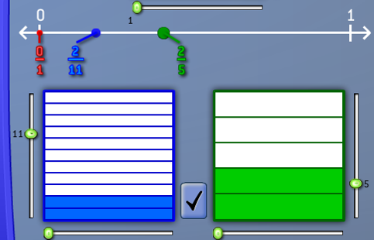
3rd Grade: Comparing Fractions with Like Numerators
25
3.NF.3.a, page 41, MP3. p.15 Massachusetts Curriculum Framework for Mathematics, March 2011
Illuminations
http://illuminations.nctm.org/ActivityDetail.aspx?id=80
Notes:
This example also comes from the Illuminations website. A feature of this activity that adds rigor is that it connects the representation of the fraction on a number line to the representation on a tape diagram. Students can explain that 2/5 is greater than 2/11 because more of the shape is filled in. They can also explain on the number line that 2/5 is greater because it is further to the right.

Slide 26
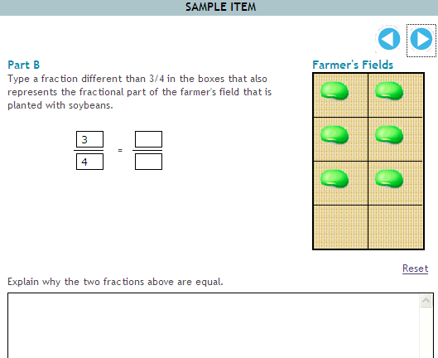
3rd Grade PARCC Prototype Item
3.NF.1, page 41, MP 2, MP7 p. 15 Massachusetts Curriculum Framework for Mathematics, March 2011
PARCC Prototype Item http://www.parcconline.org/samples/item-task-prototypes
Notes:
The prototypes for the new Partner for Assessment of College and Career Readiness (PARCC) assessments reflect the focus on visual representations in the new standards. Here is a sample third grade PARCC prototype item using technology. In Part A, students are told: “A farmer plants 3/4 of the field with soybeans. Drag the soybean to the field as many times as needed to show the fraction of the field that is planted with soybeans.” The soybeans represented above are one possible configuration. (There are 28 possible ways to drag 6 soybeans into a grid of 8 squares. All are acceptable.) In Part B, students are asked to “type a fraction different from ¾” that “also represents the fractional part of the farmer’s field that is planted with soybeans.” They are then asked to explain why the two fractions are equal. Please note that this task calls for students to reason abstractly and quantitatively (Math Practice 2) and to look for and make use of structure (MP7).

Slide 27
Fourth Grade Fraction Critical Area #2
(2)Students develop understanding of fraction equivalence and operations with fractions. They recognize that two different fractions can be equal (e.g., 15/9 = 5/3), and they develop methods for generating and recognizing equivalent fractions. Students extend previous understandings about how fractions are built from unit fractions, composing fractions from unit fractions, decomposing fractions into unit fractions, and using the meaning of fractions and the meaning of multiplication to multiply a fraction by a whole number.
Page 43, Massachusetts Curriculum Framework for Mathematics, March 2011
(bolded for emphasis)
27
Notes:
In fourth grade the second critical area is also about fractions. On the following slides, you will see visual models intended to help students recognize equivalent fractions and use the meaning of fractions and of multiplication to multiplying a fraction by a whole number.

Slide 28

4th Grade: Using the Area Model to Show Equivalence
2
4 X 2
8
=
=
3
4 X 3
12
4.NF.1, page 46, MP 7, p. 16 Massachusetts Curriculum Framework for Mathematics, March 2011
28
Illuminations http://illuminations.nctm.org/ActivityDetail.aspx?id=80
Notes:
This visual model also comes from the Illuminations website. Students can see that the green representation on the right has shaded as much of the rectangle as the blue representation on the left. The green representation has simply been divided into a greater number of pieces. Students are not memorizing a procedure to multiply the numerator and the denominator by the same number, they are being given an opportunity to generate their own method for finding equivalent fractions. Students need multiple opportunities to experience equivalent fractions with visual models. As you will see in the fifth grade section, equivalence is a key concept that is built upon later on.

Slide 29


4th Grade: Using a Number Line to Multiply a Unit Fraction by a Whole Number
0/8 1/8 2/8 3/8 4/8 5/8 6/8 7/8 8/8 9/8 10/8 11/8 12/8 13/8 14/8 15/8 16/8
0 1 2
29
4.NF.3.b, page 46, MP. 7, p.16 Massachusetts Curriculum Framework for Mathematics, March 2011
Notes:
Students are building on their knowledge from whole numbers that multiplication can be solved by repeat addition. They are using the visual model of a number line to connect their understanding of multiplication to their understanding of fractions. Being able to show how the visual model and the equation are connected increases the rigor.

Slide 30
Fifth Grade Fraction Critical Area #1
(1)Students apply their understanding of fractions and fraction models to represent the addition and subtraction of fractions with unlike denominators as equivalent calculations with like denominators. They develop fluency in calculating sums and differences of fractions, and make reasonable estimates of them. Students also use the meaning of fractions, of multiplication and division, and the relationship between multiplication and division to understand and explain why the procedures for multiplying and dividing fractions make sense. (Note: this is limited to the case of dividing unit fractions by whole numbers and whole numbers by unit fractions.)
Page 48, Massachusetts Curriculum Framework for Mathematics, March 2011
(bolded for emphasis)
30
Notes:
In fifth grade, the first critical area is fractions. You will notice that now all of the time invested in fourth grade in gaining a deep understanding of equivalent fractions should pay off. Students will use this understanding to add and subtract fractions with unlike denominators. Students will also focus on explaining why procedures for multiplying and dividing fractions make sense.

Slide 31

5th Grade Adding Fractions with Unlike Denominators by Replacing them with Equivalent Fractions
31
5.NF.2, page 50 Massachusetts Curriculum Framework for Mathematics, March 2011
Based on “Fraction Bars” activity found in the National Library of Virtual Manipulatives http://nlvm.usu.edu/en/nav/topic_t_1.html
Notes:
If students have a strong understanding of equivalent fractions, they know that 3/4 is equivalent to 9/12. They do not need to learn a procedure to find the common denominator. They can find equivalent fractions that have the same denominator.

Slide 32
5th Grade Adding Fractions with Unlike Denominators by Replacing them with Equivalent Fractions
Checking work with a tape diagram and number line
2
3
0 1 2 3 4 5 6 7 8 9 10 11 12 13 14 15 16 17 18 19 20 21
12 12 12 12 12 12 12 12 12 12 12 12 12 12 12 12 12 12 12 12 12 12
5.NF.2, page 50 Massachusetts Curriculum Framework for Mathematics, March 201
Based on “Fraction Bars” activity found in the National Library of Virtual Manipulatives http://nlvm.usu.edu/en/nav/topic_t_1.html
Notes:
They can check their work with a tape diagram. Here we can see that 2/3 equals 8/12.

Slide 33
5th Grade Adding Fractions with Unlike Denominators by Replacing them with Equivalent Fractions
Checking work with a tape diagram and number line
2
3
0 1 2 3 4 5 6 7 8 9 10 11 12 13 14 15 16 17 18 19 20 21
12 12 12 12 12 12 12 12 12 12 12 12 12 12 12 12 12 12 12 12 12 12
2
3
3
4
0 1 2 3 4 5 6 7 8 9 10 11 12 13 14 15 16 17 18 19 20 21
12 12 12 12 12 12 12 12 12 12 12 12 12 12 12 12 12 12 12 12 12 12
33
5.NF.2, page 50 Massachusetts Curriculum Framework for Mathematics, March 2011
Based on “Fraction Bars” activity found in the National Library of Virtual Manipulatives http://nlvm.usu.edu/en/nav/topic_t_1.html
Notes:
In the new standards the focus is on being able to find a common denominator, not on finding the least common denominator. This example is based on an interactive activity to practice adding fractions using a tape diagram on the National Library of Virtual Manipulatives website.

Slide 34
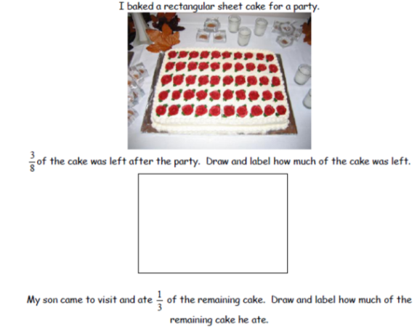
5th Grade: A Context for Multiplication of Fractions
5.NF.4, page 51, MP 2, 4, p 15 Massachusetts Curriculum Framework for Mathematics, March 2011
Math Learning Community Materials Session 13 http://www.doe.mass.edu/omste/instructional.html
Notes:
When performing operations on fractions, it is important to provide a context for students. In this example, 3/8 of the cake is available after the party and 1/3 of that was eaten. This example comes from one of fifteen Math Learning Community sessions available on the ESE website. The materials support productive use of common teacher planning time through establishment and development of a professional learning community with a focus on looking at student work. The sessions are aligned to the new frameworks and several of them focus specifically on fraction concepts.
Note: The words for this problem may be difficult read, you may want to read them aloud. A handout sheet is also attached to this presentation. If time allows, participants could solve this problems and discuss their solutions.

Slide 35
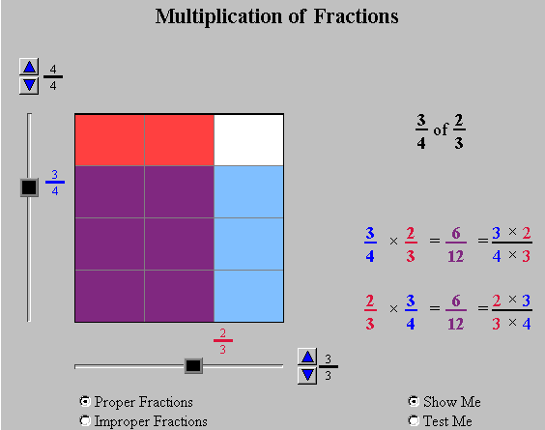
5th Grade: Multiplying Fractions using the Area Model
35
5.NF.4.b, page 51, MP 7 Massachusetts Curriculum Framework for Mathematics, March 2011
National Library of Virtual Manipulatives http://nlvm.usu.edu/en/nav/frames_asid_194_g_2_t_1.html?from=topic_t_1.html
Notes:
The National Library of Virtual Manipulatives has a nice interactive activity for using the area model to multiply fractions. In this image we are finding 3/4 of 2/3. The 2/3 are represented by the two red vertical strips. The ¾ is represented by the 3 horizontal blue strips. The purple pieces show the over lap. 6 of the total 12 pieces are purple.

Slide 36
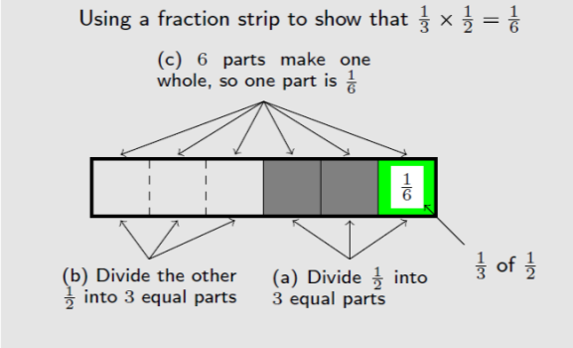
5th Grade: Multiplying Fractions using a Tape Diagram
36
5.NF.4.a, page 51 Massachusetts Curriculum Framework for Mathematics, March 2011
3-5 Number and Operations--Fractions http://ime.math.arizona.edu/progressions
Project Director: Bill McCallum
Notes:
Students are now able to use the tape diagram (or fraction strip) to multiply fractions. This image comes from Bill McCallum’s 3-5 fraction progression and illustrates the idea that 1/3 X ½ means 1/3 of 1/2. In part a) the students are finding ½ of the whole. In part b) they are finding 1/3 of the ½. It is important to remember the whole (all 6 parts) when determining what one piece equals.

Slide 37
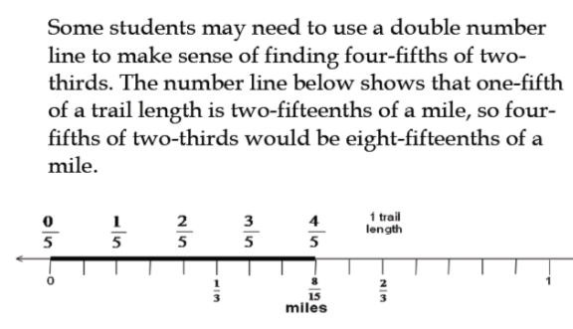
5th Grade: Multiplying Fractions using a Double Number Line
37
5.NF.4.b., page 51, MP 2 p.15 Massachusetts Curriculum Framework for Mathematics, March 2011
Rational Numbers Project
http://www.cehd.umn.edu/ci/rationalnumberproject/RNP2/Lesson24.pdf
Notes:
Optional Slide: This double number line comes from an exercise in the Rational Numbers Project. The context for the equation is: “Hannah hikes along the Nature Trail at Mud Lake. The trail is 2/3 of a mile. She hikes 4/5 of the trail before she stops to take a picture of a hummingbird with her high speed Leica camera. How many miles did she hike before taking the picture?”
In this case, the double number line is most useful in helping students make sense of the algorithm. One of the tricky aspects of the double number line is that students must be able to make sure that they are using evenly spaced markers.
Note to facilitator: If time allows, you might want to have participants try creating their own double number line to solve this problem. They may solve the problem like this: The number line is first partitioned into thirds. The two thirds is then divided into five fifths. Students might see that the fifths need to be cut in half to fall evenly on the 1/3 marker. If they place all of these evenly spaced markers along the number line to 1 they will see that they have divided the line into fifteenths. They might also use their knowledge of equivalent fractions to notice that 1/3 is the same as 5/15 and the marker that coincides with the 4/5 is at 8/15.

Slide 38
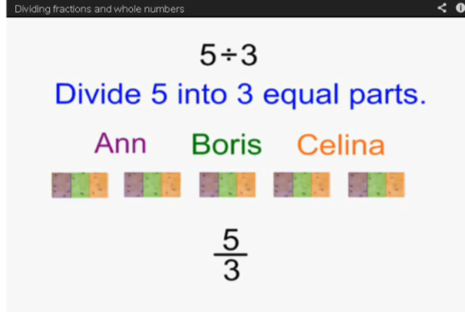
5th Grade: Relationship Between Division and Fractions
5.NF.3, page 51 Massachusetts Curriculum Framework for Mathematics, March 2011
Illustrative Mathematics http://www.illustrativemathematics.org/pages/fractions_progression
Notes:
The following illustration comes from a series of short videos for teachers in the Fractions Progression Module on the Illustrative Mathematics website. It shows why 5 divided by 3 equals 5/3. This is another foundational concept. There are five crackers, being shared between 3 people. Each person gets 1/3 of a cracker or 5/3 in all. Therefore, 5 divided by three equals 5/3.

Slide 39
V. Grade Six: Dividing Fractions by Fractions and connecting Fractions to Ratios and Proportional Relationships

Slide 40
Sixth Grade
6.NS.1 Interpret and compute quotients of fractions, and solve word problems involving division of fractions by fractions, e.g., by using visual fraction models and equations to represent the problem.
Notes:
In Sixth grade, there is one fraction standard in “The Number System” domain.

Slide 41
Turn and Talk
Create a context for this problem. Then solve the problem by using a visual model.
^{1 ¾} ÷ ^{½}
6.NS.1, page 55, MP 2,3, 4 p.15 Massachusetts Curriculum Framework for Mathematics, March 2011
Based on a discussion from p. 55 Liping Ma Knowing and Teaching Elementary Mathematics
Notes:
Think about a real world context that this problem might represent.
Participants can share their solutions. It is helpful to have a way share their visual models with the whole group. You might use a document camera or have them draw it on the board or on chart paper.
Possible context: I have 1 ¾ of a feet of ribbon. I need to cut the ribbon into ½ foot strips. How many strips will I have?
On the following slides, we have provided possible visual solutions to this context.

Slide 42
Some possible solutions
1 foot of ribbon
¾ foot ribbon
    1 ¾
½
Notes:
1 ¾ feet of ribbon are represented here.

Slide 43

Some possible solutions
½ foot of ribbon
1 half-foot strip
^{1¾} ÷ ½
Notes:
½ a foot strip of ribbon is cut from the 1 ¾ feet of ribbon. We want to count how many half-foot strips we can cut from the 1¾ feet.

Slide 44
Some possible solutions
½ foot of ribbon
½ foot of ribbon
1 half-foot strip
1 half-foot strip
^{1¾} ÷ ½
Notes:
Now we have cut 2 half-foot strips.

Slide 45
Some possible solutions
½ foot of ribbon
½ foot of ribbon
½ foot of ribbon
1 half-foot strip
1 half-foot strip
1 half-foot strip
1 ¾ ÷ ½
Notes:
Now we have used 3 half feet strips.
The tricky part is to know how to count the remaining section of ribbon. It is half of a strip.

Slide 46
Some possible solutions
½ foot of ribbon
½ foot of ribbon
½ foot of ribbon
¼ foot ribbon
1 half-foot strip
1 half-foot strip
1 half-foot strip
½ half- foot strip
1 ¾ ÷ ½ = 3 ½
Notes:
We have used 3 ½ “half-feet strips.” 3 ½ is our solution.
Please note: there are a few common misconceptions with division of fractions that might be surfaced by doing this problem.
Misconception #1: division always results in a smaller number. (By counting each half-foot strip of ribbon, participants will focus on how many times the ½ foot strip of ribbon is subtracted from the 1 ¾ feet of ribbon. If they focus on repeated subtraction, they can see that by counting the number of times you need to subtract, you will end up with a larger number.)
Misconception #2: the final piece should be ¼ because it is half of a half of a foot of ribbon. (Again, but focusing on counting the number of times the strip is being subtracted, rather than on the size of the pieces, this confusion should be eliminated.)

Slide 47
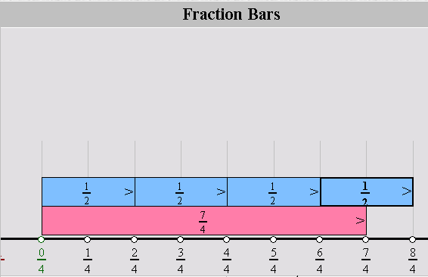
Some possible solutions
National Library of Virtual Manipulatives http://nlvm.usu.edu/en/nav/frames_asid_265_g_3_t_1.html?open=activities&from=category_g_3_t_1.html
Notes:
Here is another representation using tape diagrams and a number line from the Library of Virtual Manipulatives. Again, you can see that the pink bar can be divided into 3 ½ blue bars. Note that 0 is shown as 0/4, 1 ¾ is shown as 7/4 and 2 is shown as 8/4 in the fraction bar visual.

Slide 48
Sixth Grade Ratio and Proportional Reasoning Critical Area # 1
(1) Students use reasoning about multiplication and division to solve ratio and rate problems about quantities. By viewing equivalent ratios and rates as deriving from, and extending, pairs of rows (or columns) in the multiplication table, and by analyzing simple drawings that indicate the relative size of quantities, students connect their understanding of multiplication and division with ratios and rates. Thus students expand the scope of problems for which they can use multiplication and division to solve problems, and they connect ratios and fractions. Students solve a wide variety of problems involving ratios and rates.
Page 53, Massachusetts Curriculum Framework for Mathematics, March 2011
(bolded for emphasis)
48
Notes:
In 6th grade, the critical area of focus is now ratios, rates and proportionality and how they connect to fractions.

Slide 49
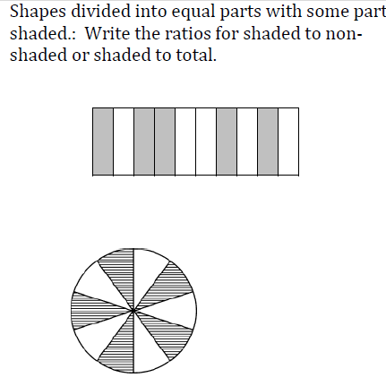
6th Grade Part-to-Whole to Part-to-Part
6.RP.1, page 55, MP 7, p 16 Massachusetts Curriculum Framework for Mathematics, March 2011
Ratios and Rates Grade 6 Mathematics Model Curriculum Unit
http://www.doe.mass.edu/candi/model/sample.html
Notes:
In sixth grade, students transition from thinking about part-to-whole relationships (5/10 of the bars are shaded) to part-to-part relationships (the bars are shaded at a ratio of 5 shaded to 5 unshaded). This shift in thinking can cause quite a bit of confusion for students and it is important for teachers to be aware that the students are coming from a part-to-whole mind-set in order to help them see how ratios are different. This example comes from the draft of the Grade 6 Mathematics Ratios and Rates Model Curriculum Unit available on the ESE website.

Slide 50
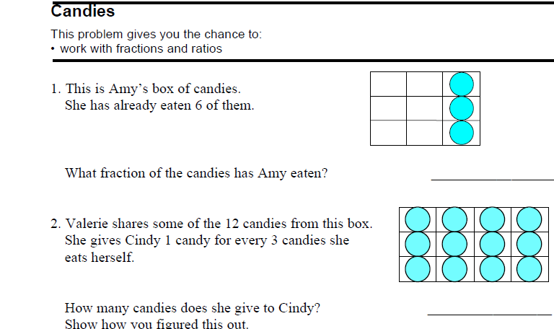
6th Grade Part-to-Whole to Part-to-Part
50
6.RP.1, page 55 Massachusetts Curriculum Framework for Mathematics, March 2011
Noyce Foundation and Inside Mathematics: http://www.insidemathematics.org/index.php/classroom-video-visits/public-lessons-proportions-a-ratios
Notes:
Look at this MARS Task from the Inside Mathematics Website. Turn and Talk: How are these two problems similar and different?
Some possible thoughts: In the first problem, Amy has eaten 6 of the 9 candies. In the second problem, Valerie is distributing candies for herself and Cindy. We still know the whole amount, but we are starting to look at a 1 to 3 ratio. Students may see the boxes of candies as resembling an array and are able to use this knowledge to find equivalent ratios. (Even before they know that they are ratios.)

Slide 51
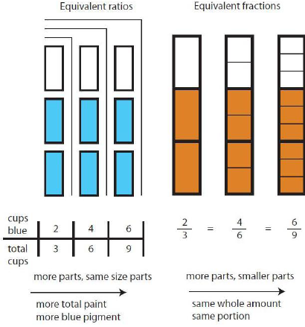
6th Grade: Equivalent Ratios vs. Fractions
6.RP.1, page 55 Massachusetts Curriculum Framework for Mathematics, March 2011
51
6-7, Ratios and Proportional Relationships http://ime.math.arizona.edu/progressions
Project Director: Bill McCallum
Notes:
This image comes from Bill McCallum’s Ratios and Proportional Relationships Progression. It illustrates an important difference between equivalent fractions and equivalent ratios. The illustration on the left is showing paint pigment. The ratio is two cups of blue paint to a total of three cups of paint. You will notice that if you increase to 4 cups of paint, you will need to increase the cups of white paint to maintain the pigment and will therefore increase the total number of cups. The size of the parts stays the same and the total increases. The image on the left, on the other hand, shows a fraction of two thirds. To find an equivalent fraction of 4/6, the whole stays the same, but it is divided into smaller parts. This is an important distinction between ratios and fractions and is clearer with a visual representation.

Slide 52

6th Grade: Tape Diagrams
Apple-Grape Juice
6.RP.1, page 55 Massachusetts Curriculum Framework for Mathematics, March 2011
6-7, Ratios and Proportional Relationships http://ime.math.arizona.edu/progressions
Project Director: Bill McCallum
Notes:
Students can continue to use familiar representations such as tape diagrams in 6th grade, but now they are using them to compare ratios and develop an understanding of proportional relationships. This diagram can be interpreted as representing any mixture of apple juice and grape juice with a ratio of 3 to 2. The total amount of juice is represented as partitioned into 5 parts of equal size, represented by 5 rectangles. For example, if the diagram represents 5 cups of juice mixture, then each of these rectangles represents 1 cup. If the total amount of juice mixture is 1 gallon, then each part represents 1/5 gallon and there are 3/5 gallon of apple juice and 2/5 gallon of grape juice.

Slide 53
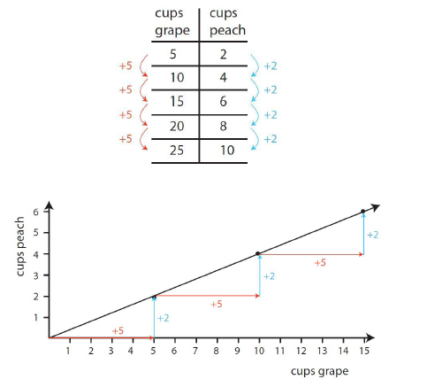
6th Grade: Visual Representation of Proportional Relationship
6.EE.9, page 57, MP 4 p. 16 Massachusetts Curriculum Framework for Mathematics, March 2011
6-7, Ratios and Proportional Relationships http://ime.math.arizona.edu/progressions
Project Director: Bill McCallum
Notes:
In sixth grade, students now learn to model ratio and proportional relationships by creating ratio tables and corresponding graphs. In seventh grade they will learn that the unit rate is the slope of a line.

Slide 54
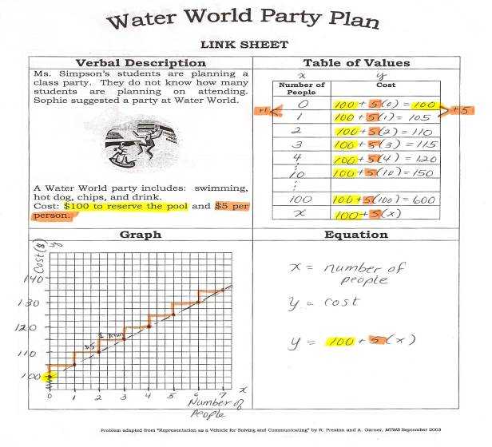
6th Grade and Beyond: Multiple Representations
54
PD Offering: Increasing Accessibility to Algebra and Geometry for ALL Students http://www.doe.mass.edu/apa/sss/support/development.html?section=MATH
Notes:
This Water World Party Plan worksheet comes from a PD offering for teachers of grades 5-10 called Increasing Accessibility to Algebra and Geometry for all Students.
Please note: You may want to pass out a hard copy of this slide so that that participants can more easily read it. A blank copy has also been attached to the handouts if you want to extend the activity and have participants solve it.
This sheet allows students to access a problem through multiple representations. Some students may start with an equation, others might start with the table. No matter where they start though, they are expected to represent the verbal description using a table of values, a graph and an equation. The rigor and their conceptual understanding is increased by having them draw connections between the four representations using orange and yellow highlighting. In this example, “$5 per person” is highlighted in orange on the verbal representation. The 5 is shown in the table of values in orange as well. It becomes the slope on the graph and equation and is shown in orange there as well. This particular example does not start at the origin, so it is in fact beyond the sixth grade standard, but could easily be adapted for sixth grade.

Slide 55
6th Grade PARCC Prototype Item
6.RP.3.a page 55, MP 4, p. 16 Massachusetts Curriculum Framework for Mathematics, March 2011
PARCC Prototype Item http://www.parcconline.org/samples/item-task-prototypes
Notes:
Here is a sample a sixth grade PARCC prototype item. Notice that again, students need to be comfortable with multiple representations in order to compare the rate of miles to a gallon driven.
Note to facilitator: If time allows, you might want to have participants solve this problem.

Slide 56
Turn and Talk
Reflect on the visual models you have looked at today. Which ones do you plan to use at the grade level(s) you teach? Why?
56

Slide 57
Websites
ESE: MLC http://www.doe.mass.edu/omste/instructional.html
ESE: Model Curriculum Units http://www.doe.mass.edu/candi/model/sample.html
ESE : Professional Development Institutes: http://www.doe.mass.edu/candi/institutes/
Illuminations http://illuminations.nctm.org/
Illustrative Mathematics http://www.illustrativemathematics.org/
Inside Mathematics http://www.insidemathematics.org/
Library of Virtual Manipulatives http://nlvm.usu.edu/en/nav/grade_g_2.html
PARCC http://www.parcconline.org/
Progressions Documents for the CC Standards http://ime.math.arizona.edu/progressions/
Rational Numbers Project http://www.cehd.umn.edu/ci/rationalnumberproject/

Slide 58

Questions?

