Slide 1
Transitioning to the 2016 Science and Technology/Engineering (STE) Curriculum Framework

Slide 2
Understanding the Vision and Goals of the Massachusetts STE Standards

Slide 3
Turn and Talk: How are these words related to your current science program/curriculum?
Relevance
Rigor
Coherence
Engagement
Notes:
The Vision for the MA 2016 STE standards are built on these core ideas –relevance, rigor, coherence and engagement.

Slide 4
Vision Interactive
Read the MA STE Vision pages 3-6 of the 2016 STE Framework
Identify a key sentence or phrase that you think is particularly important for your work.
What is one message you will take away?
Notes:
Print the Vision document of the Framework pages 3-6 (stop at Key features middle of pg. 6). Debrief by asking educators to share a key phrase or message that resonated with them and/or where they see themselves and their instruction with the 2016 STE vision.

Slide 5
Goals for STE education
Civic Participation – Informing real world decisions and solving problems
College Preparation – Developing a deep understanding of concepts and practices
Career Readiness – Engaging in the scientific and technical reasoning required by many fields
5
Notes:
The larger goals for science education nationally are translated into some slightly more specific goals for MA Science Education

Slide 6
Emphasis in 2016 STE Standards | Implication for Curriculum & Instruction
Relevance: Organized around core explanatory ideas that explain the world around us | The goal of teaching needs to shift from facts and concepts to explaining phenomena
Rigor: Central role for science and engineering practices with concepts | Inquiry- and design-based learning involves regular engagement with practices to build, use, and apply knowledge
Coherence: ideas and practices build over time and among disciplines | Teaching involves building a coherent storyline over time and among disciplines
Notes:
This slide can be used to highlight the shifts with curriculum and instruction to emphasize Relevance, Rigor, and Coherence

Slide 7
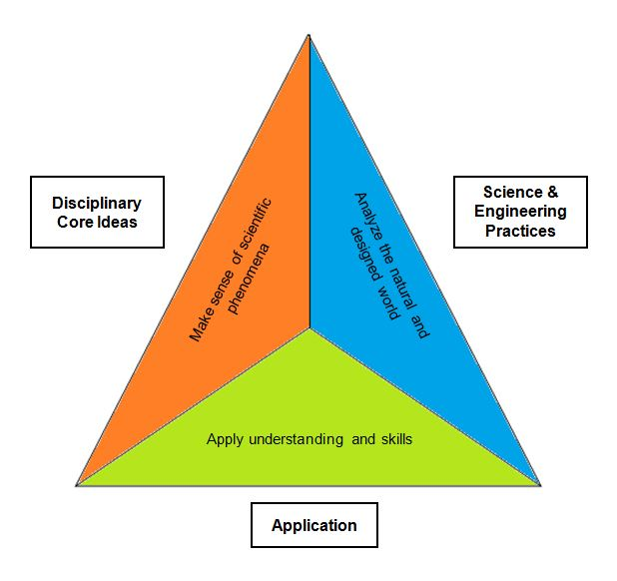
Rigor: The balance of Concepts, Practices and Applications
Notes:
Graphic depicts the balance the STE standards put forth and emphasizes the key vision for 2016 MA STE standards-- that students will understand the disciplinary core ideas and science & engineering practices and be able to apply their understanding of these to relevant real world issues

Slide 8
Blending Science, Engineering, & Technology
Science
Engineering
Technology
Understands natural world
Needs new tools for discoveries
Designs products and processes to meet needs
Uses science discoveries
Result of engineering
Created to solve needs and wants
Interconnectedness – Aspects of each discipline play a role in helping explain and connect concepts and applications.
Science answers questions using technology for experiments and observations that engineers have created.
8
Notes:
For example, scientists use the technologies that engineers create (such as microscopes, monitors, and meters) to conduct their research. And when engineers start to design a new technology, they call on the knowledge of the natural world developed by scientists (for example, the law of gravity or how fluid flows.) Engineering, science, and technology connect to—and influence—each other. - http://eie.org/overview/science-engineering-technology

Slide 9
Framework Components

Slide 10
Aspirations for MA 2016 Standards originated from A Framework for K-12 Science Education
Successful students will:
Have an appreciation for the beauty & wonder of science
Gain knowledge to engage in public discussion
Become analytical consumers of scientific technology and information
Develop skills to enter careers in science, technology, or engineering
10
Notes:
The MA STE standards were established from this research: A Framework for K- 12 Education, from the National Research Council and the aspirations reflect what students will have attained by the end of their K-12 education with science technology and engineering

Slide 11
2016 STE Framework Components
A Vision of STE Education
Guiding Principles for Effective STE Education
STE Standards
Science and Engineering Practices Progression Matrix
Value of Language, Literacy, & Math for STE Learning for All
Disciplinary Core Idea Progression Matrix
Strand Maps of STE Standards
The Case for an Integrated Approach for Pre-K-8
Importance of Science and Engineering in Early Education
Science and Technology/Engineering Laboratories
Value of Crosscutting Concepts and Nature of Science in Curriculum
Relevant Contexts for Teaching STE
The Value of Out of School Time Programming
Safety Practices and Legal Requirements
Dissection and Dissection Alternatives
Notes:
All framework documents can be downloaded as individual documents and give guidance to teachers and districts

Slide 12
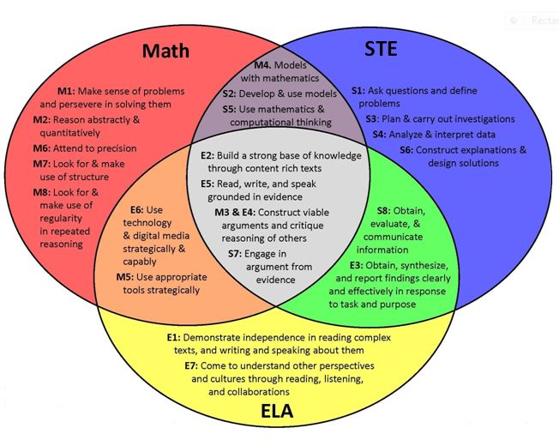
Relationships of disciplinary practices across content
12
Notes:
Graphic developed at Stanford University to highlight the overlapping nature of the ELA, Math & STE practices

Slide 13
Overview of the Standards

Slide 14
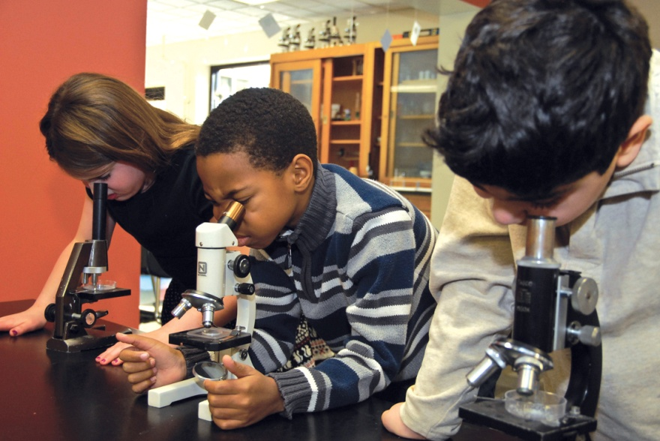
Key innovations for MA
Explain phenomena & apply concepts
Practices & core ideas
Coherent progressions of learning
PreK-8 grade-by-grade standards
14
www.nymetroparents.com/fairfield/article/Hamden-Hall-Country-Day-School-in-CT-Hosts-Engineering-Workshop-for-Elementary-Teachers#.VFo0pGewWTE

Slide 15
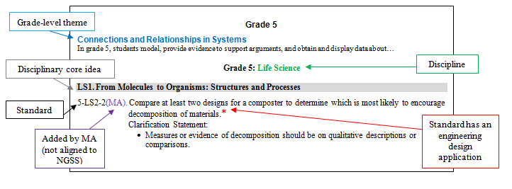
Structural Features of the Standards

Slide 16
What an STE standard looks like Early Elementary
ESS3. Earth and Human Activity
K-ESS3-3. Communicate solutions to reduce the amount of natural resources an individual uses.* Clarification Statement: Examples of solutions could include reusing paper to reduce the number of trees cut down and recycling cans and bottles to reduce the amount of plastic or metal used.
Asterisk (*) at the end of some standards designates those standards that have an engineering design application.
Articulates expected performance/demonstration
Does not limit curriculum and instruction to the included practice
Notes:
Make sure to distinguish the practice (red) from content (blue). Also highlight that ESS3 Earth and Human Activity is a new topic in the standards.

Slide 17
What an STE standard looks like Upper Elementary
PS4. Waves and Their Applications in Technologies for Information Transfer
4-PS4-1. Develop a model of a simple mechanical wave (including sound) to communicate that waves (a) are regular patterns of motion along which energy travels and (b) can cause objects to move. Clarification Statement: Examples of models could include diagrams, analogies, and physical models. State Assessment Boundary: Interference effects, electromagnetic waves, or non-periodic waves are not expected in state assessment.
Articulates expected performance/demonstration
Does not limit curriculum and instruction to the included practice
Notes:
Make sure to distinguish the practice (red) from content (blue). Also highlight that PS4 is a new topic in the standards.

Slide 18
What an STE standard looks like Middle School
LS2. Ecosystems: Interactions, Energy, and Dynamics
7.MS-LS2-5. Evaluate competing design solutions for protecting an ecosystem. Discuss benefits and limitations of each design.* Clarification Statements: Examples of design solutions could include water, land, and species protection, and the prevention of soil erosion. Examples of design solution constraints could include scientific, economic, and social considerations.
asterisk (*) at the end of some standards designates those standards that have an engineering design application.
Articulates expected performance/demonstration
Does not limit curriculum and instruction to the included practice
Notes:
Highlights- numbering system in MA is NGSS system except that MA Standards are broken out into grade by grade standards that were grade span in NGSS. 7 Middle School LS2 Life Science Domain Ecosystems. Practice is red, clarifications are examples and assessment boundary won’t be tested.

Slide 19
What an STE standard looks like High School
PS2. Motion and Stability: Forces and Interactions
HS-PS2-5. Provide evidence that an electric current can produce a magnetic field and that a changing magnetic field can produce an electric current. Clarification Statements: Examples of evidence can include movement of a magnetic compass when placed in the vicinity of a current-carrying wire, and a magnet passing through a coil that turns on the light of a Faraday flashlight. State Assessment Boundary: Explanations of motors of generators are not expected on state assessment.
Articulates expected performance/demonstration
Does not limit curriculum and instruction to the included practice
Notes:
Make sure to distinguish the practice (red) from content (blue).

Slide 20
PreK- 8 Standards now include:
Earth and Space Science
Life Science (Biology)
Physical Science (Chemistry and Physics)
Technology/Engineering
Districts may provide a context or specific focus:
Robotics
Marine Ecology
Biotechnology
Computer Science
Notes:
Each grade includes the four disciplines of STE and districts can choose to address the standards with a context that may be relevant for their community or needs of their students. High School standards are broken into 5 courses of study: Earth and Space Science, Life Science, Chemistry, Physics and Tech/eng

Slide 21
PreK-8 grade-by-grade standards
Grade-specific standards support:
Collaboration and sharing across districts on curriculum and resources
Consistency when students move schools/districts
Standards are appropriate for students of each grade
All 4 disciplines in each grade encourage integrated curriculum
Notes:
Massachusetts adopted grade by grade standards because of inconsistency when students transfer districts or within a district. research found that many students had gaps in their science education due to the fact that the former standards were grade band standards

Slide 22
Key take aways
The standards are the outcomes of learning that students can demonstrate
what they know
what they are able to do
A lesson may include one or more practices.
By the end of the unit or year, students should have multiple opportunities to apply a number of practices.
STE standards guide teaching and learning.
Notes:
Main shifts in the standards. Practices are generalizable and students will experience multiple practices within a unit and lessons

Slide 23
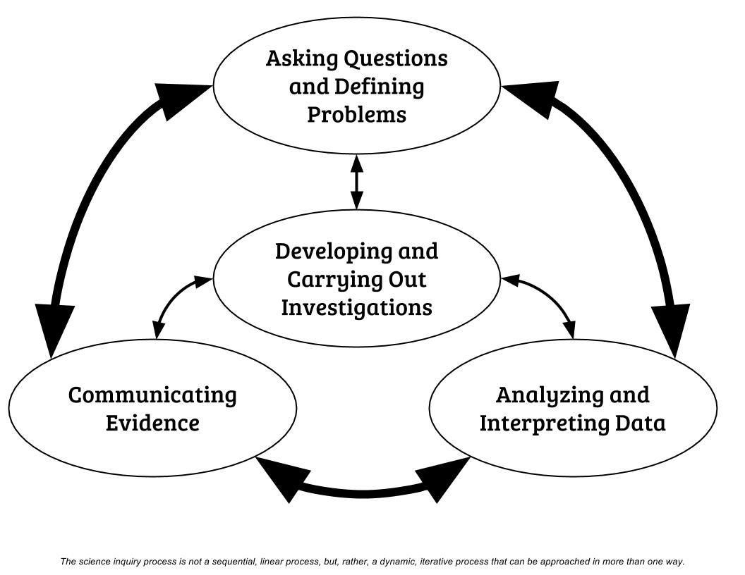
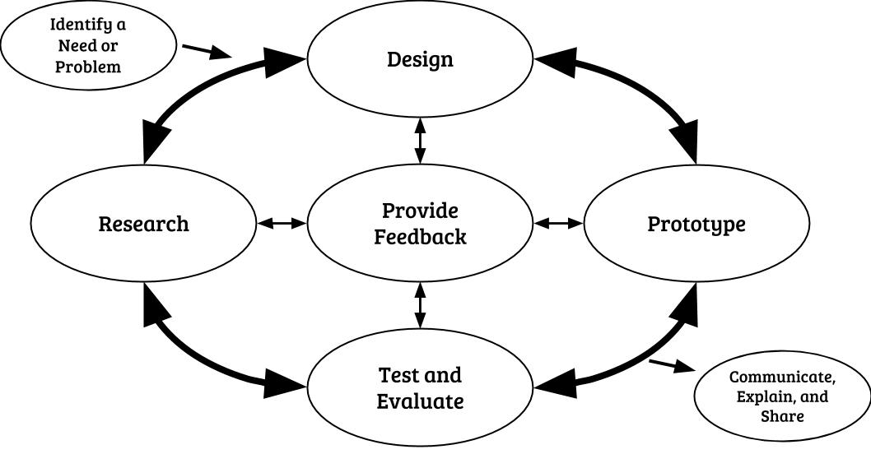
Scientific Inquiry
Engineering Design
2016 Massachusetts Science and Technology/Engineering Curriculum Framework
Appendix 1: Science and Engineering Practices Progression Matrix
Notes:
Two new designs for the process of doing science and engineering. The state is encouraging educators to use this cycle of scientific inquiry and design and to move away from the more linear “scientific method” Consider what might happen if you first started by looking at data…where could you go from there?

Slide 24
Science and Engineering Practices
Asking questions (for science) and defining problems (for engineering)
Developing and using models
Planning and carrying out investigations
Analyzing and interpreting data
Using mathematics and computational thinking
Constructing explanations (for science) and designing solutions (for engineering)
Engaging in argument from evidence
Obtaining, evaluating, and communicating information
24
Notes:
These are the 8 practices that are embedded within the STE standards. The practices are active and require students to demonstrate what they know and will be able to do with their understanding of the science core ideas (which have not changed over the years)

Slide 25
Science and Engineering Practices
Pick a Standard and Brainstorm with group:
What does this practice look like in the classroom? What will students be doing?
How will students demonstrate their understanding of this practice?
Record ideas for both questions
Notes:
Activity to do with educators

Slide 26
Resources

Slide 27
Transition Resources
FAQ
Science Ambassadors
Crosswalk 2001/2006 to 2016 Standards
Strand Maps
STE Model Curriculum Units
What to Look for guides
Quality Review Rubric for evaluating curriculum
All resources accessed at:
www.doe.mass.edu/stem/review.html
Notes:
Crosswalk document illustrates the overlapping standards from 2001/06 to 2016 and are very useful for reviewing curriculum and science resources in your district. Strand maps show the PreK- 12 progression of learning

Slide 28
Massachusetts Science Ambassadors are a cadre of effective science educator leaders that are committed to raise awareness and provide information about the MA revised Science Technology Engineering (STE) Standards across the state.
Request an Ambassador: scienceambassadors@doe.mass.edu

Slide 29
PreK-5 STE Model Curriculum Units
Content | Grade | Topic
SCI-ELA | PreK | Content Literacy Science: My Five Senses
SCI | Prek | Sound and Music
SCI-ELA | K | Content Literacy Science: Life Cycles:
SCI | K | Sunlight Warms Earth's Surface
SCI-ELA | 1 | Informational Text, Research, and Inquiry Circles: Animals and Habitats
SCI | 1 | Light and Shadows
SCI-ELA | 2 | Content Literacy Science: Animals Depend on Their Habitats
SCI | 2 | The Effects of Wind and Water Movement on Earth's Landscape
SCI | 2 | Investigating Material Properties
SCI-ELA | 3 | Content Literacy Science - Extreme Weather
SCI | 3 | Effects of Changes in an Environment on the Survival of Organisms
SCI | 4 | Weathering and Erosion
SCI | 5 | Plants Make Their Own Food

Slide 30
6-12 STE Model Curriculum Units
Middle School Science 6-8
SCI | 6 | Causal Patterns in Density
SCI | 6 | Reconstructing Massachusetts Past
SCI | 7 | Invasive Species: A Study of the Disruption of an Ecosystem's Dynamics
SCI | 7 | Thermal Design Challenges
SCI | 7 | Differential Survival of Organisms
SCI | 8 | Shaping Natural Systems through Evolution
High School Science 9-12
SCI | 9-10 | Use of Bioplastics in Food Safety
SCI | 9-12 | The Ocean System

Slide 31
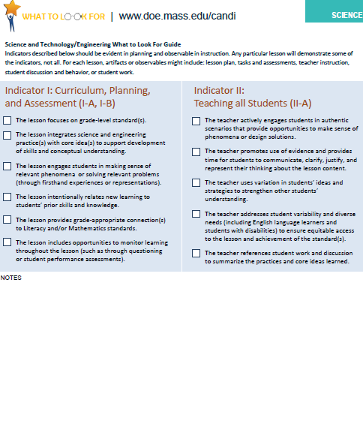
Grades K-8 What to Look For Guides
Notes:
What to look for guides are one page documents that outline and summarize the standards and practices at each grade. DESE also has what to look for guides for Math and ELA K-8

Slide 32
Transition Planning
What will work for your district, teachers and students?
Consider collaborating with nearby districts or grade alike teachers
Likely differences for PK-5, 6-8, 9-12
Analyze transition strategies and lessons learned from Math and ELA implementation
Resources available for school improvement, professional development, and student support can be used for science
Think about the system; how individual grades or teachers contribute to transitioning the system
32
Notes:
Use the Arthur Ashe quote to reassure educators that the transition will be a gradual process…start where you are, use what you have and do what you can!

Slide 33
STE MCAS Transition
 | 2016–17 | 2017–18 | 2018–19 | 2019–20
Grade 5 STE test | Assess 2001/2006 standards* | Assess overlapping standards (2001/2006 and 2016)** | Assess 2016 standards
Grade 8 STE test | Assess 2001/2006 standards* | Assess overlapping standards (2001/2006 and 2016)** | Assess 2016 standards
High School | Assess 2001/2006 standards | Assess 2001/2006 standards | TBD pending BESE discussion/decision | TBD pending BESE discussion/decision
Moving to computer-based testing (The 2017 STE tests will be paper-based.)
Questions? please call 781-338-3625 or send an email to mcas@doe.mass.edu
33
Notes:
Grades 5 and 8 MCAS STE Transition Timeline
*Over the next few months, the Department will provide additional information about the Grades 5 and 8 STE tests, including lists of the 2001/2006 standards that will be assessed on the 2017 tests. The 2017 STE tests will be paper-based.
**Items that will count toward student scores will be based on content that is covered in both the 2001/2006 standards and the 2016 standards. Additional information about which standards are eligible to be assessed in 2018 will be made available by February 2017.
High School MCAS STE Transition
Currently there are four high school STE tests: Biology, Chemistry, Introductory Physics, and Technology/Engineering, that can be taken at grade 9 or 10. The Department has yet to determine which high school STE tests will be included in the testing program going forward.

Slide 34
STE Implementation Support
STE Ambassadors
Raise awareness of 2016 STE Standards
scienceambassadors@doe.mass.edu
Regional District STE Planning Networks
District collaboration to support STE implementation planning
STEDistrictcollaboration@doe.mass.edu
34
Notes:
STE ambassadors will come to your school and present to your teachers with interactives and answer questions.
STE district collaborations has some funding to support multiple (or nearby districts or grade like teams) groups at they plan to transition to the 2016 STE standards. Please email for more information!

Slide 35
Questions?

