Slide 1

MAKING MONEY MATTER
(M³)
Statewide System of Support
April 9, 2019

Slide 2
WELCOME
to the DESE M³ Video Conference

Slide 3
Contents
01
M³ Overview
02
DESE Assistance & Support
CONTENTS
03
Alignment to School Improvement
04
Grant Requirements

Slide 4
Overview
M³ OVERVIEW
01

Slide 5
M³ INCEPTION
Launched in FY17
As part of MA Results Driven Accountability (RDA) initiative
To reconsider systemic use of federal special education funds
  First Year dedicated to data analysis and planning
  Subsequent years dedicated to program implementation

Slide 6
M³ PARTICIPANTS
Districts that have
  Needs Assistance, Intervention, or Substantial Intervention Special Education Determination and
  At least 1 school in MA Accountability percentiles 1-10
Reserve small portion of FC 240 IDEA funds
  At least 2% for this initiative

Slide 7
M³ PROGRAM
Offers an opportunity for collaboration to:
  Explore data,
  Investigate root causes,
  Identify needs,
  Develop a Multi-Year Strategic Plan,
  Design annual Action Plans,
  Implement strategies, and
  Engage in a continuous improvement cycle
    Intended to accelerate improved student performance outcomes, especially for students on IEPs.

Slide 8
CORE PRINCIPLES
Investment in effective, sustainable instructional practices
Engagement in a continuous cycle of improvement
Collaboration among stakeholders
Integration with district/school improvement efforts, including blending and braiding of funds
Support from DESE
Accountability for outcomes

Slide 9
M3 Assistance and Support
M³ Assistance and Support
02

Slide 10
M³ REVIEW & IMPROVEMENT
The initiative is completing 3rd year
Responsive to district feedback and recent research
Aligned more closely to District/School Improvement Efforts
Reviewed, fine-tuned, and updated initiative

Slide 11
DESE M³ UPDATED THEORY OF ACTION
IF we require that
  a portion of entitlement funding be directed toward district improvement of performance outcomes for students on IEPs
  through evidence-based, inclusive instructional practices and services; and
  DESE provides technical assistance…

Slide 12
DESE M³ UPDATED THEORY OF ACTION
THEN districts will
  Uncover system gaps,
  Identify high impact interventions to fill those gaps, that
  Emphasize Tier 1 inclusive practices and supports, and
  Build capacity and systems to implement and sustain identified practices with fidelity and at scale
SO THAT all student’s performance outcomes, especially students on IEPs, will improve.

Slide 13
“EVIDENCE-BASED” STRATEGIES RECOMMENDED
Aligning with Every Student Succeeds Act (ESSA) definition:
  Strong evidence from at least one well-designed and well-implemented experimental study;
  Moderate evidence from at least one well-designed and well-implemented quasi-experimental study; or
  Promising evidence from at least one well-designed and well-implemented correlational study with statistical controls for selection bias.

Slide 14
DESE ASSISTANCE
Statewide System of Support (SSoS)
  Transitioned from Special Education Policy and Planning Office (SEPP)
  Focus on targeted assistance supports to districts & schools
  SSoS Malden Office – initiative management & grant technical assistance
  SSoS Regional Offices - Coastal & West/Central Assistance Directors & Assistance Leads & Strategic Transformation Targeted Assistance Liaisons
  customized support to SSoS-served districts as part of assistance to districts and schools for turnaround
Charter Schools and School Redesign Office –
  assistance and supports specific to Charter and Virtual Districts
Resource Allocation Strategy and Planning Office –
  application review as part of new consolidated FC 240/262 IDEA application

Slide 15
M³ Alignment to School Improvement
M³ Alignment to School Improvement
03

Slide 16
Align M³ with Other School Improvement Strategies
Consult with SSoS Regional Assistance Directors, Assistance Leads & Targeted Assistance Liaisons
Integrate with other turnaround/improvement initiatives and action plans
Prioritize schools designated as Requiring Assistance or Intervention (percentiles 1-10 or low performing subgroups)
Prioritize schools identified for Low Performance of Students with Disabilities subgroup

Slide 17
DISTRICT EXAMPLE STRATEGY
Identified Need: Improve literacy performance for students on IEPs
Strategy: After School Tiers 2 & 3 Supports
  aligned to turnaround plan
  with regular review of data for outcomes
  plan for gradual expansion to other grade levels & schools
  fine tuning of program as successes & challenges identified

Slide 18
DISTRICT EXAMPLE STRATEGY
Identified Need: Improve Tier 1 participation
Strategy: Cross-district Professional Development Partnership
  PD for administrators, teachers, & paraprofessionals on inclusive practices, emphasizing co-teaching model
  School schedule & structure changes
  gradual expansion to more schools
  supported differently in each district based on context

Slide 19
DISTRICT EXAMPLE STRATEGY
Identified Needs: Increase high school graduation rates, reduce disciplinary incidents, improve MCAS performance, & increase student engagement for students on IEPs
Strategy: School Culture & Climate Improvement
  Thorough data review
  Multi-year behavior & inclusion specialist consultation
  Multi-year inclusive practice PD on supports for children with social-emotional needs, behavior & disability relationship, & de-escalation
  Multi-Tiered Structures – scheduling, course sequences, & supports
  Each year, expanding & deepening staff training

Slide 20
DISTRICT EXAMPLE STRATEGY
Identified Need: Improve middle school inclusive education
Strategy: Co-Planning & Co-Teaching
  Focused on one low performing school
  Hired Consultants
  Closely involved SSoS/DSAC Regional Team
  Built teacher inclusive practice capacity
  Introduced common planning time & peer modeling
  Monitored success & planned new M³ initiative

Slide 21
DISTRICT EXAMPLE STRATEGY
Identified Needs: Improve academic achievement for students on IEPs & reduce special education placement
Strategy: All classrooms introduce strategic lesson design (framing, presenting, cognitive engagement, checking for understanding, anchoring)
  Intensive PD to Instructional Leadership Teams by consultant
  Closely involved SSoS/DSAC Regional Team
  PD for co-teaching teams

Slide 22
DISTRICT EXAMPLE STRATEGY
Identified Needs: Increase collaborative leadership & cultural competency & reduce disproportional placement
Strategy: District-wide common infrastructure
  All teachers establish clear, measurable, rigorous academic objectives tied to MA Standards & daily formative assessment
  All faculty and administrators engage PBIS & SEL strategies
  Aligned to turnaround plan
  Review of hiring & grading policies for cultural responsiveness
  Partnership with another district

Slide 23
DISTRICT EXAMPLE STRATEGY
Identified Need: Improve elementary curriculum quality for students on IEPs
Strategy: Evidence-based reading program
  District wide approach – all elementary schools
  Coaching for special education administrators & district staff on data collection & root cause analysis
  PD on Tier 1 inclusive practice support for special educators & literacy specialists
  Curriculum PD & modeling for general education teachers who work with students on IEPs

Slide 24
DISTRICT EXAMPLE STRATEGY
Identified Need: Close achievement gap for students on IEPs
Strategy: Restructuring at lowest performing schools
  Culture & Climate Committee
  Child Study Teams & Common Planning Time (CPT)
  Co-teaching
  Multi-Tiered Systems of Support (MTSS)/RTI
  Social Emotional Learning PD
  Leading Educational Access Project (LEAP)-SSoS Systems for Student Success Office (SfSS) initiative
  Universal Design for Learning (UDL) Academy – SfSS initiative

Slide 25
M³ Grant Requirements
M³ Grant Requirements
04

Slide 26
FY19 M³ YEAR-END ACTIVITIES
In May, notice of FY20 Eligibility & FY19 Report template
Report from All districts by August 31(sooner is better)
  Informs targeted assistance planning & program improvement
  Non-continuing district reports are important
  Word or SurveyGizmo format options
  Length and scope similar to past
  Aligned with FY20 Application Program Description
Submit Multi-year Strategic Plan and FY20 full Action Plan (if applicable) by August 31

Slide 27
FY19 M³ YEAR-END REPORTING
FY19 M³ Planning or Monitoring Process
  M³ Planning team membership
  Improvement leadership team involvement
  SSoS support
Fund Use
  FC 240 IDEA funds percentage
  Budget detail
  Braided or blended resources (i.e., coordination of multiple funding sources toward common goals or strategies)

Slide 28
FY19 M³ YEAR-END REPORTING
Current M³ Program Status
  M³ Theory of Action and targeted needs
  Program Description
  Alignment with other school improvement
  Stakeholder involvement
  Accomplishments & Impact, including historically underserved student groups
  Challenges
  Sustainability
FY20 Action Plan Summary (if applicable)
  Use for FY20 application

Slide 29
FY20 M³ ELIGIBILITY CRITERIA
2018 Special Education Determination Level
  Needs Assistance (NA),
  Needs Intervention (NI), or
  Needs Substantial Intervention(NSI)
AND
2018 Accountability Determination
  At Least 1 School in Percentile 1-10

Slide 30
ELIGIBILITY DURATION
Eligibility continues for at least 3 years from first year of participation
  Eligibility will continue as long as a district meets both the Special Education and school percentile criteria;
  Districts that no longer meet those criteria, but have participated for less than three years remain eligible for a minimum of 3 years

Slide 31
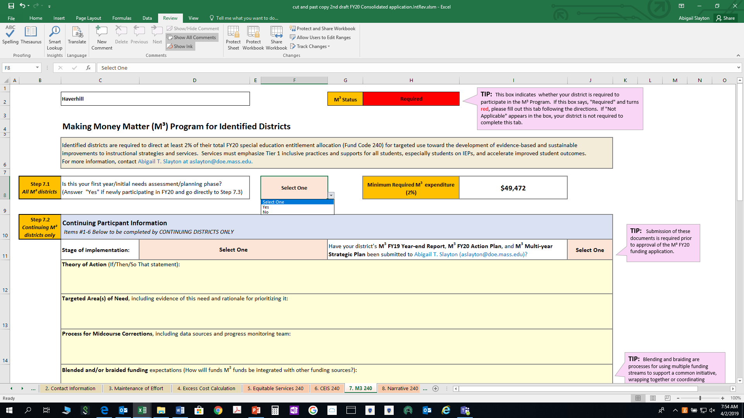
FY20 M3 APPLICATION
All year-end documents and all parts of FY20 M³ application must be complete for FY20 FC 240 IDEA grant approval
FC 240/262 Consolidated Workbook - Tab 7

Slide 32
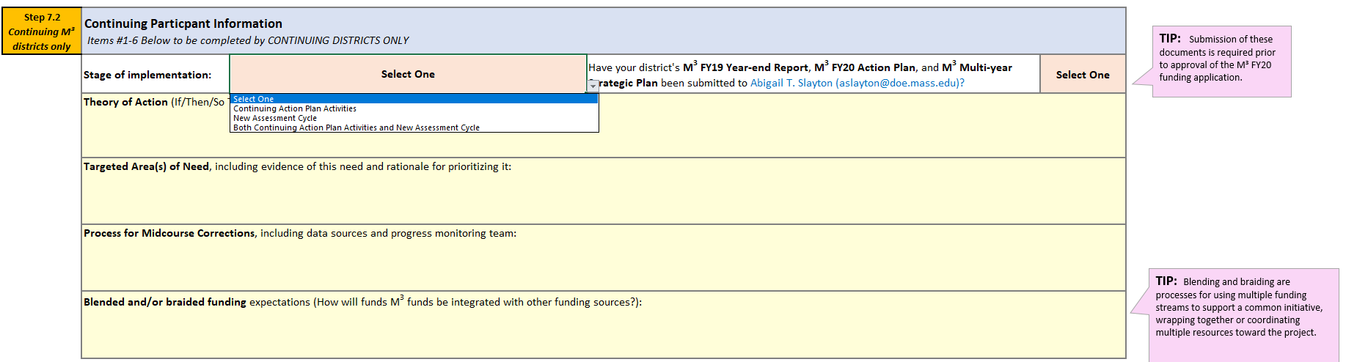
PROGRAM DESCRIPTION PART I - CONTINUING DISTRICTS ONLY

Slide 33
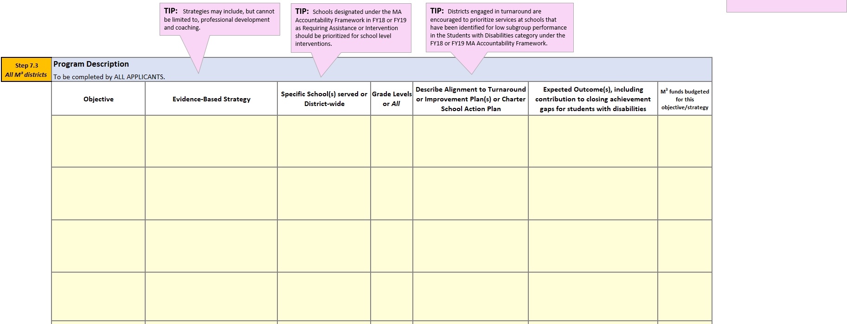
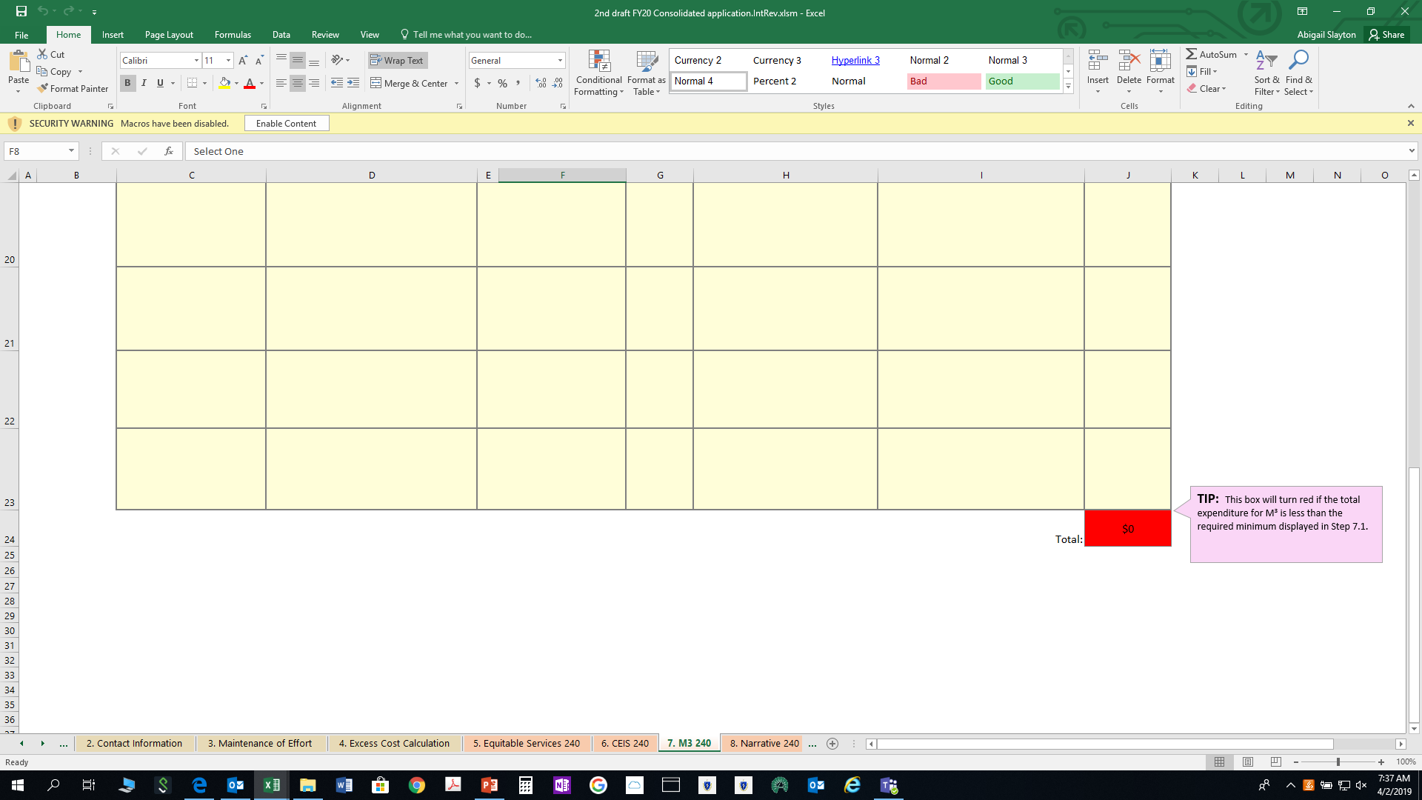
PROGRAM DESCRIPTION PART II – ALL DISTRICTS
Quick Reference Guide for 240: http://www.doe.mass.edu/federalgrants/idea/resources/qrg-240.docx
Allowable Costs Document: http://www.doe.mass.edu/federalgrants/idea/resources/allowablecosts.docx

Slide 34
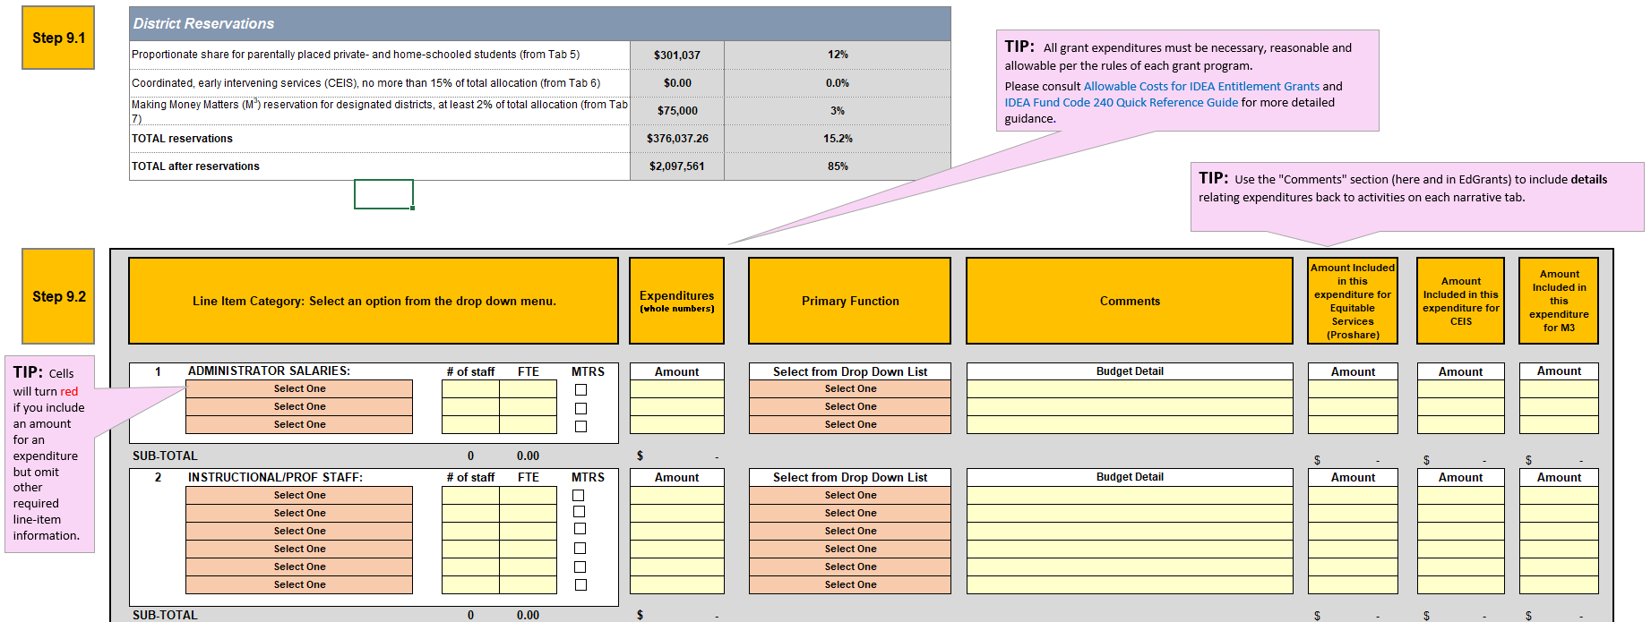
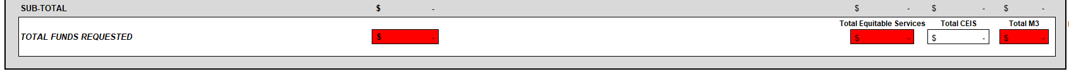
FY20 FC 240/262 CONSOLIDATED APPLICATION BUDGET

Slide 35
FY20 M3 YEAR-END REPORT
Due by June 30, 2020
Very similar to FY19
  No Fund Use reporting
Link will be in FY20 Posting for Consolidated Grant

Slide 36




Thank you
THANK YOU
David Parker, Regional Assistance Manager & Abigail Slayton, M³ Project Manager
123.456.7890
aslayton@doe.mass.edu
www.doe.mass.edu
75 Pleasant Street, Malden, MA 02148

