Slide 1
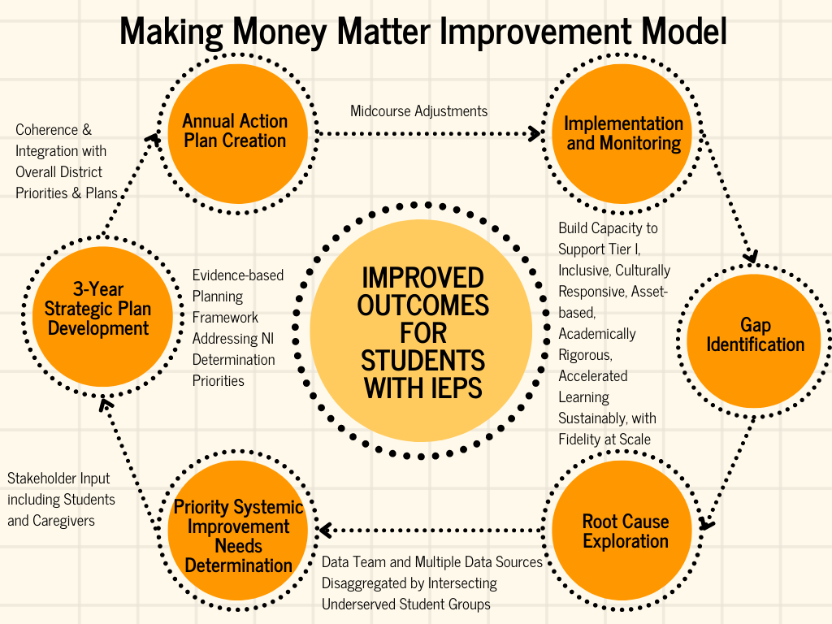
Making Money Matter Improvement Model
Reported in IDEA Application

