Slide 1
2021 World Languages Curriculum Framework
Introduction to the New Framework

Slide 2
Introducing the New Framework
-Heather Peske, Senior Associate Commissioner
1

Slide 3
The Need for a New Framework
The World Languages Framework had not been updated since 1999. It was the oldest existing framework in the Department.
Since 1999, the American Council on the Teaching of Foreign Languages (ACTFL) published national standards, bringing linguistic proficiency to the forefront of world language education.
With the passage of the LOOK Act in 2017, the Department aligned the Seal of Biliteracy with ACTFL’s proficiency levels.

Slide 4
Public Input, Research, and Common Practices
In 2019, the Department commissioned a study to survey the literature, other states’ practices, and the attitudes of world language teaching professionals in Massachusetts.
The study found that nearly all other states employ the ACTFL standards to some degree.
The study also found that many MA educators not only preferred the ACTFL standards, but that they were already implementing them in their classrooms.

Slide 5
Statewide Participation
The mandate to base the new standards off the ACTFL standards was clear.
The Department convened teams of K-16 world language teachers, instructors, administrators, and students to adapt the ACTFL standards to MA priorities.
The Department also consulted teams of content advisors to ensure inclusivity and applicability to all disciplines under the World Language umbrella.
These volunteers worked before and throughout the pandemic to incorporate ACTFL standards, social and emotional learning theory, and social justice priorities to provide the content for this framework.

Slide 6
Public Comment and Finalization
The Board of Elementary and Secondary Education (the Board) approved a draft of the new framework to go before the public and receive feedback in December 2020.
The Department received and responded to over 100 comments from K-12 teachers and administrators, post-secondary faculty, and parents.
The Board voted unanimously to approve the final draft on April 20.

Slide 7
Review Panelists and Facilitators
Communication | Cultures | Comparisons | Connections | Communities
Sarah Moghtader Marieangie Ocasio-Varela | Carlos-Luis Brown Karin Portocarrero-Heisler | Jessica Nollett Anna Barinelli Tirone | Grace Lytle Dominique Trotin | Terresa Pietro Amy St. Arnaud
Beckie Bray Rankin Maura Bulman Timothy Eagan Jennifer Faulkner Sam Harb Michelle Huaman Na Lu-Hogan Lisa Machnik Catherine Moss Susan Olsen Vula Roumis Kate Shah Kelly Shamgochian Ellen Toubman | Amy Chacharone Sharon Charbonnier Jessica Clifford Justine DeOliveira Buffy Hines Jessica Kaplan Shan-Lee Liu Emily Loughlin Diane Mehegan Erica Pollard Madelyn Gonnerman Torchin Ronie R. Webster | Dana Curran Lauren Downey Nicole Haghdoust Sean Kinney Amy Moran Lindsay Perry Jessica Sapp Nicole Sherf Katie Tomten | Jeremiah Ames Katie Cardamone Karena Hansen Nancy Kundl Ana Pimentel Catherine Ritz Gale Stafford Mellissia Walles | Julie Caldarone Christmas Carroll Kelly Cooney Marilia (Mia) Correia Ann Ferriter Linda Hackett Heidi Olson Amy Roberts Michael Travers
State Student Advisory Council – Dina Gorelik, Andrew Horton, Katherine Nessel

Slide 8
Content Advisors
Tanya Alvarado Nancy Antonellis Nancy Braga Jasmine Carbone Xi Chen Pei-Chi Chuang Michael Cowett Julianna Fernandez Kelly Gilbert Kimberlee Kasanov Christine Kelley Elizabeth Kelley Valeriya Kozlovskaya Lisa Machnik | Danja Mahoney Erin Manzi Fabiane Noronha Jennifer O’Brien Adria Osborne Sara Peters Katherine Quackenbush Saviz Safizadeh Mary Simmons Karen Soto Adriana Thomas Arlene Vellman Iolanda Volpe

Slide 9
Participating Districts/Organizations
K-12 Public School Districts |  |  |  | Colleges, Universities, Other Organizations
Agawam Andover Arlington Barnstable Bedford Boston Brockton Brookline Cambridge Canton Chelmsford Concord Danvers Duxbury East Longmeadow Global Learning Charter (New Bedford) Hamilton-Wenham | Hingham Holliston Hopedale Hudson Innovation Academy (Tyngsborough) Ipswich King Philip KIPP Academy Lynn Collegiate Lee Lenox Lexington Lincoln Littleton Marshfield Martha’s Vineyard Medfield Medway | Mendon-Upton Methuen Middleborough Millis Monomoy Nantucket Nauset Needham Newton North Andover North Reading Norwood Pembroke Pentucket Pioneer Valley Chinese Immersion Charter Reading Salem Saugus | Silver Lake Somerville Springfield Sudbury Swampscott Wachusett Wakefield Waltham Ware Wayland Wellesley Westford Weston Wilmington Winchester Worcester | Boston College Boston University Brandeis University Salem State University Tufts University Idioma Education & Consulting

Slide 10
Vision, Scope, and Guiding Principles
-Andy McDonie, World Languages Specialist
2

Slide 11
Vision

Slide 12
Vision
All Massachusetts students will acquire a high* level of linguistic and cultural proficiency in at least one world language. Proficiency in one or more world languages will empower students to use languages other than English to tell their own stories, understand the stories of others, and engage with their communities.
*M.G.L. c. 69 § 1Q. – The MA State Seal of Biliteracy requires a high level of proficiency in one or more world languages. The Department determined that Intermediate High on the ACTFL scale met the criteria for high, because it is at that level that the language is appropriate for college/career environments.

Slide 13
Vision
All Massachusetts students will acquire a high level of linguistic and cultural proficiency in at least one world language. Proficiency in one or more world languages will empower students to use languages other than English to tell their own stories, understand the stories of others, and engage with their communities.

Slide 14
The World-Ready Student All students at all levels of proficiency will use the target language to:
Communicate with speakers/signers of the target language, especially those in their schools and communities;
Explore and celebrate the products, practices, and perspectives of multiple cultures;
Compare their own languages and cultures with those of the target communities;
Expand their academic knowledge of other disciplines;
Serve and lead in their academic, local, and global communities;
Become lifelong beneficiaries of the opportunities that proficiency in multiple languages can offer them; and
Become agents of change that promote equity, global awareness, and multicultural understanding.

Slide 15
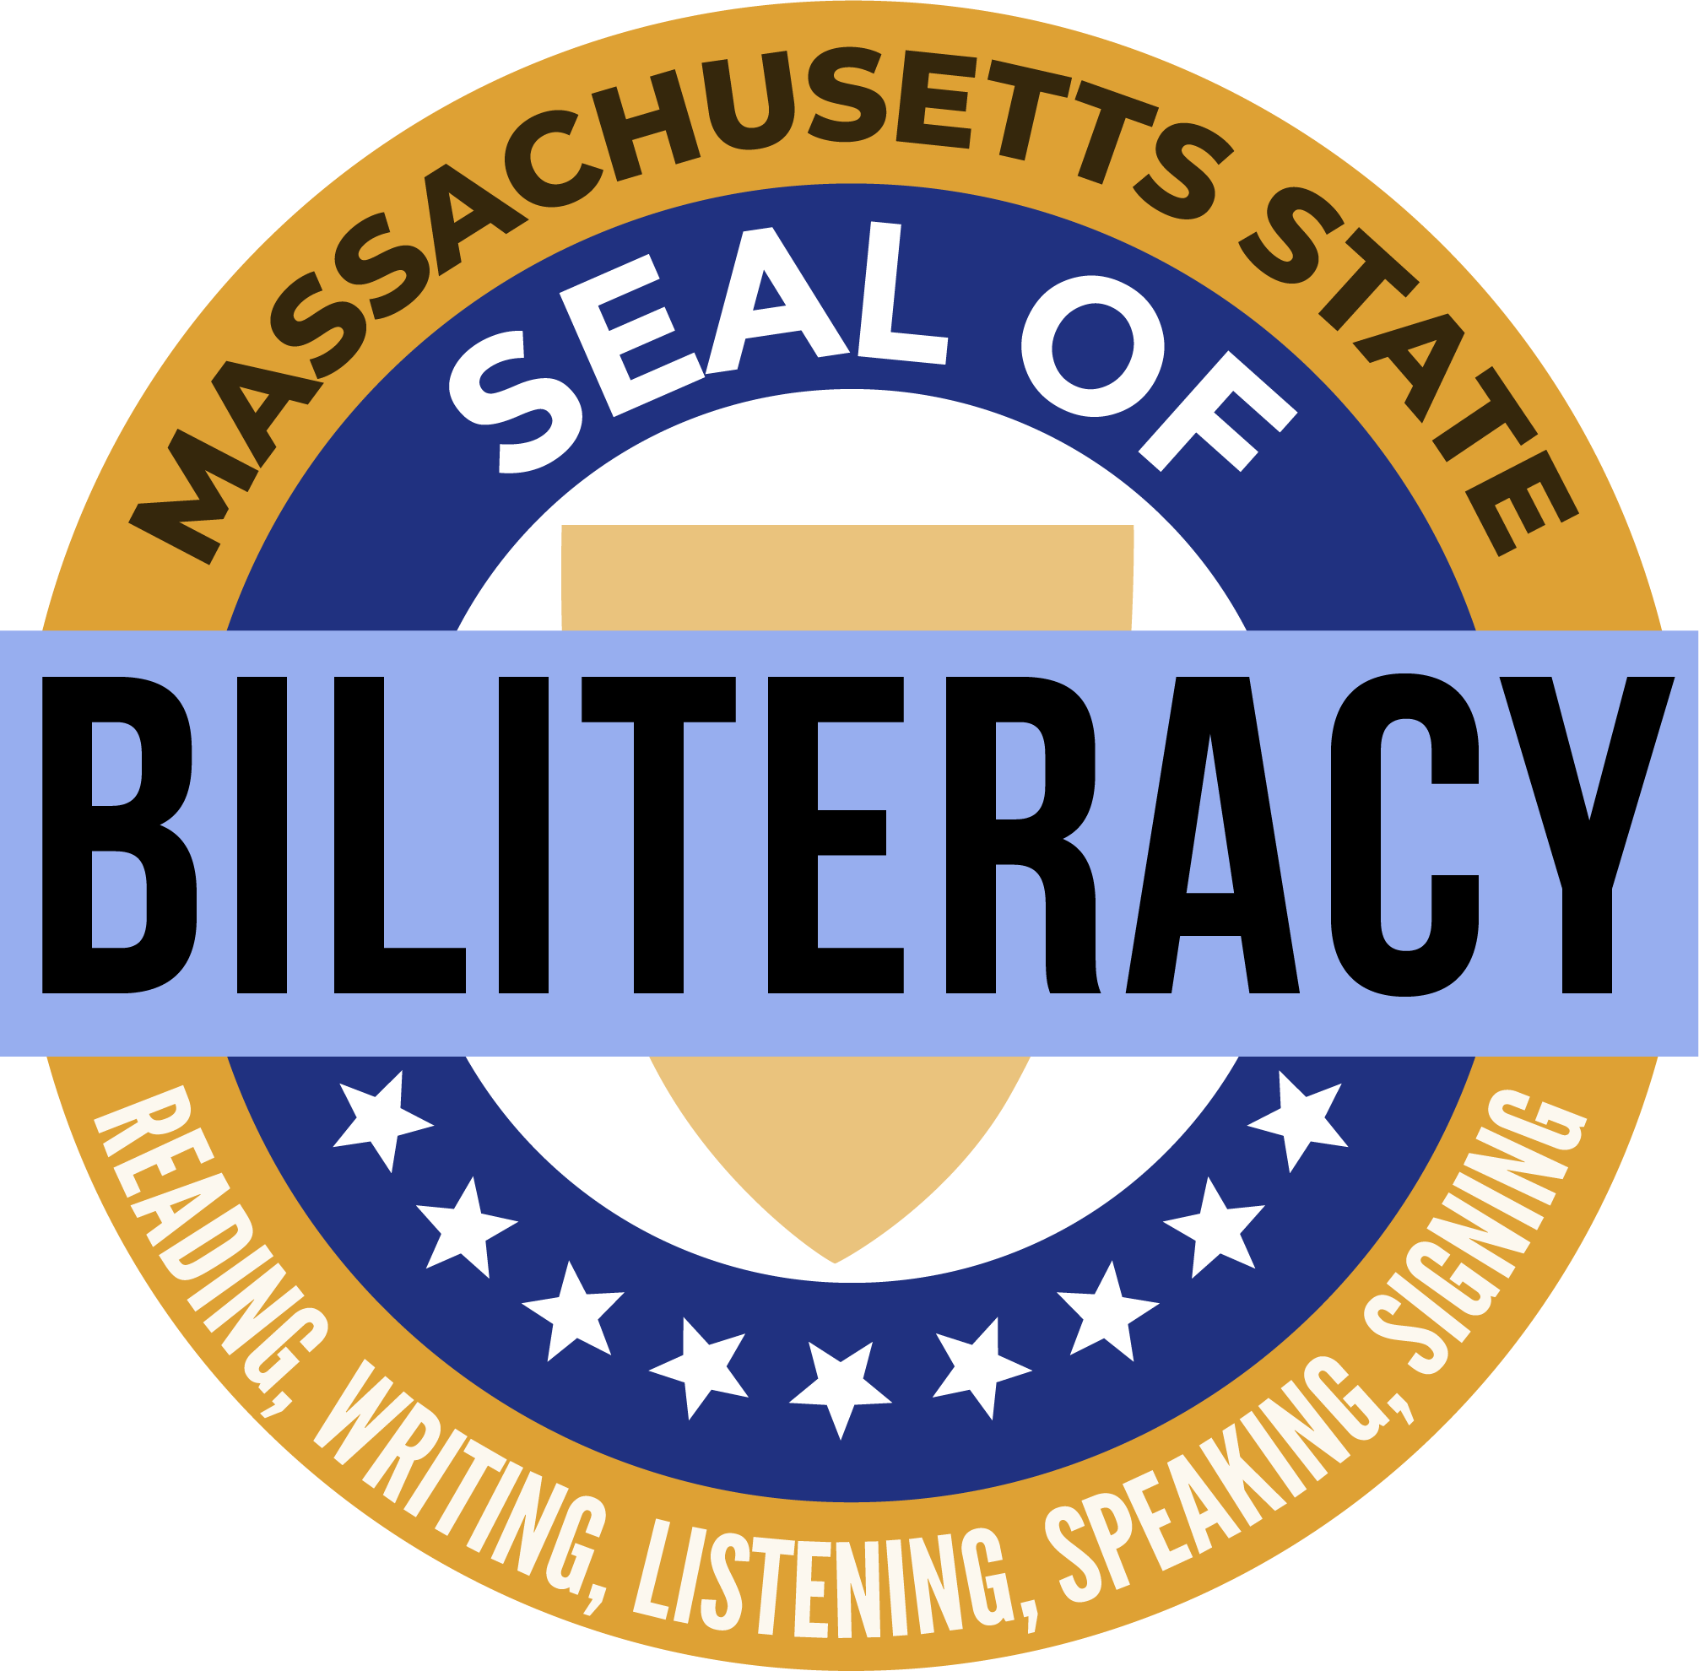
The World-Ready Student (Cont.)
Students receive more tangible benefits when they are not only highly proficient in multiple languages, but even more when they are officially recognized as being biliterate.
The Massachusetts Seal of Biliteracy completes the vision of the world-ready student.

Slide 16
The Necessity of World Languages
Multicultural and linguistic proficiency benefits students personally and professionally.
Academic breadth
Social connections
Cognitive advantages over monolinguals
Multicultural and linguistic proficiency benefits society.
Community service and leadership
Diverse perspectives
The federal government reinforces the country’s need for more language.
National security
Strong economy
Scientific engagement
Domestic rights and services

Slide 17
Terminology: World Languages
Foreign is no longer an appropriate way to describe languages.
Many non-English languages spoken in the U.S. predate the arrival of English in North America.
Many non-English languages are part of local or regional U.S. histories.
World Languages
Languages other than English
See ACTFL’s Statement What is a World Language? (2017)

Slide 18
Scope

Slide 19
What the Framework Does and Does Not Do
Framework Structure
District Decisions about Topical Content
Supporting the MA State Seal of Biliteracy
Supporting High-Leverage Teaching Practices
Supporting All Students

Slide 20
Framework Structure
Vision – provides district/programmatic goals
Guiding Principles – support districts to develop and evaluate world language programs
Standards for World Language Practices – support districts to select, develop, and evaluate world language curriculum
World Language Content Standards – describe what students can do.

Slide 21
District Decisions about Topical Content
The Framework is topic-neutral.
Districts should select content that is most appropriate for students (age, maturity, prior language/culture experience, student interest, cultural and community context).
Broad suggestions for topical content:
Proficiency Level | Description of Topics that are Most Suitable
Novice | Topics that are personally connected to the student
Intermediate | Topics that are connected to the student or their familiar environment
Advanced | Topics of general, social, academic, or professional interest
Superior | Topics that are abstract, hypothetical, and or specialized

Slide 22
Supporting the MA State Seal of Biliteracy
This framework supports districts to design programs in which all students meet or exceed the high levels of proficiency needed for the Seal of Biliteracy.
Intermediate High (IH) should be thought of as the minimum programmatic goal for districts.
It often takes 6 or more years of well-articulated language courses to reach IH.

Slide 23
Supporting High-Leverage Teaching Practices
DESE frameworks do not aim to prescribe teaching practices.
The standards and practices described in this framework are best understood through the lens of high-leverage teaching practices (Glisan & Donato, 2017).
Facilitating target language comprehensibility
Guiding learners through interpreting authentic resources
Designing oral interpersonal communication tasks
Planning with the backward design model
Teaching grammar as a concept and using it in context
Providing appropriate oral feedback

Slide 24
Supporting All Students
Given students’ broad variety of abilities, pace of acquisition, and achievement levels, educators are best-equipped to identify and provide supporting practices and materials.
The Department supports educators in meeting students’ needs by providing Quick Reference Guides (QRGs) in the following fields.
American Sign Language
Assessment
Classical Languages
Elementary Language Programs
Heritage Language Programs
Languages with Diverse Written Representations (LDWRs)
Social and Emotional Learning
Students with Disabilities

Slide 25
Guiding Principles

Slide 26
Guiding Principles 1-2
Effective world language programs invite, include, support, and benefit all students.
Pre-K-12
Students who already speak/sign other languages
Students with disabilities
Effective world language programs lift up all students and empower them to act with cultural competence and critical consciousness.
Center students and their experiences
Validate students and their identities (ethnic, cultural, linguistic, gender, etc.)
Provide students with agency

Slide 27
Guiding Principles 3-4
Effective world language programs produce high levels of linguistic and cultural proficiency in one or more world languages in their students.
Proficiency – what students can do spontaneously with language (and behavior) across a variety of contexts.
Well-articulated, proficiency-driven instruction should begin in kindergarten and continue beyond grade 12.
Effective world language programs are communicative and support meaningful, authentic, and affirming interactions in the target language (TL).
Students and teachers use the TL with purpose.
For modern languages, students and teachers use the TL 90% of the time or more.
For classical languages, teachers and students use the TL to the maximum extent possible.

Slide 28
Guiding Principles 5-6
Effective world language programs measure linguistic proficiency.
The ACTFL proficiency levels provide us with common language to describe what students can do across all ages, grade levels, and languages.
These descriptors presuppose that we are assessing skills in language and not knowledge about language.
Effective world language programs foster risk-taking and mistake-making toward growth in linguistic and cultural proficiency.
At all levels, students struggle to make meaning. That struggle is productive, necessary, and welcome.
Students should be encouraged to be bold and make mistakes.

Slide 29
Guiding Principles 7-8
Effective world language programs deliver meaningful, relevant, and cross-disciplinary content to motivate students to acquire the language and build proficiency.
Students acquire language most effectively when they are striving to communicate about topics that are interesting and accessible to them.
Educators/district select topics of interest to drive language acquisition.
Effective world language programs differentiate instruction and content, so that they are accessible, rigorous, and appropriate for all students.
Students acquire language proficiency at different rates.
Programs aim to deliver instruction at or just above the students’ current level of proficiency.

Slide 30
Guiding Principles 9-10
Effective world language programs connect students to their peers in the classroom, their community, and speakers/signers of the target language throughout the world.
Language serves the practical purpose of connecting people.
Programs provide opportunities for a broad array of interactions in a variety of communities – especially the local community.
Effective world language programs promote social and emotional growth.
Encourage positive relationship-building and personal management
Promote critical thinking about their own and others’ cultural contexts

Slide 31
Practices and Content Standards
3

Slide 32
Standards for World Language Practices
Describe the skills that all students should demonstrate at all levels of world language programming.
Represent the priorities for the selection, development, and implementation of curriculum.
Eight of the practices come directly from ACTFL’s five goal areas (the 5 Cs).
Two additional practices represent MA priorities – social justice and social and emotional learning

Slide 33
Comparison of ACTFL 5 Cs to MA Practices
ACTFL Goal Areas (5 Cs)
MA Practices
Communication
Cultures
Connections
Comparisons
Communities
Domain 1: Communication
Interpretive Communication Interpersonal Communication Presentational Communication Intercultural Communication
Domain 2: Linguistic Cultures
Cultures Comparisons
Domain 3: Lifelong Learning
Connections Communities Social and Emotional Learning (SEL) Social Justice

Slide 34
5 Cs +SEL + SJ reorganized into 3 domains and 10 practices
Domain 1: Communication – How?
Domain 2: Linguistic Cultures – What?
Domain 3: Lifelong Learning – Why?

Slide 35
Reminder: All practices should be conducted almost exclusively (>90%)in the target language.

Slide 36
Practice 1: Interpretive Communication
Students understand, interpret, and analyze what is heard, read, or viewed on a variety of topics.
One-way communication: Text → Student
Students engage with text (anything artifact that transmits meaning or information).
Students demonstrate understanding of the message(s), main idea(s) and supporting detail(s) as well as the characteristics and viewpoints of the culture(s) that produced the text.
Classical languages often favor this practice over others in the communication domain.

Slide 37
Practice 2: Interpersonal Communication
Students interact and negotiate meaning in spontaneous spoken, signed, or written conversations to share information, reactions, ideas, feelings, opinions, and perspectives.
Two-way communication: Student ←→Interlocutor(s)
Students engage in and build connections through synchronous conversations with one or more interlocutors.
Students use the target language and appropriate cultural behaviors to negotiate meaning and share information.

Slide 38
Practice 3: Presentational Communication
Students present information, concepts, ideas, feelings, opinions, and perspectives to inform, explain, persuade and narrate on a variety of topics using appropriate media and adapting to various audiences of listeners, readers, or viewers.
One-way communication: Student → Audience
Students present information, concepts, and ideas to inform, explain, persuade, and narrate.
Students to present to a variety of audiences through a variety of media.

Slide 39
Practice 4: Intercultural Communication
Students interact appropriately with others in and from another culture.
One-way or two-way communication
Students interpret information through the lens of the message’s originator.
Students engage and present using topics and nonverbal behaviors that will be readily understood by their audience/interlocutor(s).

Slide 40
Practice 5: Cultures
Students gain cultural competence and understanding.
Explain and reflect on products, practices, and perspectives from the target culture
Reflect on the role culture plays in affecting their own identities
Understand how cultures influence one another over time

Slide 41
Practice 6: Comparisons
Students develop insight into the nature of language and culture to interact with cultural competence.
Recognize and analyze similarities, differences, interconnectedness, and interactions in TL cultures and the language itself
Investigate, explain, and reflect on the concept of culture
Investigate, explain, and reflect on the nature of language

Slide 42
Practice 7: Connections
Students connect with other disciplines and acquire information and diverse perspectives to use the language to function in academic and career-related situations.
Build, reinforce, and expand interdisciplinary knowledge
Acquire information from TL resources
Explore diverse perspectives

Slide 43
Practice 8: Communities
Students interact and communicate with intercultural competence and confidence to engage and responsibly collaborate with a variety of multilingual communities at home and around the world.
Maintain TL engagement
Use the TL within and beyond the classroom
Recognize strengths, set goals for growth, and reflect on progress
Use TL for enjoyment, enrichment, career advancement, and relationships

Slide 44
Practice 9: Social and Emotional Well-being
Students develop and employ social and emotional skills that are inextricably linked to language and culture acquisition.
Demonstrate self-awareness
Demonstrate self-management
Demonstrate social awareness
Use the TL to enhance relationship skills
Make responsible decisions

Slide 45
Practice 10: Social Justice
Students think and act with critical consciousness.
Demonstrate understanding of the impact of language and culture upon identity
Respond with respectful curiosity and empathy to the history and lived experiences of others
Recognize and seek to correct stereotypes, systems, and privileges that harm themselves and others.

Slide 46
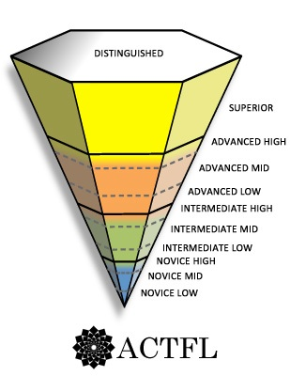
World Language Content Standards

Slide 47
Organization of the Content Standards
Proficiency Level
Domain
Standard
Practice

Slide 48
Proficiency Level

Slide 49
Domain

Slide 50
Practice (bold)

Slide 51
Content Standard

Slide 52
The standards are dense, so we break them down by linguistic components
Function
Context
Text Type
Comprehensibility
Supports

Slide 53
Function
Describes what students can do with the language.
Functions are the crux of the content standards.
Ranges from list/identify → propose/hypothesize
Note: Functions emerge and develop slowly, often over the course of several years of acquisition. Bolded functions indicate that the function is new or more developed.

Slide 54
Context
Describes the situations in which students successfully perform the function.
Ranges from topics of high familiarity/interest in highly predictable settings → wide variety of complex, hypothetical, and abstract topics in a variety of settings

Slide 55
Text Type
Describes the quality and quantity of language that students produce.
Ranges from isolated words → extended discourse of well-organized paragraphs.

Slide 56
Comprehensibility
Describes if and how easily the audience/interlocutor will understand the student.
Holistic accuracy – Was the pronunciation, grammar, spelling, and/or sign production accurate enough to be understood?
Novice: Speakers/signers of the language who are accustomed to engaging with language learners sometimes understand.
Superior: Speakers/signers of the language easily understand.

Slide 57
Identifying function, context, text type, and comprehensibility supports the most common Seal of Biliteracy assessments.
 | Rubric
STAMP
AAPPL | Your AAPPL Interpersonal Listening/Speaking score of N-1 means that you can say a few things about yourself. You can list, name, and identify common things with single words. You can answer one or two of the basic kinds of questions that you have learned and practiced in class. You can do this in a way that your teachers and others who are used to language learners can understand some of what you are saying.
ACTFL OPI | Context | Function | Text Type | Comprehensibility
DESE | Context | Function | Text Type | Comprehensibility

Slide 58
Additional Components of the Standards
Support
Describes what supports students will likely need in order to accomplish the function.
Ranges from visuals and gestures → nothing

Slide 59
Additional Components of the Standards
Standard identifier
To comply with Standards Navigator on DESE website

Slide 60
The Content Standards

Slide 61
Standard 1: Interpretive Communication
Context + Text Type + Support + Comprehensibility
Understanding of cultures and communities behind the text
Reading/Listening/Viewing for Information

Slide 62
Standard 2: Interpersonal Communication
Context + Text Type + Support + Comprehensibility
Response to interlocutors and their cultural artifacts
Exchanging information
Participation in conversation
Proposing solutions
Storytelling
Navigating complications
Abstract discussions

Slide 63
Standard 3: Presentational Communication
Context + Text Type + Support + Comprehensibility
Understanding of presentational context
Relaying information
Expressing authentic opinions
Describing, narrating, and comparing
Presenting theoretical conjectures

Slide 64
Standard 4: Intercultural Communication
Context + Text Type + Support + Comprehensibility
Selecting culturally appropriate content
Demonstrating culturally appropriate behavior
Avoiding inappropriate cultural behaviors
Understanding diversity and bias
Nonverbal negotiation

Slide 65
Standard 5: Cultures
Context + Text Type + Support + Comprehensibility
Products, practices, and perspectives
Culture and identity
Culture over time

Slide 66
Standard 6: Comparisons
Context + Text Type + Support + Comprehensibility
Cultural Comparisons
Linguistic Comparisons

Slide 67
Standard 7: Connections
Context + Text Type + Support + Comprehensibility
Use language across content areas
Access diverse viewpoints

Slide 68
Standard 8: Communities
Context + Text Type + Support + Comprehensibility
Community Engagement
Lifelong Learning

Slide 69
Resources and Implementation
4

Slide 70
Quick Reference Guides and Literature Review
American Sign Language
Assessment
Classical Languages
Elementary Languages
Heritage Speakers/Signers
Languages with Diverse Written Representations (LDWRs)
Social and Emotional Learning
Students with Disabilities

Slide 71
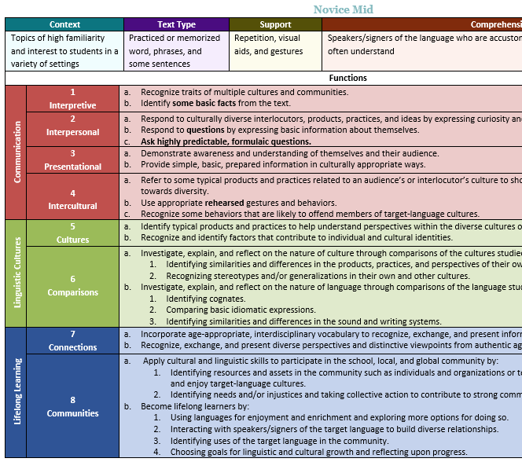
Standards at a Glance

Slide 72
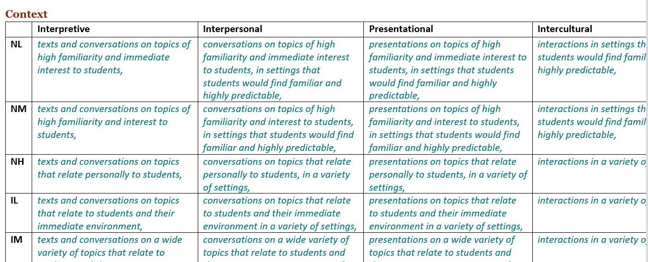
Linguistic Components Summary

