Slide 1
Massachusetts World Languages Framework Curriculum Alignment Lab #1
[Insert DATE]
[Insert Names and Titles of Presenters]

Slide 2
Overview
Today we will…
Briefly review the content of Online Modules 1-3
Introduce the Massachusetts World Languages Curriculum Alignment Guide
Discuss how the Guide incorporates proficiency- and equity-based approaches
View and discuss sample unit plans through the lens of proficiency and equity
Practice using the Curriculum Alignment Guide for Unit Planning

Slide 3
Review of Modules 1, 2, 3
Review of Modules 1, 2, 3

Slide 4
Module 1 Review
Overview
Introduces the 2021 Massachusetts World Languages Curriculum Framework
Explains how the Framework is organized
Explains how the Implementation Series is organized

Slide 5

Module 1 Review
What is the 2021 Framework?
Presents standards for the teaching of World Languages in Massachusetts
Aligned to the ACTFL World-Readiness Standards and Proficiency Guidelines and other Massachusetts Frameworks
Includes a focus on social emotional skills and social justice
https://www.doe.mass.edu/frameworks/world-languages/2021.pdf

Slide 6
Module 1 Review
What are the components of the Framework?
Vision
Guiding Principles
Practices
Content Standards
Domains
Notes:
Vision: The vision highlights the goals for all Massachusetts students with regard to target language proficiency and use
Guiding Principles: The guiding principles are philosophical statements to guide the design and implementation of world language programs.
Domains: The domains are the roles that different practices fulfill in allowing students to demonstrate proficiency in the language
Practices: The Standards for World Language Practice describe processes and skills students acquire in terms of how students use languages, what they communicate about, and why they use the language
Standards: The World Language Standards describe what students can do at each level of proficiency.

Slide 7
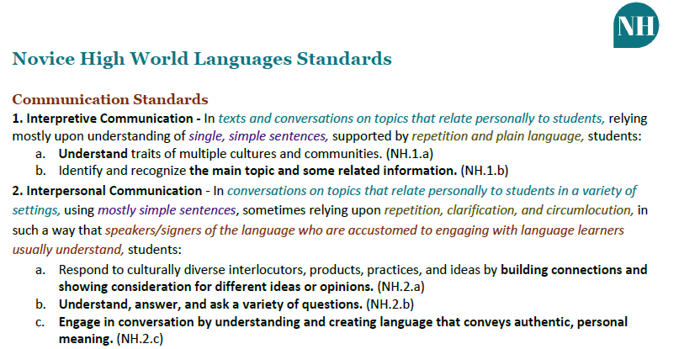
Module 1 Review
What are the components of the content standards?
Context
Support
Functions
Comprehensibility
Text Type
Notes:
[CLICK to highlight each component]
Function (lettered lists): describes what students can do with the language.
Context (teal italicized text): Describes the situations in which students successfully perform the function.
Text Type (purple text): Describes the quality and quantity of language that students produce.
Comprehensibility (italicized red-brown text): Describes if and how easily the audience will understand the student.
Support (olive green text): Describes what supports students will likely need in order to accomplish the function.

Slide 8
Module 2 Review
Overview
Explains what proficiency is and why it’s important for world language education
Discusses how to use proficiency to guide instruction
Explores the relationship between proficiency and the Massachusetts World Languages Framework

Slide 9
Module 2 Review
What is world language proficiency and why is it important?
The ability to use a language in real-world situations in a spontaneous and non-rehearsed context
Refers to skills, abilities, and competencies in listening, viewing, reading, speaking, signing, and writing
Includes linguistic and cultural proficiency
Encourages cross-cultural connections and allows full participation in local and global communities

Slide 10
Module 2 Review
Core Practices for Proficiency-Based World Language Learning
From ACTFL
Facilitate target language comprehensibility
Guide learners through interpreting authentic resources
Design interpersonal communication tasks
Plan with backward design model
Teach grammar as concept and use in context
Provide appropriate feedback

Slide 11
Module 2 Review
How does the Framework support proficiency-based instruction?
Emphasizes the importance of linguistic and cultural proficiency
Provides structure, standards, and practices that promote proficiency
Supports the Massachusetts State Seal of Biliteracy

Slide 12
Module 3 Review
Overview
Explains what equity is and why it is important for world language education
Discusses how to use equity to guide instruction
Explores the relationship between equity and the Massachusetts World Languages Framework

Slide 13
Module 3 Review
What are equitable practices and policies and why are they important?
Every student has access to the educational resources and rigor they need to succeed at the right moment in their education, regardless of gender, racial, ethnic, and cultural identity, linguistic background, sexual orientation, family income, ability, or other personal or social circumstances (nationality, religious affiliation, etc.)
Ensures that all students are able to learn and thrive
Addresses deficit-based policies, practices, and perspectives
Supports, celebrates, and creates opportunities for historically marginalized populations

Slide 14
Module 3 Review
How do I use equitable approaches to language teaching?
Recognize and redress biases in policies, practices, and perspectives
Center, affirm, and sustain different aspects of students’ identities
Ensure all students and communities feel represented and respected

Slide 15
Module 3 Review
How does the Framework support equity in language teaching?
Emphasizes the need for inclusive world language education
Makes equity a key component of all the Guiding Principles
Includes Social and Emotional Well-being and Social Justice Practices, woven through the standards

Slide 16
Curriculum Alignment
Curriculum Alignment

Slide 17
Curriculum Alignment Teams
The Department expects that the complete alignment of every unit in every course could take several years. This is a journey, not a race.
While all teachers should have a voice in the curriculum, the direct involvement in curriculum alignment may vary, depending upon the skills, schedules, and interests of teachers.
We recommend the formation of Curriculum Alignment Teams

Slide 18

Who should be on your district’s Curriculum Alignment Team?
At least one district-level representative (Curriculum director, WL director, etc.)
WL program leader
At least one WL teacher representative for each language taught
At least one WL teacher representative from each building where WLs are taught
Additional considerations: Special Ed. faculty, ELL faculty, community members, parents, students, etc.

Slide 19
Introduction to the Curriculum Alignment Guide
Introduction to the Curriculum Alignment Guide

Slide 20
Curriculum Alignment Guide
What is the Curriculum Alignment Guide?
A living document for you to
  plan for your courses and key components of your units
  consider the sequencing of units and how they articulate with one another within the course
  check for alignment to the Standards
  reflect on successes and challenges
Includes:
  Curriculum Alignment Guide for Course Planning
  Curriculum Alignment Guide for Unit Planning
  How To document to support you in completing and using the Guide

Slide 21
Curriculum Alignment Guide for Course Planning
Curriculum Alignment Guide for Course Planning

Slide 22
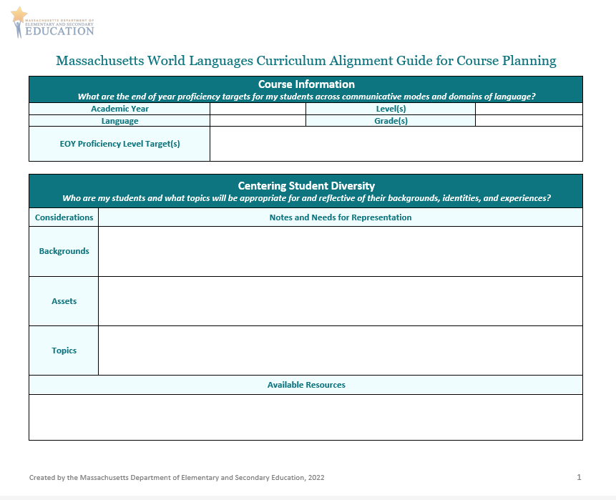
Curriculum Alignment Guide for Course Planning (1/4)
Course Information
  What are the end of year proficiency targets for my students across communicative modes and domains of language?
Centering Student Diversity
  Who are my students and what topics will be appropriate for and reflective of their backgrounds, identities, and experiences?

Slide 23
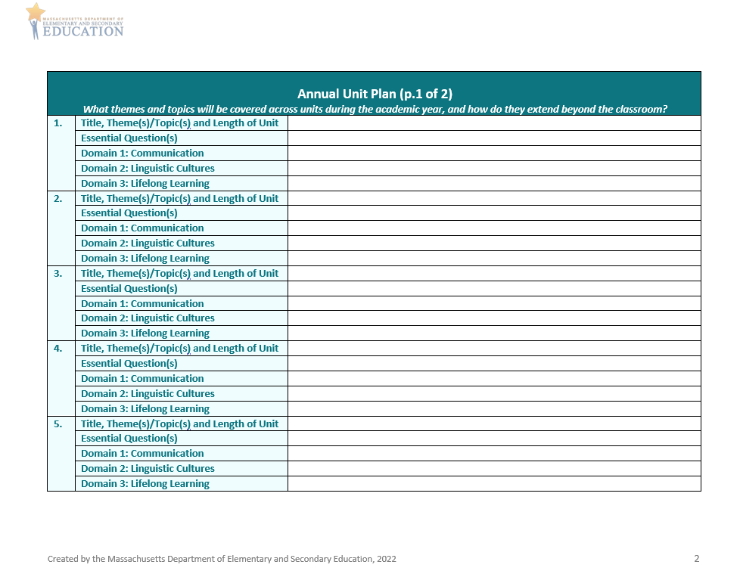
Curriculum Alignment Guide for Course Planning (2/4)
Annual Unit Plan
  What themes and topics will be covered across units during the academic year, and how do they extend beyond the classroom?
  Two pages with space to plan for 10 units

Slide 24
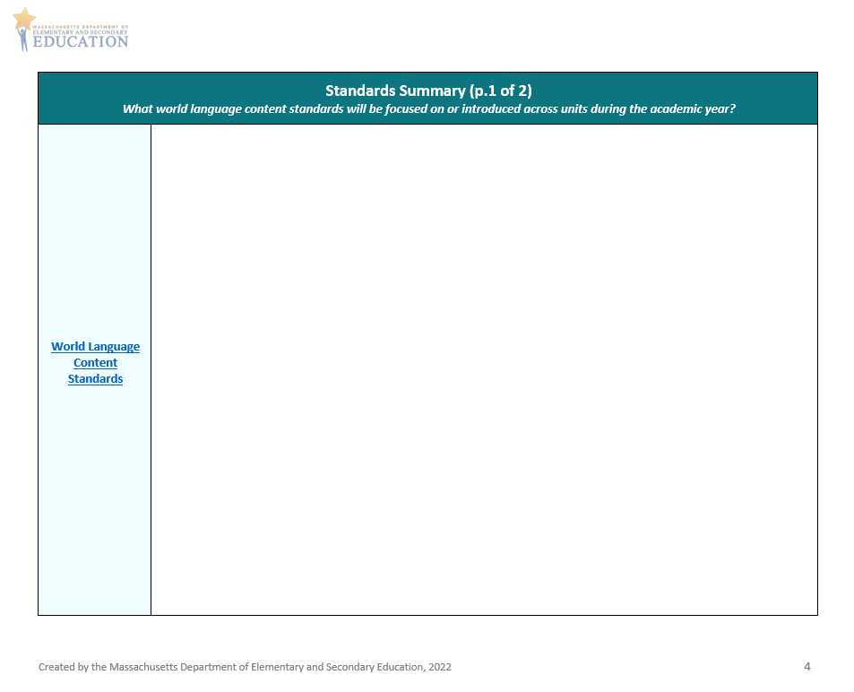
Curriculum Alignment Guide for Course Planning (3/4)
Standards Summary
  What standards will be focused on or introduced across units during the academic year?
  Two pages with space for World Language Content Standards and other standards

Slide 25
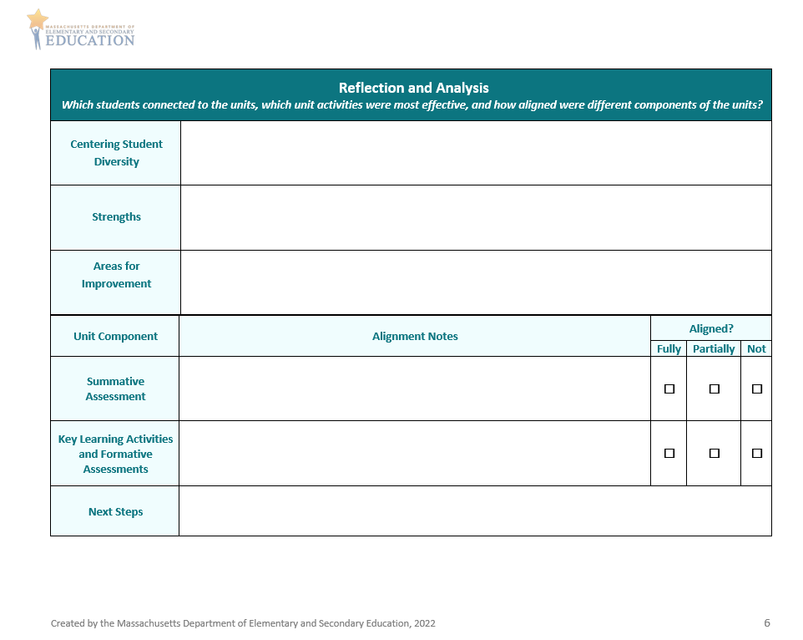
Curriculum Alignment Guide for Course Planning (4/4)
Reflection and Analysis
  Which students connected to the units, which unit activities were most effective, and how aligned were different components of the units?
Notes:
Make connections to centering student diversity; this section is designed to help you reflect on the extent to which all students felt connected to and represented in the unit or course

Slide 26
Curriculum Alignment Guide for Unit Planning
Curriculum Alignment Guide for Unit Planning

Slide 27
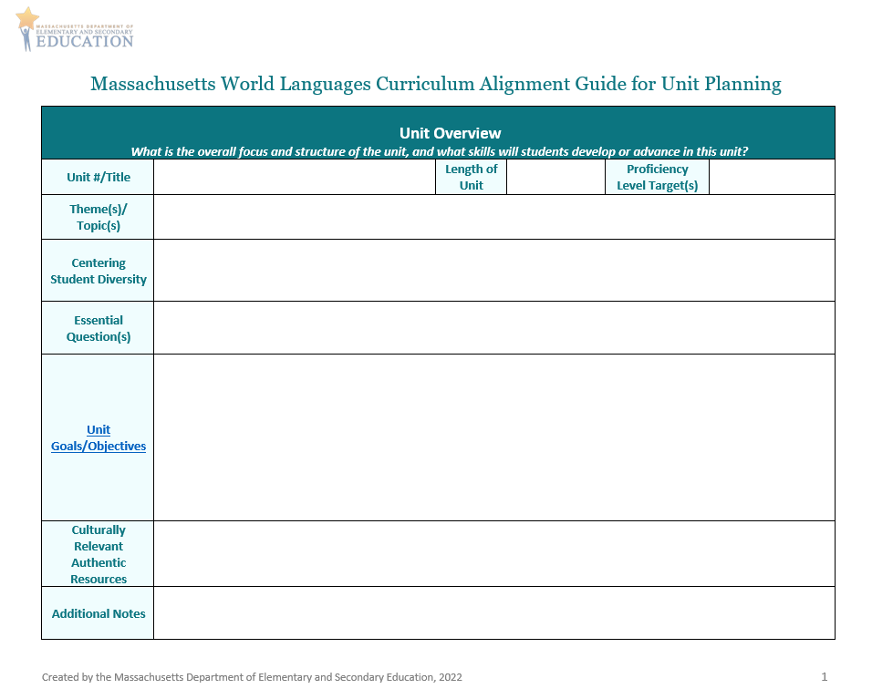
Curriculum Alignment Guide for Unit Planning (1/5)
Unit Overview
  What is the overall focus and structure of the unit, and what skills will students develop or advance in this unit?

Slide 28
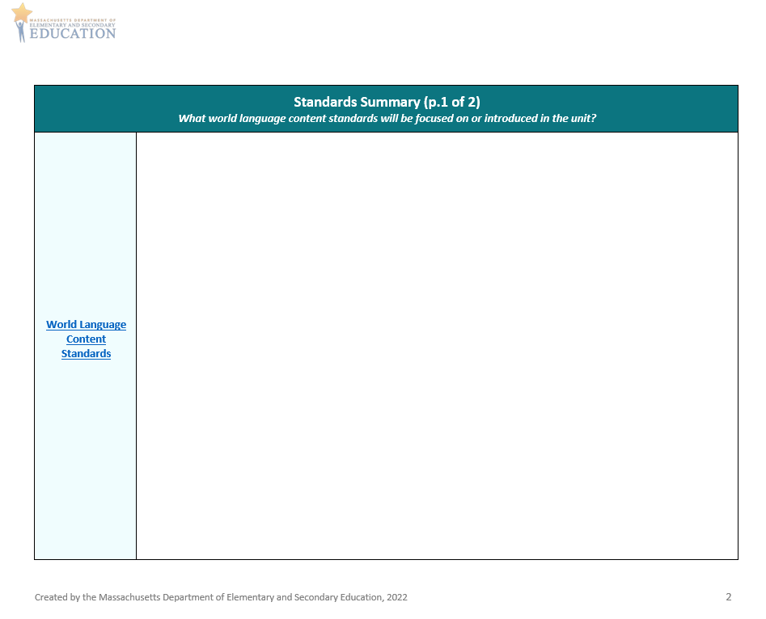
Curriculum Alignment Guide for Unit Planning (2/5)
Standards Summary
  What standards will be focused on or introduced in the unit?
  Two pages with space for World Language Content Standards and other standards

Slide 29
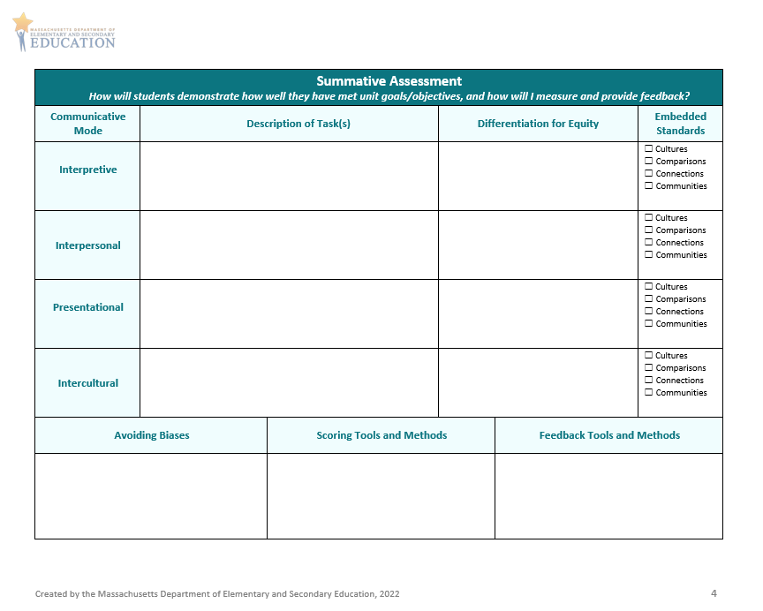
Curriculum Alignment Guide for Unit Planning (3/5)
Summative Assessment
  How will students demonstrate how well they have met unit goals/objectives, and how will I measure and provide feedback on student performances?
Notes:
Mention Assessment QRG

Slide 30
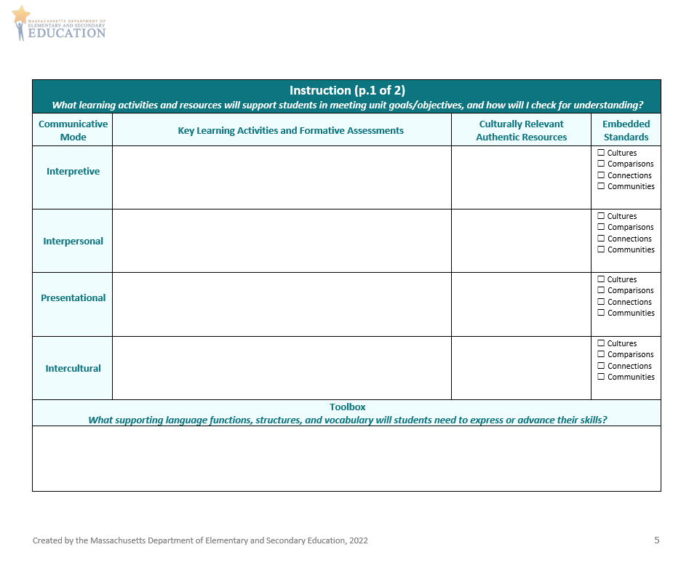
Curriculum Alignment Guide for Unit Planning (4/5)
Instruction
  What learning activities and resources will support students in meeting unit goals/objectives, and how will I check for understanding?
  What materials, strategies, and supports will I use to ensure equity in the unit, and which Core Practices will I use?
  Two pages with space to check for use of Core Practices and plan for Social and Emotional Well-Being, Social Justice, differentiation for equity, and technology

Slide 31
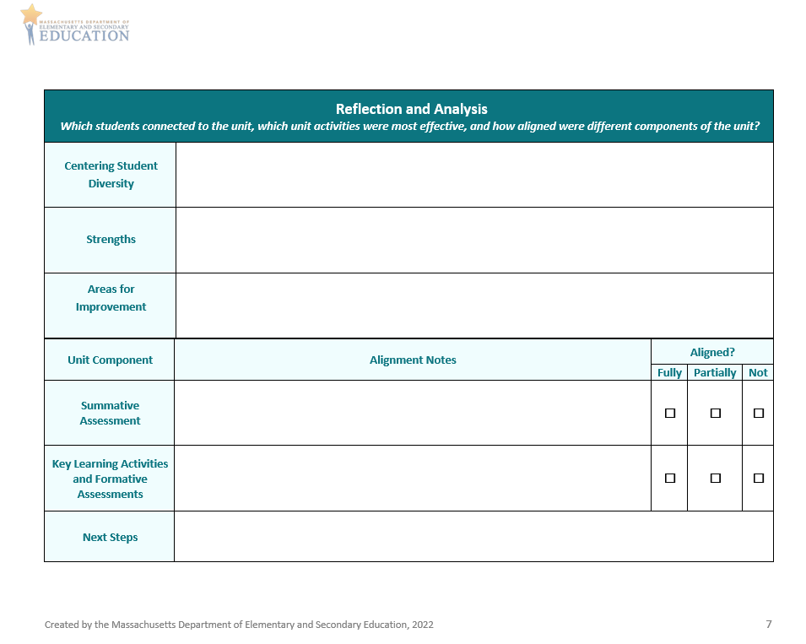
Curriculum Alignment Guide for Unit Planning (5/5)
Reflection and Analysis
  Which students connected to the unit, which unit activities were most effective, and how aligned were different components of the unit?

Slide 32
Demonstration: Sample Unit Plans
Demonstration: Sample Unit Plans
Think about how proficiency and equity are incorporated in the unit plans!

Slide 33
Sample
Insert samples when available

Slide 34
Discussion
Discussion: Sample Unit Plans
What proficiency-based practices and materials did you notice in these samples?
What equitable practices and materials did you notice in these samples?
What are some strengths of these samples?
What could be added to improve these samples?
How might you use these samples when planning your own units?

Slide 35
Application: Using the Guide
Application: Using the Guide
Complete the Unit Overview and Standards Summary sections of the Curriculum Alignment Guide for Unit Planning
  Think about proficiency and equity!

Slide 36
Discussion
Discussion: Using the Guide
How did you think about and incorporate proficiency while using the Guide?
  Did you identify appropriate proficiency targets for your students?
  Did you identify targets across communicative modes and domains of language?
How did you think about and incorporate equity while using the Guide?
  Did you identify who your students are and what assets they bring to the classroom?
  Did you identify topics that will be linguistically and culturally appropriate?
  Did you identify what resources will reflect your students’ identities and experiences?
What are some of the standards that you plan to focus on in your unit?
What are some student backgrounds, assets, and topics you plan to represent in your unit?
What was challenging about aligning your unit using the Guide?

Slide 37
Preview and Next Steps
In our next Curriculum Alignment Lab, we will…
Review Modules 4, 5, and 6
Explore and discuss more sections of the Curriculum Alignment Guide
View and discuss sample unit plans with a focus on Interpersonal and Presentational Communication
Continue using the Curriculum Alignment Guide for Unit Planning

Slide 38
Check for Learning
Check for Learning
Notes:
Assessment will be entered into an online survey platform and link will be provided by DESE

Slide 39




Thank you
THANK YOU
[Enter names of presenters]
[Enter contact info]
[Enter contact info]
www.doe.mass.edu
75 Pleasant Street, Malden, MA 02148
Notes:
Remind participants that a follow up email will be sent with a link to the evaluation

