Slide 1
Massachusetts World Languages Framework Curriculum Alignment Lab #3
[Insert DATE]
[Insert Names and Titles of Presenters]

Slide 2
Overview
Today we will…
Briefly review the content of Online Modules 7 and 8
Explore and discuss sections of the Curriculum Alignment Guide for Unit Planning with a focus on Interpretive and Intercultural Communication
View and discuss sample unit plans with a focus on Interpretive and Intercultural Communication
Discuss ways in which you can apply what you’ve learned to your own classroom

Slide 3
Review and Discussion: Modules 7 and 8
Review and Discussion: Modules 7 and 8

Slide 4
Module 7 Review
Overview
Explains the Interpretive Communication mode and why it’s important for world language education
Explores the Massachusetts World Languages Standards for Interpretive Communication
Discusses how to address the Interpretive Communication Standards in the classroom

Slide 5














Module 7 Review
What do students do in the mode of Interpretive Communication?
Exercise age and development-appropriate reading, viewing, and listening skills across a variety of genres as they engage with a text
Demonstrate understanding of the characteristics and viewpoints of multiple cultures and communities
Demonstrate understanding of messages, main ideas, and supporting details in written, spoken, or signed texts on a variety of topics in the target language

Slide 6


Module 7 Review
What are the Interpretive Communication Standards?
Descriptions of Interpretive Communication skills that students demonstrate at different levels of proficiency
Each Interpretive Communication Standard contains two Functions numbered 1.a and 1.b

Slide 7
Module 7 Review
How do the Functions progress across proficiency levels?
Functions | Proficiency Levels
 | NL | NM | NH | IL | IM | IH | AL | AM | AH | S
a. | ✓ | ✓ | ✓+ | ✓ | ✓ | ✓+ | ✓+ | ✓+ | ✓ | ✓
b. | ✓ | ✓+ | ✓+ | ✓+ | ✓+ | ✓+ | ✓+ | ✓+ | ✓+ | ✓
Notes:
As shown in the chart, some Functions are repeated from level to level (as indicated by a check mark) and some Functions progress from level to level (as indicated by a check mark with a plus sign). These Functions, which are new, more rigorous features of a previously acquired Function, appear in bolded text within the Framework.

Slide 8
Module 7 Review
How can I address the Interpretive Communication Standards in my classroom?
Select a goal or Can-Do statement aligned with the Standards for targeted proficiency level(s)
Design an aligned assessment task that use of comprehension strategies
  Incorporates age- and proficiency-level appropriate authentic resource(s)
  Inform subsequent Interpersonal and Presentational Communication task(s)
Provide continuous meaningful opportunities to engage with a variety of types of texts representing diverse perspectives
Design learning experiences with all students in mind, including students with disabilities and students from diverse linguistic, racial, and cultural backgrounds
Connect to Deeper Learning through opportunities for students to demonstrate Mastery and Identity

Slide 9
Module 7 Review
Questions?

Slide 10
Module 8 Review
Overview
Explains the Intercultural Communication mode and why it’s important for world language education
Explores the Massachusetts World Languages Standards for Intercultural Communication
Discusses how to address the Intercultural Communication Standards in the classroom

Slide 11





Module 8 Review
What do students do in the mode of Intercultural Communication?
Read, listen, and view through the lens that the message’s originator intended
Select language and topics that will be comprehensible to their audience or interlocutor(s)
Employ culturally appropriate nonverbal behaviors to set at ease or not offend their audience or interlocutor(s)

Slide 12

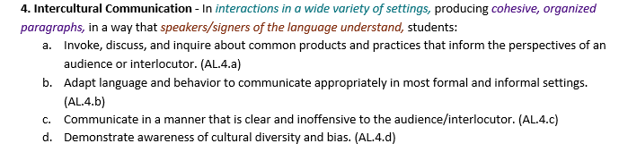
Module 8 Review
What are the Intercultural Communication Standards?
Descriptions of Intercultural Communication skills that students demonstrate at different levels of proficiency
Each Intercultural Communication Standard contains between three and five Functions numbered 4.a-4.e

Slide 13
Module 8 Review
How do the Functions progress across proficiency levels?
Functions | Proficiency Levels
 | NL | NM | NH | IL | IM | IH | AL | AM | AH | S
a. | ✓ | ✓ | ✓+ | ✓ | ✓ | ✓+ | ✓ | ✓ | ✓+ | ✓
b. | ✓ | ✓+ | ✓+ | ✓ | ✓ | ✓+ | ✓ | ✓ | ✓+ | ✓
c. | ✓ | ✓ | ✓+ | ✓ | ✓ | ✓+ | ✓ | ✓ | ✓+ | ✓
d. |  |  |  |  |  | ✓ | ✓ | ✓ | ✓ | ✓
e. |  |  |  |  |  |  |  |  | ✓ | ✓
Notes:
As shown in the chart, some Functions are repeated from level to level (as indicated by a check mark) and some Functions progress from level to level (as indicated by a check mark in a new row or a check mark with a plus sign). These Functions, which are brand new Functions that emerge at higher proficiency levels or new, more rigorous features of a previously acquired Function, appear in bolded text within the Framework.

Slide 14
Module 8 Review
How can I address the Intercultural Communication Standards in my classroom?
Select a goal or Can-Do statement aligned with the Standards for targeted proficiency level(s)
Embed Intercultural Communication into Integrated Performance Assessment tasks and rubrics and/or use alternative assessments
Provide opportunities for students to observe, compare, reflect, interact, and reflect again to develop intercultural competence

Slide 15
Module 8 Review
Questions?

Slide 16
Questions for Reflection
  Q&A in the Main Room
  What are your students able to do in Interpretive and Intercultural Communication?
  How might you address Interpretive Communication in your classroom?
  How might you address Intercultural Communication in your classroom?

Slide 17
Discussion Questions
  Discussion in Breakout Rooms
  How do you currently address Interpretive Communication in your classroom?
  How do you currently address Intercultural Communication in your classroom?
  How might you add to your current approaches based on Modules 7 and 8?

Slide 18
Exploring the Curriculum Alignment Guide
Exploring the Curriculum Alignment Guide

Slide 19
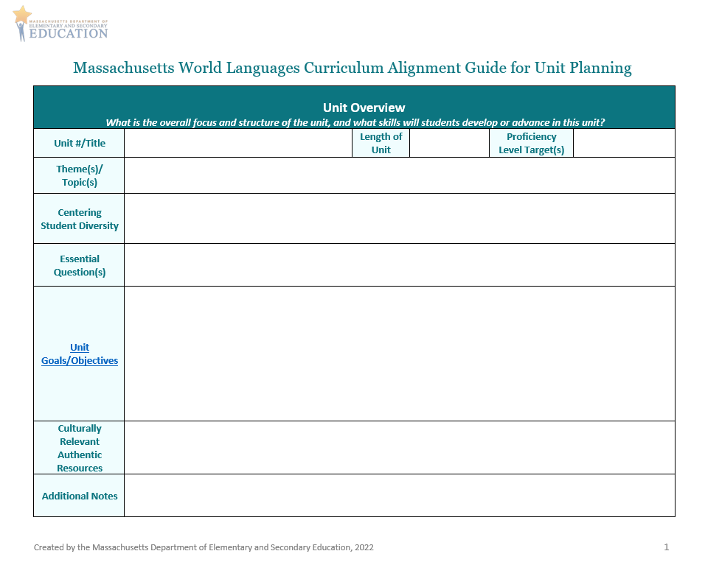
Curriculum Alignment Guide for Unit Planning (1/5)
Unit Overview
  In the Unit Goals/Objectives section, think about what you want students to be able to do in Interpretive and Intercultural Communication by the end of the unit
    Refer to the Centering Student Diversity box when creating goals/objectives for these modes!

Slide 20
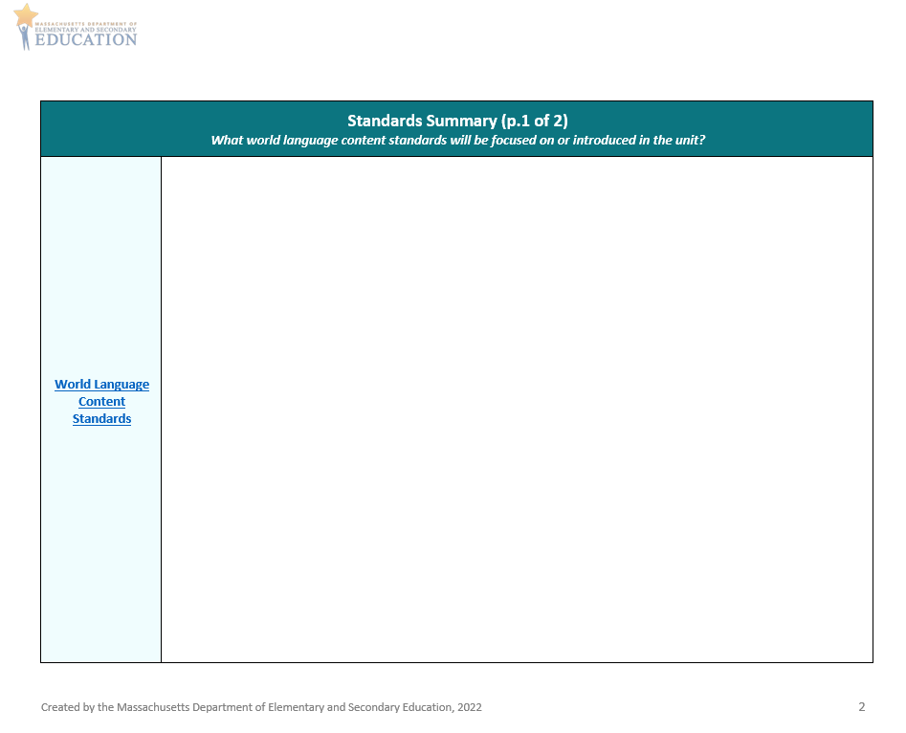
Curriculum Alignment Guide for Unit Planning (2/5)
Standards Summary
  What Interpretive and Intercultural Standards will you focus on?
  Are there other standards you would like to integrate and address via Interpretive and Intercultural Communication in this unit?

Slide 21
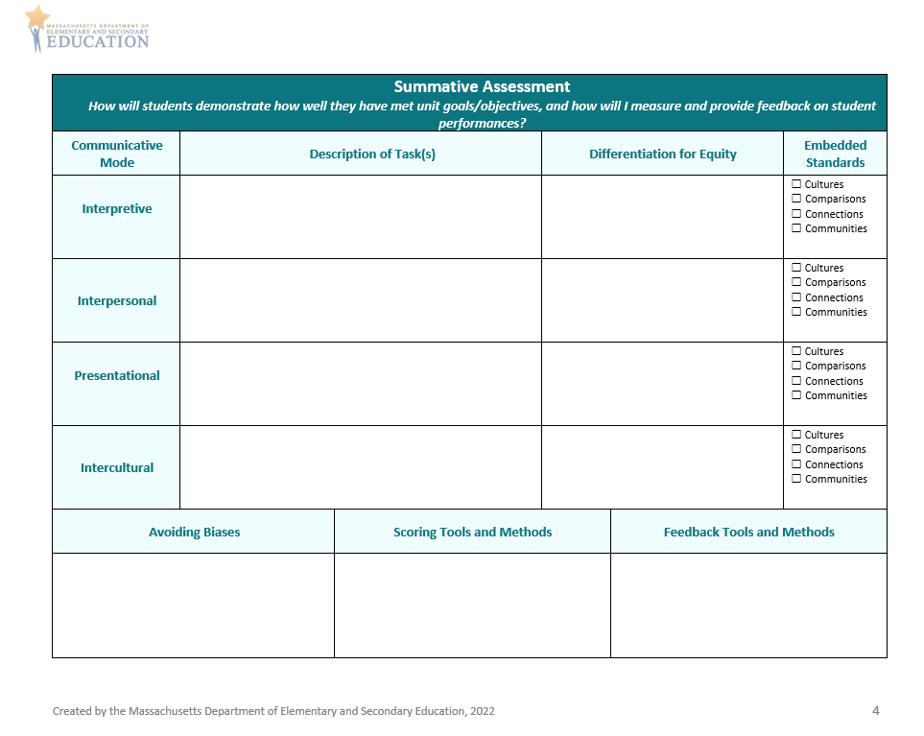
Curriculum Alignment Guide for Unit Planning (3/5)
Summative Assessment
  Consider how students will show what they can do in the Interpretive and Intercultural modes
    How can you differentiate your tasks?
    How can you represent your students’ backgrounds, identities, and experiences?
    How can you measure student performances?
    How can you provide feedback on student performances?
  Consider how to simultaneously assess embedded standards of Cultures, Comparisons, Connections, and Communities
  Remember to provide opportunities for students to demonstrate Mastery, Identity, and Creativity
*
*
*
*
*
*
*
*
*

Slide 22
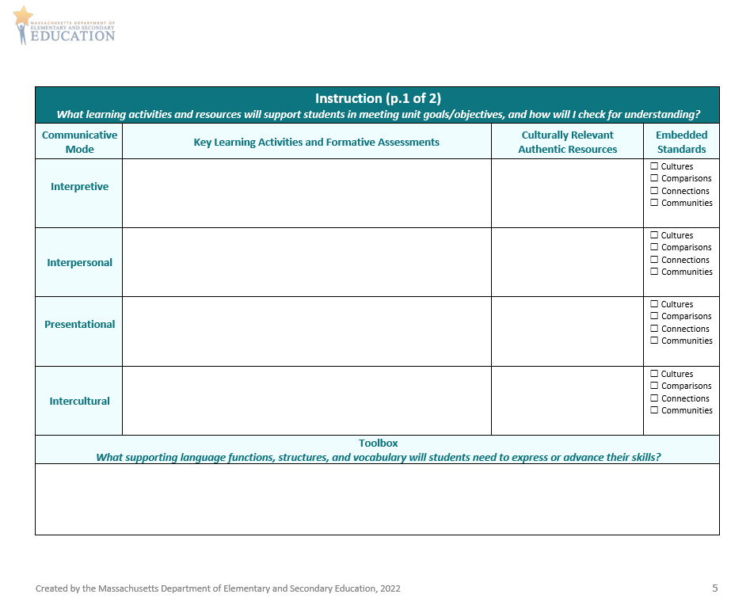
Curriculum Alignment Guide for Unit Planning (4/5)
Instruction p. 1
  Consider what learning activities will support students in meeting unit goals/objectives for Interpretive and Intercultural Modes
    How will you check for understanding and determine if additional supports are needed?
    What culturally relevant authentic resources will you use?
    What supporting language functions, grammatical structures, and vocabulary do students need in their toolbox?
  Consider how to simultaneously teach embedded standards of Cultures, Comparisons, Connections, and Communities
  Remember to provide opportunities for students to demonstrate Mastery, Identity, and Creativity
*
*
*
*
*
*
*

Slide 23
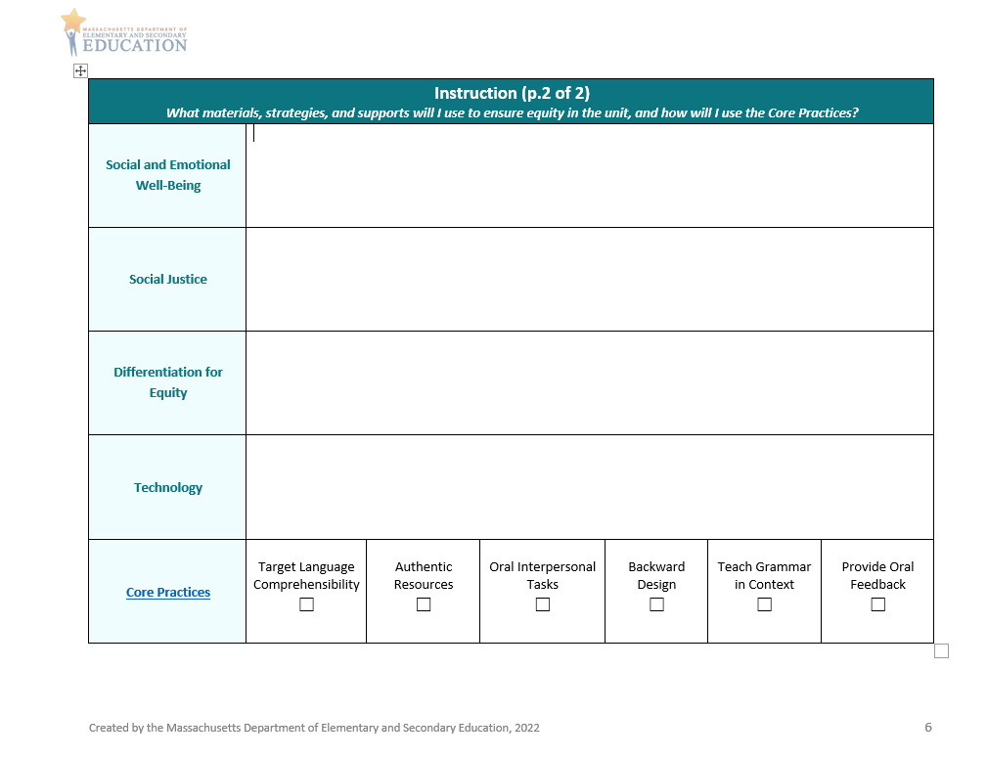
Curriculum Alignment Guide for Unit Planning (5/5)
Instruction p. 2
  Consider what materials and strategies will support students in meeting unit goals/objectives for Interpretive and Intercultural Modes
    How will you address Social and Emotional Well-Being and Social Justice?
    How will you ensure equity and representation?
    How will you integrate technology, and what supports will be needed?
    How will you use Core Practices to enhance student learning?

Slide 24
Demonstration and Discussion: Sample Unit Plans
Demonstration and Discussion: Sample Unit Plans

Slide 25
Space for sample unit plans
Insert samples when available

Slide 26
Discussion Questions
Discussion in the Main Room
What did you notice about Interpretive Communication in these samples?
What did you notice about Intercultural Communication in these samples?
How do these plans ask students to demonstrate Mastery, Identity, and Creativity through these modes of Communication?

Slide 27
Application and Discussion
Application and Discussion

Slide 28
Discussion Questions
Discussion in Breakout Rooms
What did you learn in Modules 7 and 8 that will help you in your teaching?
What are some strengths of the sample unit plans? How could they be improved?
What ideas and questions do you have to share about aligning your own units using the Curriculum Alignment Guide?

Slide 29
Wrap-up and Next Steps
Wrap Up and Next Steps

Slide 30
Preview and Next Steps
In our next Curriculum Alignment Lab, we will…
Review Modules 9, 10, and 11
Explore sections of the Curriculum Alignment Guide for Unit Planning with a focus on Cultures and Comparisons
View and discuss sample unit plans with a focus on Cultures and Comparisons
Discuss ways in which you can apply what is learned to your own classroom

Slide 31
Check for Learning
Check for Learning
What is Interpretive Communication?
How is Interpretive Communication addressed in the Curriculum Alignment Guide?
What is Intercultural Communication?
How is Intercultural Communication addressed in the Curriculum Alignment Guide?

Slide 32




Thank you
THANK YOU
[Enter names of presenters]
[Enter contact info]
worldlanguages@mass.gov
www.doe.mass.edu
75 Pleasant Street, Malden, MA 02148

