Slide 1
Massachusetts World Languages Framework Curriculum Alignment Lab #4
[Insert DATE]
[Insert Names and Titles of Presenters]

Slide 2
Overview
Today we will…
Briefly review the content of Online Modules 9–11
Explore and discuss sections of the Curriculum Alignment Guide for Unit Planning with a focus on Cultures and Comparisons
View and discuss sample unit plans with a focus on Cultures and Comparisons
Discuss ways in which you can apply what you’ve learned to your own classroom

Slide 3
Review and Discussion: Modules 9, 10, 11
Review and Discussion: Modules 9, 10, 11

Slide 4
Module 9 Review
Overview
Introduces the Linguistic Cultures Standards in the Framework
Explains how the Linguistic Cultures Standards progress across proficiency levels

Slide 5
Module 9 Review
Standards for World Languages Practice
Communication
Linguistic Cultures
Lifelong Learning
What are the Linguistic Cultures Standards?
Related to what students communicate about
Two Practices comprise Domain 2
  Cultures
  Comparisons
Accomplished through the Communicative Modes in Domain 1
Provide content, context, and purpose for Communication

Slide 6






Module 9 Review
Why are the Linguistic Cultures Standards important?
Empower students to act with cultural competence and critical consciousness
Provide an avenue for students to become critical thinkers, good problem solvers, and informed, engaged global citizens
Support students in investigating their own culture and language through comparisons with other cultures and languages
Connect students to their peers in the classroom, their community, and speakers/signers of the target language throughout the world

Slide 7






Module 9 Review
How do the Linguistic Cultures Standards progress across proficiency levels?
Text Types remain: The target language exclusively (or almost exclusively)
As the proficiency level increases…
Supports remain: Appropriate linguistic scaffolding
Functions increase and are more complex
Contexts are broader
Comprehensibility is not included

Slide 8
Module 9 Review
Questions?

Slide 9
Module 10 Review
Overview
Explains Practice 5: Cultures and why it’s important for world language education
Explores the Massachusetts World Languages Standards for Cultures
Discusses how to address the Cultures Standards in the classroom

Slide 10

Module 10 Review
What do students do in Practice 5: Cultures?
Acquire knowledge about the products, practices, and perspectives of many cultures and how these create and interact with identity
Investigate, explain, and reflect on:
  relationships among products, practices, and perspectives
  their own identities and the role cultures play in developing those identities
  how cultures influence and interact with each other over time
Products
Tangible (e.g., buildings, books) and intangible (e.g., dances, institutions)
Practices
Patterns of behavior accepted by a society
Perspectives
Ideas, values, attitudes

Slide 11

Module 10 Review
What are the Cultures Standards?
Descriptions of Cultures skills that students demonstrate at different levels of proficiency
Each Cultures Standard contains between two and three Functions numbered 5.a-5.c
Linguistic Cultures Standards
5. Cultures - In a variety of settings, using the target language exclusively or almost exclusively, with appropriate linguistic scaffolding, students minimally but consistently:
Analyze products and practices to help understand perspectives within the diverse cultures of the target-language communities. (IL.5.a)
Investigate, explain, and reflect on how culture affects identity. (IL.5.b)
Investigate, explain, and reflect on the similarities and differences of cultures over time. (IL.5.c)

Slide 12
Module 10 Review
How do the Functions progress across proficiency levels?
Functions | Proficiency Levels
 | NL | NM | NH | IL | IM | IH | AL | AM | AH | S
a. | ✓ | ✓ | ✓+ | ✓ | ✓ | ✓+ | ✓ | ✓ | ✓+ | ✓
b. | ✓ | ✓ | ✓+ | ✓ | ✓ | ✓+ | ✓ | ✓ | ✓+ | ✓
c. |  |  | ✓ | ✓ | ✓ | ✓+ | ✓ | ✓ | ✓+ | ✓
No progression of text type or supports
Notes:
As shown in the chart, some Functions are repeated from level to level (as indicated by a check mark) and some Functions progress from level to level (as indicated by a check mark in a new row or a check mark with a plus sign). These Functions, which are brand new Functions that emerge at higher proficiency levels or new, more rigorous features of a previously acquired Function, appear in bolded text within the Framework.

Slide 13



















Module 10 Review
How can I address the Cultures Standards in my classroom?
Use authentic resources to provide real-life examples of culture
Embed Cultures into goals, assessments, and tasks
Teach about culture in context and in the target language
Go beyond surface-level aspects of culture
Consider using cultural portfolios for assessment and reflection or embedding Cultures into IPAs
Provide opportunities for students to act with cultural competence
Highlight diversity within and among target language cultures

Slide 14
Module 10 Review
Questions?

Slide 15
Module 11 Review
Overview
Explains Practice 6: Comparisons and why it’s important for world language education
Explores the Massachusetts World Languages Standards for Comparisons
Discusses how to address the Comparisons Standards in the classroom

Slide 16
Module 11 Review
What do students do in Practice 6: Comparisons?
Recognize and analyze similarities, differences, interconnectedness, and interactions in target-language cultures and the language itself
Investigate, explain, and reflect on the nature of language and the concept of culture through comparisons of the language and cultures studied and their own

Slide 17
Module 11 Review
What are the Comparisons Standards?
Descriptions of Comparisons skills that students demonstrate at different levels of proficiency
Each Comparisons Standard contains between five and six Functions
  Functions related to cultures are numbered 6.a.1-6.a.3
  Functions related to language are numbered 6.b.1-6.b.3
6. Comparisons - In a variety of settings, using the target language exclusively or almost exclusively, with appropriate linguistic scaffolding, students minimally but consistently:
Investigate, explain, and reflect on the nature of culture through comparisons of the diverse target-language cultures studied and their own by:
  Making comparisons between products, practices, and perspectives. (IL.6.a.1)
  Explaining how stereotypes and past and present treatment of groups and people shape their group identity and culture. (IL.6.a.2)
Investigate, explain, and reflect on the nature of language through comparisons of the language studied and their own by:
  Interpreting, expressing, and comparing the meaning of idioms. (IL.6.b.1)
  Making comparisons of basic language forms. (IL.6.b.2)

Slide 18
Module 11 Review
How do the Functions progress across proficiency levels?
Functions | Proficiency Levels
 | NL | NM | NH | IL | IM | IH | AL | AM | AH | S
a.1 | ✓ | ✓ | ✓+ | ✓ | ✓ | ✓+ | ✓ | ✓ | ✓ | ✓
a.2 | ✓ | ✓ | ✓+ | ✓ | ✓ | ✓+ | ✓ | ✓ | ✓+ | ✓
a.3 |  |  |  |  |  |  |  |  | ✓ | ✓
b.1 | ✓ | ✓ | ✓+ | ✓ | ✓ | ✓+ | ✓ | ✓ | ✓ | ✓
b.2 | ✓ | ✓ | ✓+ | ✓ | ✓ | ✓+ | ✓ | ✓ | ✓+ | ✓
b.3 | ✓ | ✓ |  |  |  | ✓+ | ✓ | ✓ | ✓+ | ✓
No progression of text type or supports
Notes:
As shown in the chart, some Functions are repeated from level to level (as indicated by a check mark) and some Functions progress from level to level (as indicated by a check mark in a new row or a check mark with a plus sign). These Functions, which are brand new Functions that emerge at higher proficiency levels or new, more rigorous features of a previously acquired Function, appear in bolded text within the Framework. You will also notice that Function b.3. appears in the Novice standards and the Advanced standards, but not the Intermediate standards.

Slide 19







Module 11 Review
How can I address the Comparisons Standards in my classroom?
नमस्ते
Hallå
Embed Comparisons into goals, assessments, and tasks
Use authentic resources to provide real-life examples of language and culture
שלום
Hello
Make linguistic and cultural comparisons across a variety of languages/cultures
Allow students to independently discover, research, and hypothesize
Model an assets-based, holistic approach to making comparisons
Provide opportunities for project-based or experiential learning

Slide 20
Module 11 Review
Questions?

Slide 21
Questions for Reflection
  Q&A in the Main Room
  What can your students communicate about in the target language?
  How might you address Cultures in your classroom?
  How might you address Comparisons Communication in your classroom?

Slide 22
Discussion Questions
  Discussion in Breakout Rooms
  How do you currently address Cultures in your classroom?
  How do you currently address Comparisons in your classroom?
  How might you add to your current approaches based on Modules 9, 10, and 11?

Slide 23
Exploring the Curriculum Alignment Guide
Exploring the Curriculum Alignment Guide

Slide 24
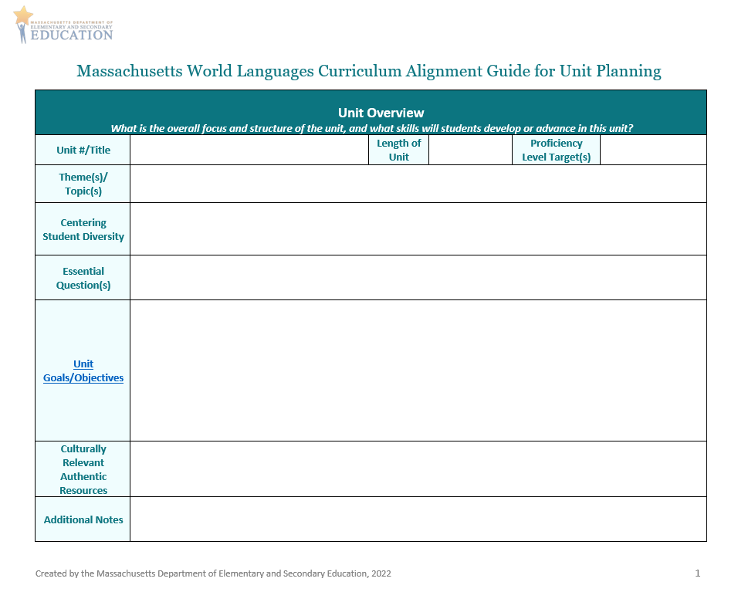
Curriculum Alignment Guide for Unit Planning (1/5)
Unit Overview
  In the Unit Goals/Objectives section, think about what you want students to be able to do in Cultures and Comparisons by the end of the unit
    Refer to the Centering Student Diversity box when creating goals/objectives for these modes!
    Think about the culturally-relevant authentic resources that you could use in your unit

Slide 25
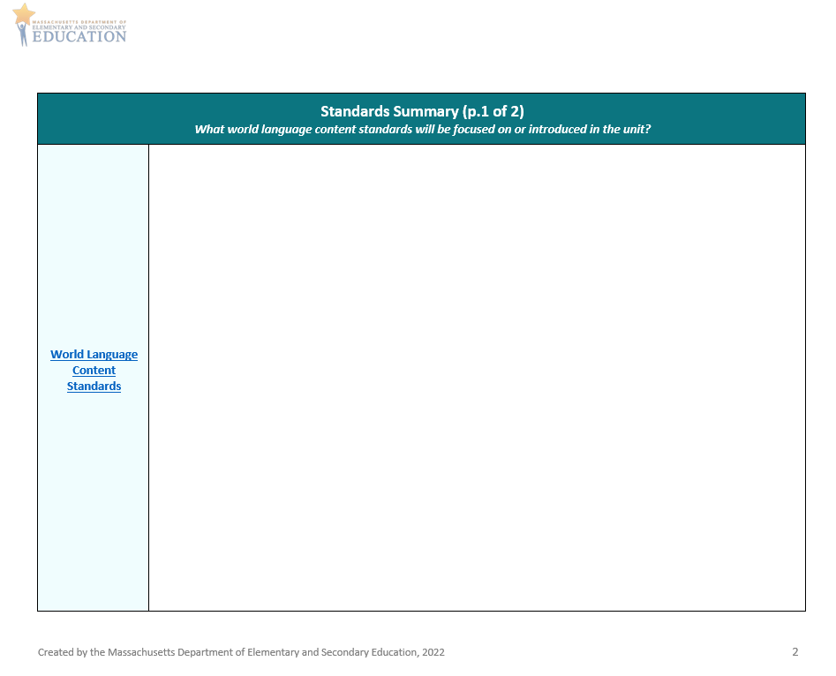
Curriculum Alignment Guide for Unit Planning (2/5)
Standards Summary
  What Cultures and Comparisons Standards will you focus on?
  Are there other standards you would like to integrate and address in this unit that relate to Cultures and Comparisons?

Slide 26
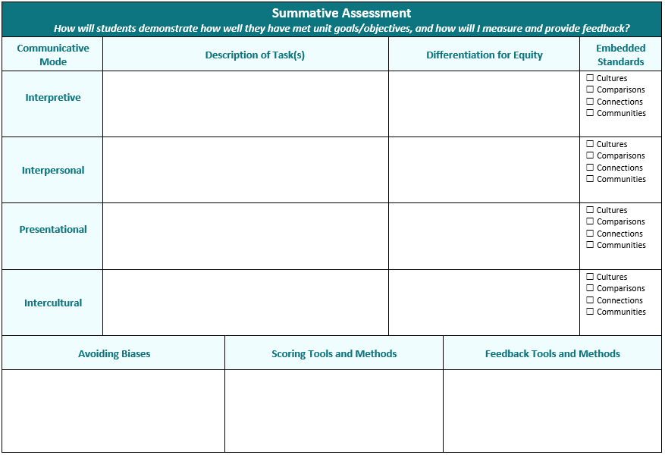
Curriculum Alignment Guide for Unit Planning (3/5)
Summative Assessment
  Consider how students will show what they can do in the areas of Cultures and Comparisons via the Communicative Modes
    How can you differentiate your tasks?
    How can you represent your students’ backgrounds, identities, and experiences?
    How can you measure student performances?
    How can you provide feedback on student performances?
  Remember to provide opportunities for students to demonstrate Mastery, Identity, and Creativity
*
*
*
*
*
*
*
*
*
*
*
Notes:
To address these Standards in your classroom, it is important to embed them into your unit goals/objectives, your summative assessment tasks, and your learning activities and experiences. Rather than being addressed in isolation or through mini-lessons on topics related to culture, the Cultures and Comparisons Standards should be simultaneously addressed through tasks and activities targeting each of the communicative modes.

Slide 27
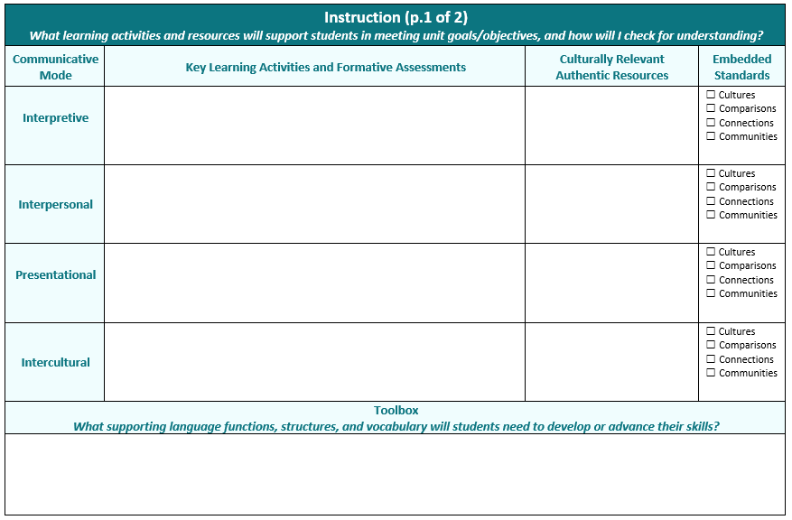
Curriculum Alignment Guide for Unit Planning (4/5)
Instruction p. 1
  Consider what learning activities will support students in meeting unit goals/objectives for Cultures and Comparisons
    How will you check for understanding and determine if additional supports are needed?
    What culturally relevant authentic resources will you use?
    What supporting language functions, grammatical structures, and vocabulary do students need in their toolbox?
  Consider how the Linguistic Cultures areas can be embedded within different Communicative Modes
  Remember to provide opportunities for students to demonstrate Mastery, Identity, and Creativity
*
*
*
*
*
*
*
*
*

Slide 28
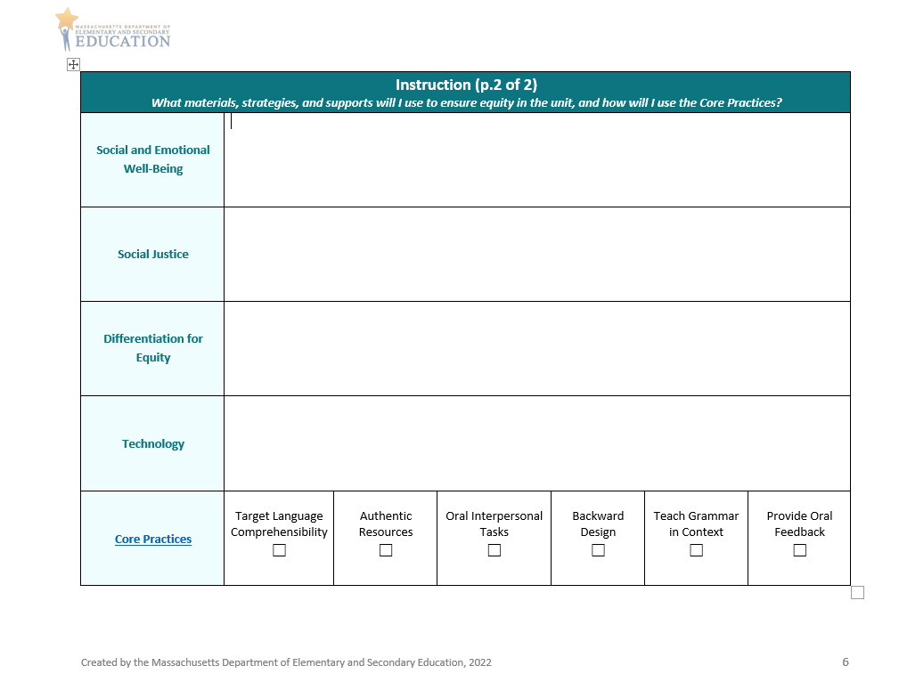
Curriculum Alignment Guide for Unit Planning (5/5)
Instruction p. 2
  Consider what materials and strategies will support students in meeting unit goals/objectives for Cultures and Comparisons
    How will you address Social and Emotional Well-Being and Social Justice?
    How will you ensure equity and representation?
    How will you integrate technology, and what supports will be needed?
    How will you use Core Practices to enhance student learning?

Slide 29
Demonstration and Discussion: Sample Unit Plans
Demonstration and Discussion: Sample Unit Plans

Slide 30
Space to Insert Samples
Insert samples when available

Slide 31
Discussion Questions
Discussion in the Main Room
What did you notice about Cultures in these samples?
What did you notice about Comparisons in these samples?
How do these plans ask students to demonstrate Mastery, Identity, and Creativity through these Practices?

Slide 32
Application and Discussion
Application and Discussion

Slide 33
Discussion Questions
Discussion in Breakout Rooms
What did you learn in Modules 9, 10, and 11 that will help you in your teaching?
What are some strengths of the sample unit plans? How could they be improved?
What ideas and questions do you have to share about aligning your own units using the Curriculum Alignment Guide?

Slide 34
Wrap-up and next steps
Wrap Up and Next Steps

Slide 35
Preview and Next Steps
In our next Curriculum Alignment Lab, we will…
Review and discuss Modules 12, 13, and 14
Explore sections of the Curriculum Alignment Guide for Unit Planning with a focus on Connections and Communities
View and discuss sample unit plans with a focus on Connections and Communities
Discuss ways in which you can apply what is learned to your own classroom

Slide 36
Check for Learning
Check for Learning in Main Room
What are the Linguistic Cultures Standards?
How are the Linguistic Cultures Standards organized in the Framework?
What is Practice 5: Cultures?
What is Practice 6: Comparisons?
How are Practices 5 and 6 addressed in the Curriculum Alignment Guide?

Slide 37




Thank you
THANK YOU
[Enter names of presenters]
781-338-3000
worldlanguages@mass.gov
www.doe.mass.edu
75 Pleasant Street, Malden, MA 02148

